Slide 1
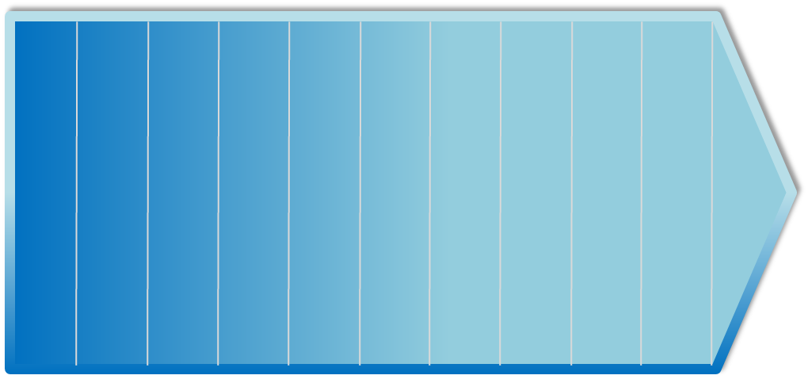
Natural Hazard Mitigation Plan Renewal Project 2011
Hazard and Vulnerability Assessment
Draft Plan
Stakeholders Review Plan
Plan Refinement
Plan Approval and Adoption
FEB
MAR
APR
MAY
JUN
JUL
AUG
SEP
OCT
NOV
This month we have begun to gather historical data regarding local natural hazard impacts. Data is coming from many sources including you the public. Please follow the link below to particpate in our public questionnaire.

