Slide 1

PERS Health Insurance Program

Slide 2
What is the PERS Health
Insurance Program (PHIP)?
PHIP is a group insurance plan specifically designed for retired Oregon public employees and their eligible family members.
Currently offering:
  Health insurance
    Medicare health plans
    Non-Medicare health plans
  Dental insurance

Slide 3




Health Plans Offered by PHIP
Medicare and Non-Medicare options:
When selecting a PHIP health plan, your primary residence (not mailing address)
must be within the United States and the health plan’s service area.

Slide 4


Dental Plans Offered by PHIP
PHIP offers two dental plans:
You are eligible to enroll in PHIP dental only if you also are enrolled in PHIP medical
If anyone in your family wants dental coverage, the whole family must have dental coverage
You can enroll in either dental plan regardless of your medical plan selection
  Must live in the Kaiser Permanente service area to enroll in the Kaiser dental program
Notes:
May choose either Dental plan available regardless of the Medical Plan-must live in Kaiser service area to choose Kaiser

Slide 5
Who is eligible for PHIP?
A PERS retiree, who is receiving a PERS retirement allowance or benefit, or who received an optional lump sum payment.
The spouse of an eligible PERS retiree.
A dependent child who is less than 26 years of age and meets the following definitions:
  A natural child
  A legally adopted child or a child placed in the home pending adoption
  A step-child who resides in the household of an eligible retiree
  A grandchild
    Whose parent resides in the retired member’s household and was covered under the retired member’s health plan at the time of birth.

Slide 6
Who is eligible for PHIP?
An overage dependent (26 or older) who is unable to achieve self-support through work due to a developmental disability as verified by a physician.
A dependent domestic partner who meets the following definitions:
  Has a relationship and resides with the PERS retiree for a minimum of 12 months;
  The PERS retiree is providing more than 50% of the financial support;
  Listed as a dependent on most recent federal tax return;
  Must provide an Affidavit of Domestic Partnership.
An eligible surviving spouse or dependent of an eligible PERS retiree
Notes:
Must provide an Affidavit of Domestic Partnership
SVS
Continuing - SVS enrolled in PHIP will automatically roll onto their own plan
Not yet enrolled – 90 day enroll opportunity from the death of the PERS retiree or upon next available enrollment opp

Slide 7

Value to Retirees
Enhanced Medicare Part D and non-Medicare Prescription Drug Plan:
No deductible
No coverage gap (Donut Hole)
Annual out of pocket cost will not exceed $4,850
Notes:
Healthwise: A quarterly newsletter providing a variety of topics mailed to enrolled PHIP members
Website: If you lose your handbook you can access it here as well as all forms, the newsletter and links to each of the health plans microsites for more specific plan information
Health Fairs-quarterly in Portland, Bend, Eugene and Salem
Toll free customer service dedicated to PHIP members

Slide 8
Value to Retirees
Prescription Drug Comparison
PHIP Prescription Drug Plan 2016 (Medicare Part D)
Medicare Part D Basic 2016
You pay 40% not to exceed $150 per prescription; No coverage gap
After $4,850 you pay $0
Calendar Year Deductible
Initial Coverage
Coverage Gap (Donut Hole)
Catastrophic Coverage
You pay first $360
You and the Plan pay up to a combined total of $3,310
You pay 58% of generic medications You pay 45% of all other medications Up to $4,850
Generics - $2.95 or 5% whichever is greater All other medications - $7.40 or 5% whichever is greater

Slide 9


Value to Retirees
PERS Medicare Premium Subsidy:
(Available to eligible Tier 1 and 2 PERS retirees enrolled in a PHIP sponsored health plan)
  Retirement Health Insurance Account (RHIA)
  Medicare retirees only
  Subsidy $60 a month
  8 or more years of qualified service
  PHIP will automatically verify the subsidy if you qualify.

Retiree and spouse enroll separately if both are eligible for a subsidy
Notes:
There are two subsidy programs available.
If you are a PERS Retiree, eligible for Medicare and have a total of 8+ years of service under PERS a subsidy of $60.00 will be applied towards your Medical premium. This is called a RHIA subsidy.
We verify the number of years and automatically apply the subsidy
This is for the PHIP only. You are unable take the subsidy with you to purchase a community plan
There is also a subsidy available for non-Medicare State Retirees
To be eligible for the RHIPA subsidy you must apply for your PERS retirement at the time of leaving State employment and had a minimum of eight years of service.
This subsidy is on a sliding scale based on years of service.
If both husband and wife are PERS Retirees and meet the subsidy eligibility rules, you will want to enroll separately.
PHIP can apply only one subsidy per account.
Can not be used for plans outside of PHIP

Slide 10
Value to Retirees
Annual plan change available
(Guaranteed regardless of health status)
October 1st through November 15th
  Different than Medicare Annual Enrollment Period (AEP)
Changes effective January 1st
To make plan changes, submit two forms
  Disenrollment form for current plan
  Enrollment Request form for new plan
Not a time to
  Add dental benefit
  Add dependents
Notes:
A benefit of the PERS Health Insurance Program is some flexibility to change plans at specified times.
There are two times that you can do that:
If you leave the service area for more than 60 days or permanently move
You have the ability to switch to another plan that is available within that service area
You can also change plans during the annual plan change period
This occurs between October 1 and November 15th.
You are allowed to switch between any available plans, including switching from a Supplement to a Medicare Advantage plan.

Slide 11

Value to Retirees
Member Resources
Quarterly Healthwise Newsletter
PHIP Website
  pershealth.com
Quarterly PERS Health Fairs
Dedicated Customer Service
  1-800-768-7377
Notes:
Healthwise: A quarterly newsletter providing a variety of topics mailed to enrolled PHIP members
Website: If you lose your handbook you can access it here as well as all forms, the newsletter and links to each of the health plans microsites for more specific plan information
Health Fairs-quarterly in Portland, Bend, Eugene and Salem
Toll free customer service dedicated to PHIP members

Slide 12

Medicare Eligibility
Medicare is health insurance available to:
65 years of age or older
Under 65 but have been receiving Social Security Disability Insurance for more than 24months
Have End State Renal Disease (ESRD) or Amytrophic Lateral Sclerosis (ALS)

You become eligible for Medicare at age 65, regardless of whether you are receiving Social Security benefits at the time.

Slide 13

Medicare Enrollment Periods
Initial Enrollment Period
7 month Initial Enrollment Period (IEP)
  3 months before the month you turn 65
  The month of your 65th birthday
  3 months after the month you turn 65
General Enrollment Period
January 1-March 31 each year
  Medicare coverage starts July 1
Special Enrollment Period (Due to loss of employer sponsored group coverage)
Based on current employment (COBRA and Retiree coverage doesn’t apply)
  8-month Special Enrollment Period to sign up for Part A and/or Part B that starts the month after the employment ends or the group health plan insurance based on current employment ends, whichever happens first.

You become eligible for Medicare at age 65, regardless of whether you are receiving Social Security benefits at the time.
https://www.medicare.gov/sign-up-change-plans/get-parts-a-and-b/when-sign-up-parts-a-and-b/when-sign-up-parts-a-and-b.html
Notes:
IEP-In most cases, if you don’t sign up for Medicare Part B when you’re first eligible, you’ll have to pay a late enrollment penalty for as long as you have Part B and could have a gap in your health coverage.
GEP-if you didn't sign up for Part A and/or Part B (for which you must pay premiums) when you were first eligible, and you aren’t eligible for a Special Enrollment Period (see below), you can sign up during the General Enrollment Period between January 1–March 31 each year.
Your coverage will start July 1. You may have to pay a higher premium for late enrollment in Part A and/or a higher premium for late enrollment in Part B.
SEP-There are several reasons you may have an SEP, but for PHIP purposes we will concentrate on an SEP due to loss of employer sponsored active group coverage. Once your Initial Enrollment Period ends, you may have the chance to sign up for Medicare during a Special Enrollment Period. If you're covered under a group health plan based on current employment (key point) you have a Special Enrollment Period to sign up for Part A and/or Part B any time as long as you or your spouse (or family member if you're disabled) is working, and you're covered by a group health plan through the employer or union based on that work. Usually, you don't pay a late enrollment penalty if you sign up during a Special Enrollment Period.

Slide 14
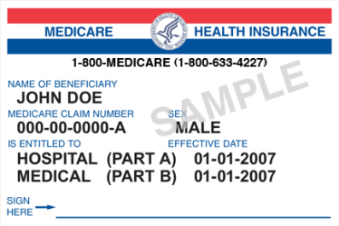
Enrolling in Medicare
  Already receiving Social Security benefits?
    You are automatically enrolled in Medicare Parts A & B at age 65 or on the first day of 25th month after your Social Security Disability benefits began.
  Not yet receiving Social Security benefits?
    You MUST APPLY for Medicare Parts A & B
    May apply 90 days in advance of Medicare eligibility
    Contact the Social Security Administration (SSA) for more information regarding when to apply for Medicare

Notes:
Medicare is effective the first day of the calendar month in which you turn 65.
If you are born on the first of the month Medicare is effective the first of the prior month.
You are automatically enrolled in Parts A and B if you are receiving Social Security benefits
If you are waiting to draw your SSA pension until after age 65, contact your local social security office approx three months prior to your 65th birthday to apply for Medicare. Part A is free.
You should receive the PERS Health Insurance packet in advance of you turning 65
When you receive your Medicare card that is your trigger to enroll in coverage.

Slide 15

What if I Work Past 65 and Waived Medicare?
When you lose active employer-sponsored group coverage, you have a Special Election Period to join Medicare Part A and B without a penalty.
In order to enroll into Medicare Parts A and B you should:
Determine when your active employer-sponsored group coverage will end
3-4 months prior to retiring or losing active employer sponsored group coverage, contact the Social Security Administration (SSA) to receive the necessary paperwork to apply for Medicare Parts A & B (You may have to have your employer sign the paperwork to prove you had group coverage)
Complete and return the necessary paperwork to SSA
Once you are enrolled in Medicare Parts A and B contact the Medicare plan you would like to enroll in (please always be aware of enrollment guidelines)

Cannot enroll in PHIP until Parts A and B have been obtained
Notes:
If you continue working past 65 you should:
Enroll in Medicare, Part A is free. You will be registered with Medicare, which can assist with preventing any issues later on when enrolling in Part B.
If you are not receiving your social security pension, you will have to go to your local Social Security Administration office to enroll. On-line enrollment is not available.
Once you know that you will be leaving employment sign up for your Part B 3-months in advance of your coverage ending. You have a special enrollment period for eight months after leaving employment or coverage ends.
To ensure full coverage on a plan after your employer’s coverage ends both Parts A and B must be in effect because you may have to pay the entire medical claim and you may miss your PERS enrollment opportunity.
SEP: not available in initial Medicare period; check with SS about whether to decline/delay

Slide 16
Original Medicare
Medicare pays their portion to your health care providers directly for Medicare-approved services. You pick up the remainder of the cost.
ORIGINAL MEDICARE
2015 information-as of 9/1/2015 the 2016 information has not been released
Monthly Base Premium
Annual Deductible
Coinsurance
PART A
None
$1,260 (per hospital admit)
None
PART B
$104.90
$147
20% (for most covered services)
Notes:
Let’s start with Parts A and B, which are also known as Original Medicare. These plans are run by the Federal Government through the Centers for Medicare and Medicaid Services.
Part A provides coverage for Inpatient hospital, Skilled Nursing Facility, Hospice and Home Health Care services.
There is normally no premium for Part A, since that was paid through your Medicare taxes.
There is a $___deductible per admission under Original Medicare.
Part B helps cover doctor’s services, out-patient care, lab, x-ray and preventive services.
There is a premium for Part B which is begins at $___ for established Medicare-eligible individuals prior to 01/01/10 and newly eligible individuals have a base premium of $_____ . Premiums are determined by income from the tax period 2 years previous. Premiums are paid via your Social Security pension if receiving or directly to CMS.
You are responsible for an annual deductible of $___ and 20% coinsurance after deductible. Medicare pays 80% of all Medicare-eligible services under Part B.

Slide 17
Types of Medicare Coverage
ORIGINAL MEDICARE
Medicare pays their portion directly to your health care providers for Medicare-approved services (80%) YOU pick up the remainder of the cost (20%)
MEDICARE SUPPLEMENT (MEDIGAP)
Covers the gaps in Parts A and B for Medicare-approved services. Supplement plans allow you to choose any physician who is a Medicare participating provider.
The Medigap plan will pick up some or all of the cost after Medicare has paid depending on the plan you select. Supplement plans do not include a prescription drug plan.
MEDICARE ADVANTAGE (PART C)
Medicare Advantage (MA) plans contract with hospitals and physicians to provide care.
Medical providers will bill the insurance company directly. Typically pay a fixed charge, called a “copay” or “coinsurance” depending on the type of MA plan you select. Typically includes a prescription drug plan.
You can only be enrolled in one Medicare Advantage or Medicare Part D Prescription Drug Plan at a time.

Slide 18

Medicare Prescription Drugs (Part D)
Private Insurance companies contract directly with Medicare to offer a Part D prescription plan
Prescription Coverage | Medicare-allowed generic and brand name drugs-varies by plan
Pharmacy Access | Must use a network of pharmacies in most cases
 | Individual Member Out-of-Pocket Responsibility
Monthly Base Premium | Varies by plan**
Deductible | Varies by plan
Coinsurance | Varies by plan
Catastrophic Coverage | $4,850
Late Enrollment Penalty: | 1% of the Part D National Base Beneficiary Premium for every full month you did not have creditable prescription drug coverage; continues for lifetime
** Part D IRMAA: You may have to pay a Part D premium if your Modified Adjusted Gross Income (MAGI) exceeds $170,000 (married filing jointly) or $85,000 (all other filing statuses). Contact Medicare directly for questions.

Slide 19
Medicare Must-Dos
Obtain your Medicare Parts A and B timely; maintain it while enrolled in any Medicare Supplement or Medicare Advantage plan.
Pay Medicare Part D (IRMAA) assessment if billed by Medicare
Do not enroll in another Medicare Advantage or Medicare Part D Prescription plan while enrolled in PHIP.
If not enrolling into Medicare at age 65, be aware of enrollment timelines.
Contact Medicare directly for questions regarding when or how to enroll into Medicare.

Slide 20
PHIP Enrollment

Slide 21
PHIP Initial Enrollment Opportunities
Applies to Medicare and Non-Medicare
New retiree
Up to 90 days after the effective date of your PERS retirement
Loss of employer-sponsored coverage
Must apply within 30 days of loss of employer-sponsored group coverage
Must have 24 consecutive months of employer-sponsored group coverage immediately preceding enrollment into PHIP
Initial Medicare eligibility
Up to 90 days after your initial Medicare eligibility into both Medicare Parts A and B (Usually the last opportunity to enroll in PHIP)
Effective date of coverage: Your PHIP effective date is based on receipt of your COMPLETED Enrollment Request Form within your enrollment opportunity. For more information refer to pages 12-14
Notes:
So again, in order to enroll in the PERS Health Insurance Program you must be retired and receiving either a service or disability pension benefit under PERS or have taken an optional lump sum payment.
Enrollment is effective the first of the month of the enrollment opportunity or the first of the month following the date you signed the application within the allowed timelines.
There are 3 enrollment opportunities for the PERS Health Insurance Program and they are as follows:
When you retire – read bullet
Group health coverage is ending – you must have 24 months of continuous group coverage to enroll in the PERS plan.
Medicare eligibility due to age or disability– Read Bullet.
Medicare is usually your last opportunity to come onto the PERS Program.
BEWARE:
If you miss an opportunity you will either have to wait until the next enrollment opportunity, if available, or lose the ability to enroll in the PERS Program altogether.
If you leave the PERS Health Insurance Program you cannot come back
If you enroll in another MA or PDP you will automatically be dis-enrolled from your entire PERS coverage with the probability of no reinstatement

Slide 22

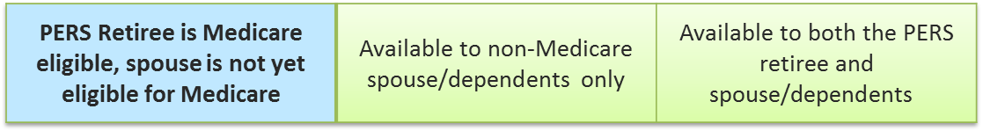
I’m the PERS retiree and will be Medicare eligible before my non-PERS spouse
If PERS retiree is eligible for Medicare before the non-PERS spouse.
    PERS retiree can join PHIP before non-PERS spouse
      Non-PERS spouse can join later at an enrollment opportunity
Coverage Options Available Outside of PHIP

Slide 23
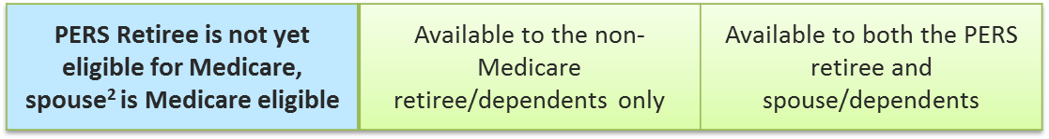
My Non-PERS Spouse will be Medicare eligible first
If non-PERS spouse is eligible for Medicare before the PERS retiree:
    Spouse can join PHIP before PERS retiree, contingent on the PERS retiree joining PHIP at their last enrollment opportunity
    Spouse can wait and enroll in PHIP at the PERS retiree’s enrollment opportunity
Coverage Options Available Outside of PHIP
² Spouse’s coverage requires future enrollment of the PERS retiree. If the PERS retiree does not join PHIP at his/her last enrollment opportunity, the non-PERS spouse will be terminated from PHIP coverage.

Slide 24
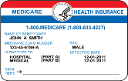




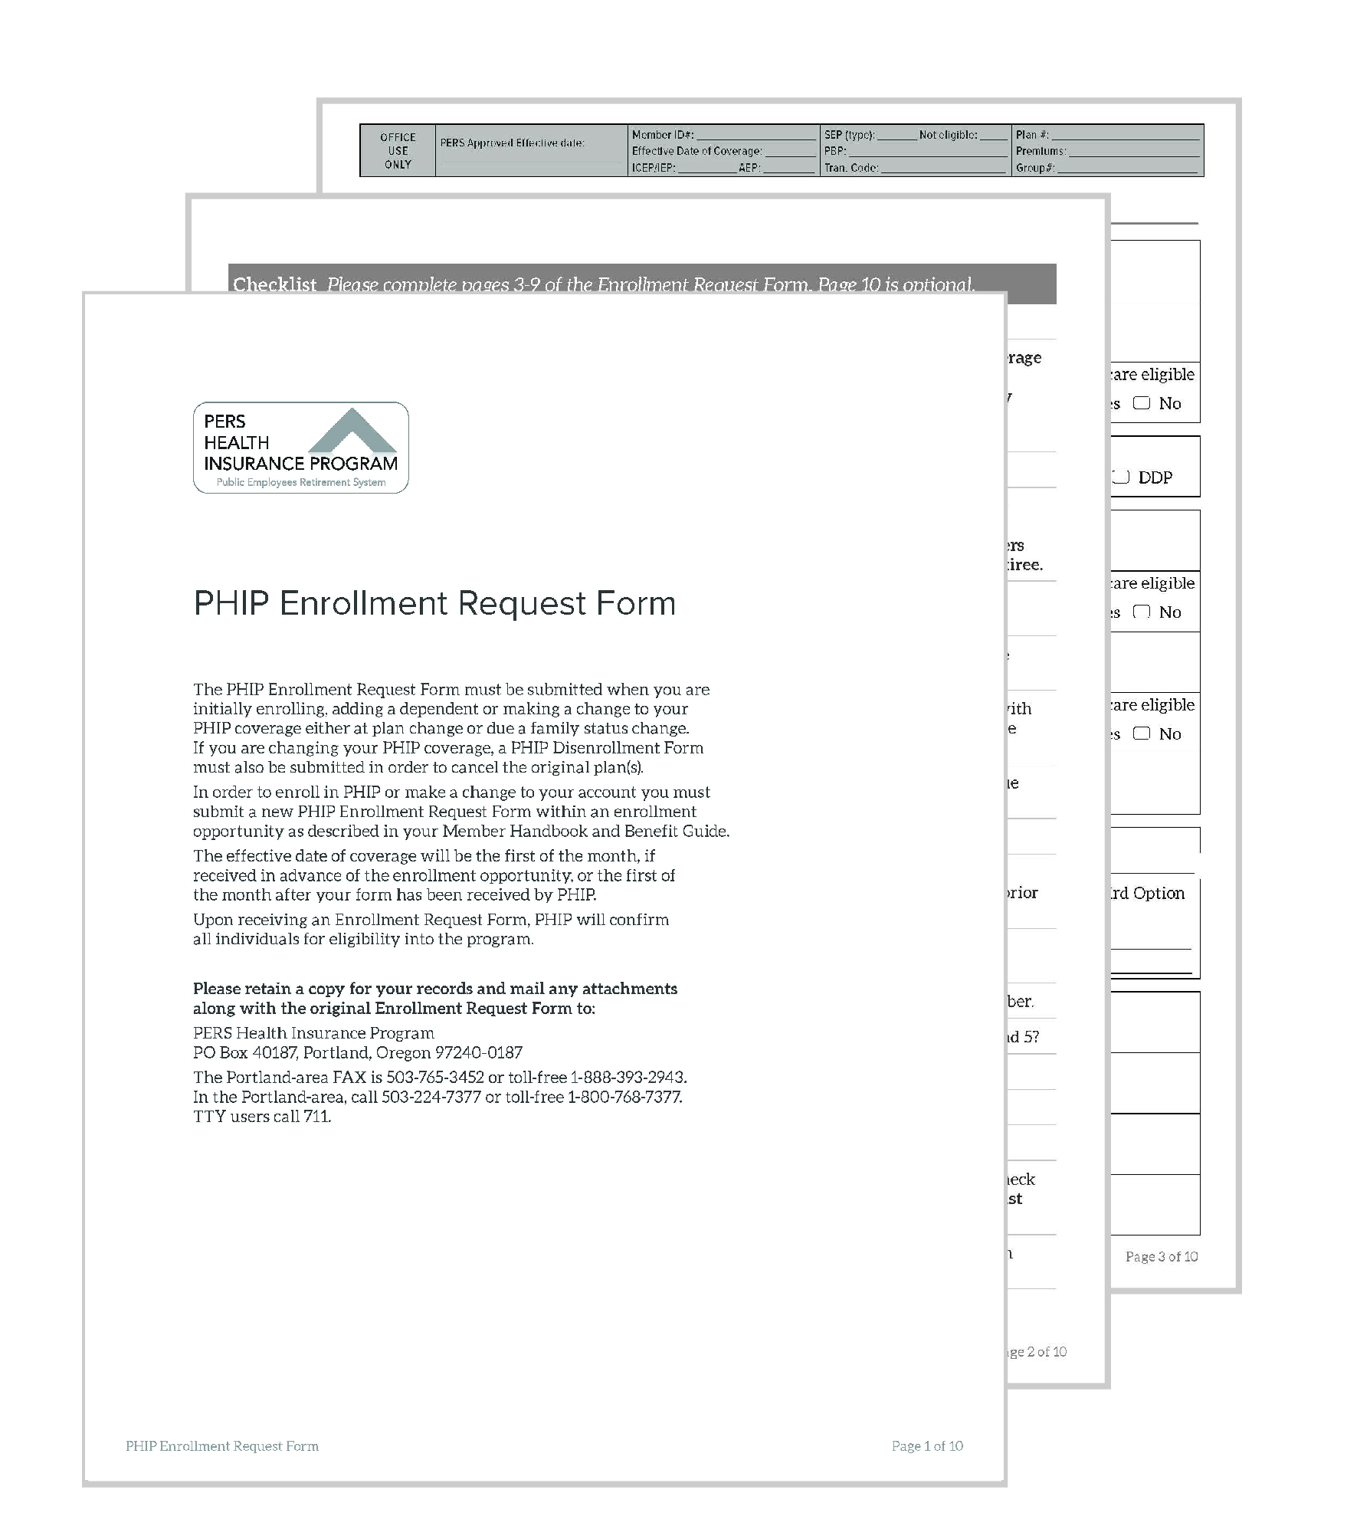
PHIP Enrollment Process
Step 1
      Enroll in Medicare Parts A and B (when eligible)
      Compare and choose a medical plan
      All include PHIP Prescription Drug Plan (Part D)
Step 2
Step 3
      Compare and choose a dental plan (Optional)
Step 4
      Submit enrollment request form
      to PHIP ↓

Applications may be submitted to PHIP as early as 90 days prior to the effective date of your enrollment opportunity
Notes:
There are 4 easy steps to enroll in the PERS Health Insurance Program
If eligible for Medicare, it is required that you are enrolled in Medicare Parts A and B
Compare and select a Medical plan that best meets your needs
All plans include prescription coverage
Compare and select a Dental plan
You must take medical to receive dental
Dental cannot be added later on so, if you are considering dental you will want to enroll at your initial enrollment.
If one person elects dental everyone must enroll in dental.
Fill out the Enrollment Request Form and send to the PERS Health Insurance Program
Your enrollment will begin at your Retirement or Medicare entitlement date if sent in advance
Otherwise, enrollment will start the first of the month after the date signed on the enrollment request form

Slide 25
PHIP Enrollment Must-Dos
Obtain your Medicare Parts A and B timely; continue to pay your Medicare premiums
Submit your PHIP Enrollment Request form during a qualified enrollment opportunity
For changes after enrollment refer to your PHIP Member Handbook and Benefit Guide or pershealth.com

Slide 26

After Enrollment
Changing Plans
Permanently moving outside of your plans service area
  Switch to a PHIP plan within a new service area
Temporarily living outside your service area (over 60 days)
  Review your health plan’s travel benefits
  Snowbird Option
Notes:
After enrollment, if you permanently move out of your current service area you must notify PHIP and move to a plan available within your new service area within 30days.
You will need to complete and submit a disenrollment form for your current plan as well as a new enrollment request form for the new plan.
You are not able to add dental or change from the select value ($1000 deductible plan) to a core value ($500 deductible or traditional kaiser plan if you have kaiser) at that time.
If you are traveling for long periods time – over 60 days you will be able to use your plans travel benefits. Review your plans travel benefits before you decide to take an extended vacation
If you snowbird, PHIP allows the option of moving from your current plan to Medicare Supplement plan while you are out of your permanent residential area. In order to use the snowbird option you will need to complete and submit a disenrollment form for your current plan, using the reason for terminating as “snowbird” as well as a new enrollment request form to move the Medicare supplement plan. Once you return to your permanent residence you will need to do process all over again in reverse to move you back to your home plan.
This is not a time to add a spouse or dependent, nor are you able to add dental to your plan. Additionally, if you are enrolled in a non-Medicare select plan, you will not be able to move to the core plan from the select (higher deductible) plan

Slide 27
After Enrollment
Making Monthly Premium Payments
  Pension Deduction
  Electronic Funds Transfer (EFT) from checking or savings
Surviving Spouse or Dependent Benefits
As a surviving spouse or dependent of a PERS retiree
  Continue PHIP if already enrolled
  Not yet enrolled in PHIP – 90 day enrollment opportunity from death of PERS retiree
Notes:
Premium payments are due on or before the first of the month, to ensure your payments are timely, PHIP offers two payment options.
Pension deduction for those who are receiving a monthly retirement benefit
Or EFT from a checking or savings account for those who may have taken a total lump sum benefit option and are not receiving a monthly pension allowance.
If your coverage is terminated because of a delinquent payment, you may not be able to re-enroll unless you experience a new enrollment opportunity.

Slide 28
We Are Here to Help You
PHIP
Eligibility and Enrollment
Rates
Premium payments: PERS pension deduction
Address updates, family status changes
Websites and phone numbers are listed in the PHIP Member Handbook and Benefit Guide


Slide 29

PHIP Questions & Answers

