Slide 1
Studying Drug Addiction as a Brain Disease
Timothy P. Condon, Ph.D.
Research Professor
Center on Alcoholism, Substance Abuse and Addictions
University of New Mexico
Justice Reinvestment Summit 2017
What Works
Salem, Oregon, February 16, 2017

Slide 2
Advances in Science
Have Revolutionized Our
Way of Life…
And Our Fundamental Views of
Drug Abuse and Addiction

Slide 3

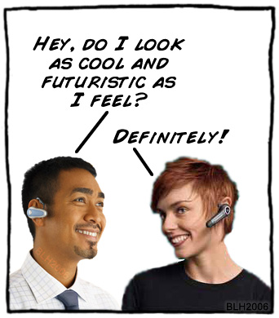
Remember Ohura’s Communicator?
Science Fiction?
Or Science Fact?

Slide 4
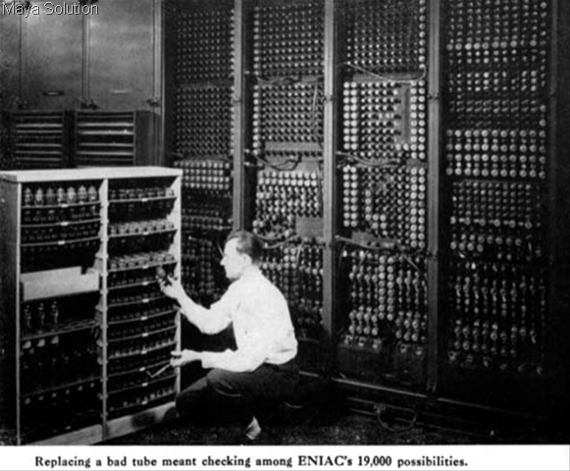
Then…

Slide 5
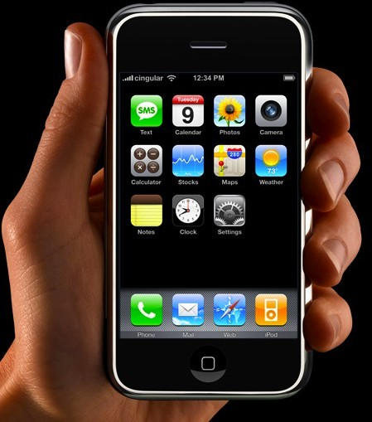
And Now

Slide 6
Advances in Science
Have Revolutionized Our Fundamental Views of
Alcohol and Drug Abuse and Addiction

Slide 7
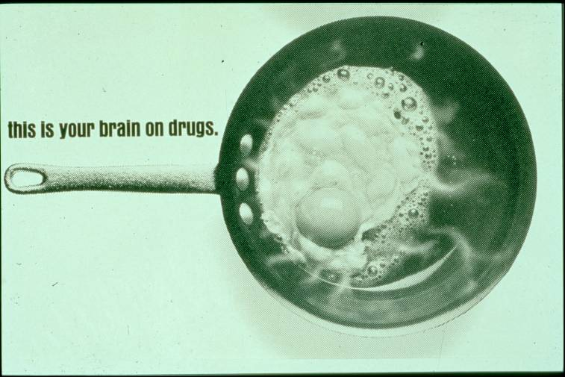
Your Brain on Drugs - Then

Slide 8
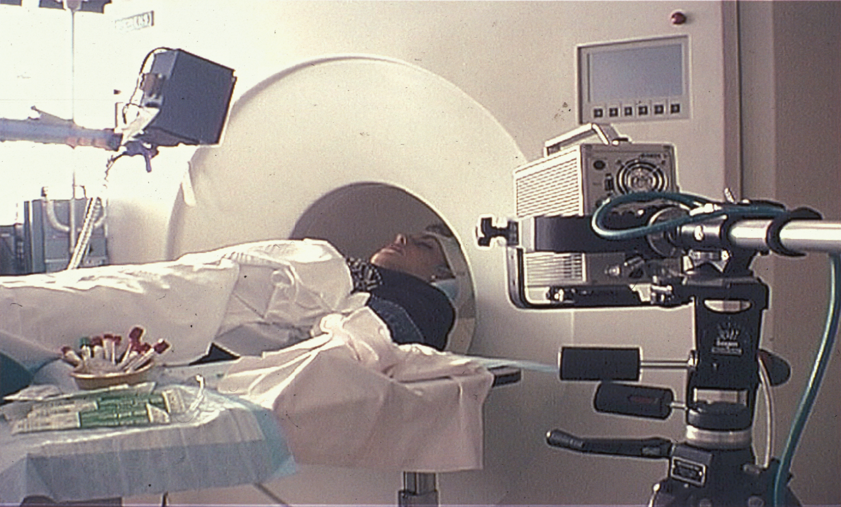
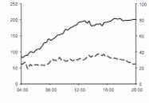
Infusion Rate
VAS

Slide 9
Your Brain on Drugs – Now
Source: Breiter & Rosen, Ann N Y Acad Sci 1999

Slide 10
What have we learned?

Slide 11
Drug Abuse Is A Preventable Behavior
Drug Addiction Is A Treatable Disease
Partnership for a Drug Free America

Slide 12
Why ?
Why do people take drugs?

Slide 13
Drug Abuse Risk Factors
Community
Peer Cluster
Family
Individual

Slide 14
Why do people take drugs?
To feel good
To have novel:
Feelings
Sensations
Experiences
AND
To share them
To feel better
To lessen:
Anxiety
Worries
Fears
Depression
Hopelessness
Withdrawal
Drawings courtesy of Vivian Felsen

Slide 15
A Major Reason People
Take a Drug is They Like
What It Does to Their Brains

Slide 16
Addiction:
A Complex Behavioral and Neurobiological Disorder
HISTORICAL
PHYSIOLOGICAL
- previous history
- expectation
- learning
Alcohol &
Drugs
- genetics
- circadian rhythms
- disease states
- gender
ENVIRONMENTAL
- social interactions
- stress
- conditioned stimuli
BRAIN
MECHANISMS
BEHAVIOR
ENVIRONMENT

Slide 17
What have we learned about Vulnerability?
Why do some people become addicted while others do not?

Slide 18
Drug Abuse Risk Factors
Community
Peer Cluster
Family
Individual

Slide 19
Genetics
Gene/
Environment
Interaction
Environment
Notes:
From Linda 10/26/00 for New Orleans Neuroscience presentation

Slide 20
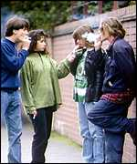
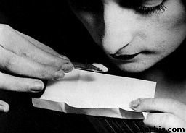
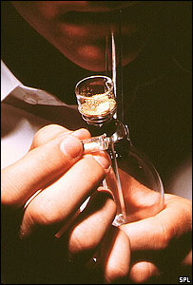
Effects of Social Stressors
on Illicit and Licit Drug Use
Facilitate
Initiation
Increase Risk
of Addiction
3. Trigger Relapse

Slide 21
What have we learned about
other aspects of vulnerability?

Slide 22
ADDICTIVE DISORDERS OFTEN CO-EXIST
WITH MENTAL DISORDERS
Comorbid
Disorders
Mental
Disorder
Addictive
Disorder

Slide 23
Between 30 and 60 percent of drug abusers have concurrent mental health diagnoses - including personality disorders, major depression, schizophrenia, and bipolar disorder
Notes:
NIDA Notes 14-4, Dir Col

Slide 24
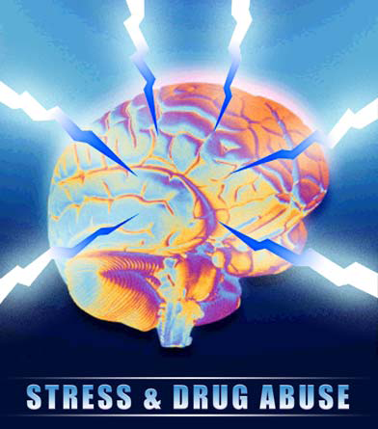
Many Common Factors Are Involved in Addiction and Mental Illness
Addiction:
Early Physical or
Sexual Abuse
Stress
Family History
Mental Illness
Peers who use Drugs
Mental Illness:
Early Physical or
Sexual Abuse
Stress
Family History
Drug and Alcohol Abuse

Slide 25
Which Came First?
Substance Abuse
Mental Health Disorder

Slide 26

Why Do Mental Illnesses and Substance Abuse Co-occur?
Self-medication hypothesis
  Substance abuse begins as a means to alleviate symptoms of mental illness
Causal effects of substance abuse
  Substance abuse may increase vulnerability to mental illness
Common or correlated causes
  The life processes and risk factors that give rise to mental illness and substance abuse may be related or overlap

Slide 27
Comorbidity Is a Reality

Slide 28
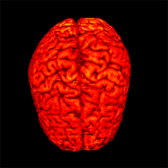
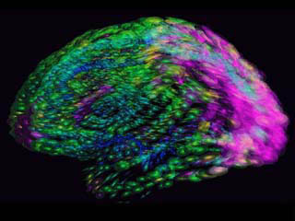
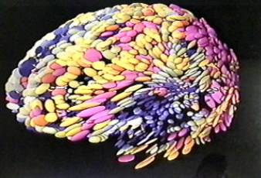
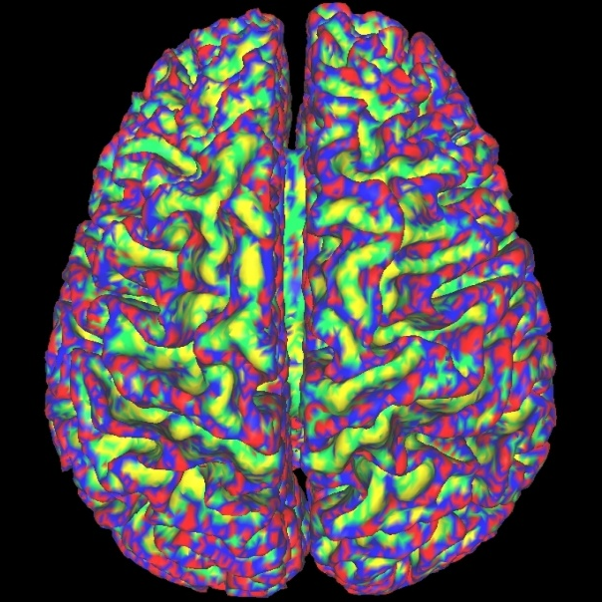
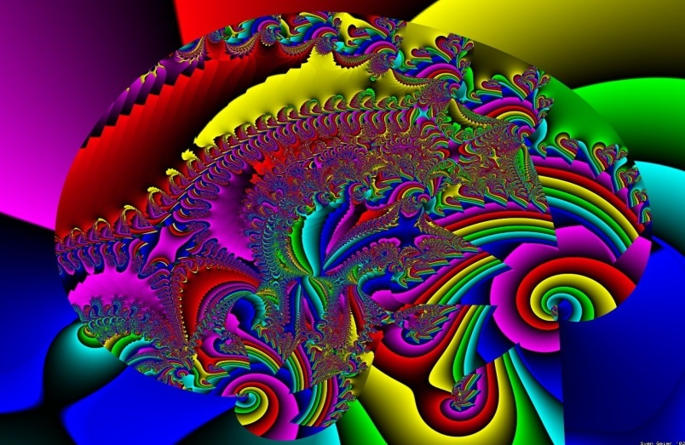
Why Do People Take Drugs?
They Like What Drugs Do to Their Brains

Slide 29
Initial Drug Use Is A
Voluntary Behavior…
A Person Chooses to
Take a Drug for the First Time

Slide 30
Initially, A Person Takes a Drug
Hoping to Change Their Mood,
Perception, or Emotional State
Translation---
…Hoping to Change Their Brain

Slide 31
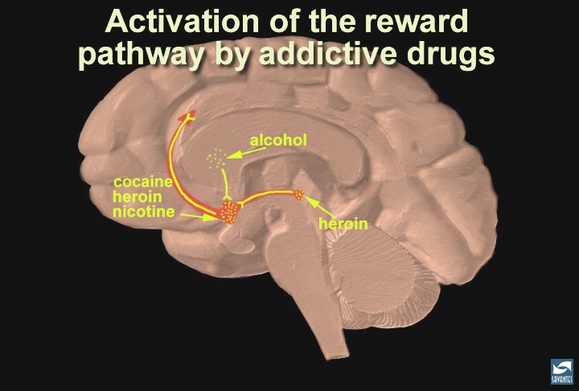
Notes:
Slide 30: Summary; addictive drugs activate the reward system via increasing dopamine neurotransmission
In this last slide, the reward pathway is shown along with several drugs that have addictive potential. Just as heroin (morphine) and cocaine activate the reward pathway in the VTA and nucleus accumbens, other drugs such as nicotine and alcohol activate this pathway as well, although sometimes indirectly (point to the globus pallidus, an area activated by alcohol that connects to the reward pathway). While each drug has a different mechanism of action, each drug increases the activity of the reward pathway by increasing dopamine transmission. Because of the way our brains are designed, and because these drugs activate this particular brain pathway for reward, they have the ability to be abused. Thus, addiction is truely a disease of the brain. As scientists learn more about this disease, they may help to find an effective treatment strategy for the recovering addict.

Slide 32
We Know That…
In Combination with Many
Other Transmitter Systems, and
Despite Their Many Differences,
Most Abused Substances Enhance
Dopamine Activities

Slide 33
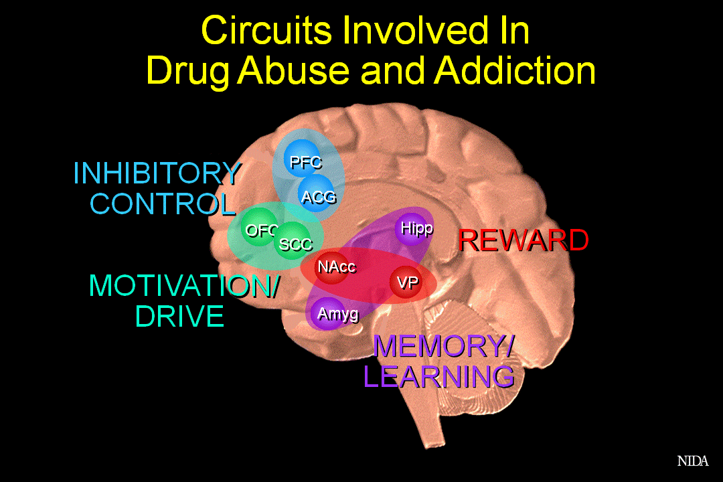
mOFC

Slide 34
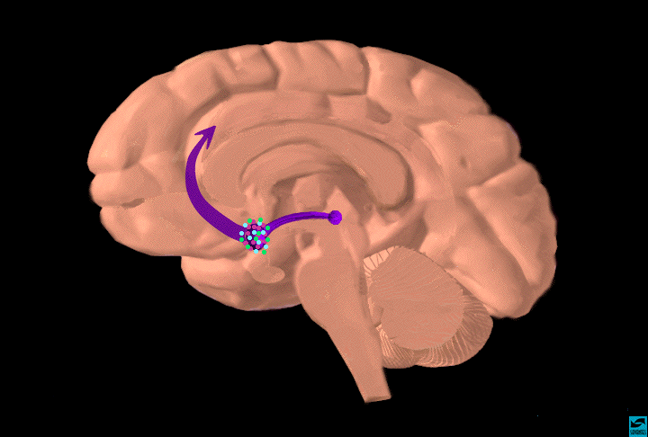
Dopamine Pathways
frontal
cortex
striatum
hippocampus
substantia
nigra/VTA
Functions
reward (motivation)
pleasure, euphoria
motor function
(fine tuning)
compulsion
perseveration
nucleus
accumbens

Slide 35
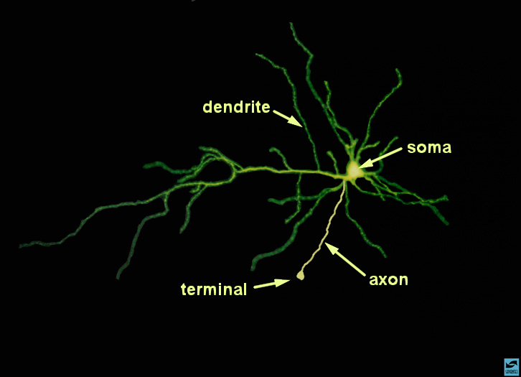

Slide 36
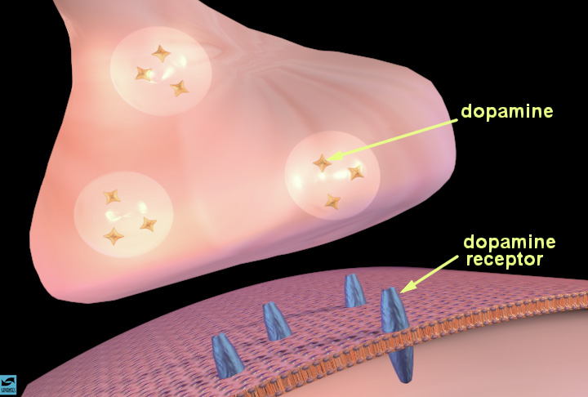
Notes:
The synapse and synaptic neurotransmission
Describe the synapse and the process of chemical neurotransmission. Indicate how vesicles containing a neurotransmitter, such as dopamine (the stars), move toward the presynaptic membrane as an electrical impulse arrives at the terminal. Describe the process of dopamine release (show how the vesicles fuse with the presynaptic membrane). Once inside the synaptic cleft, the dopamine can bind to specific proteins called dopamine receptors (in blue) on the membrane of a neighboring neuron. Introduce the idea that occupation of receptors by neurotransmitters causes various actions in the cell; activation or inhibition of enzymes, entry or exit of certain ions.

Slide 37
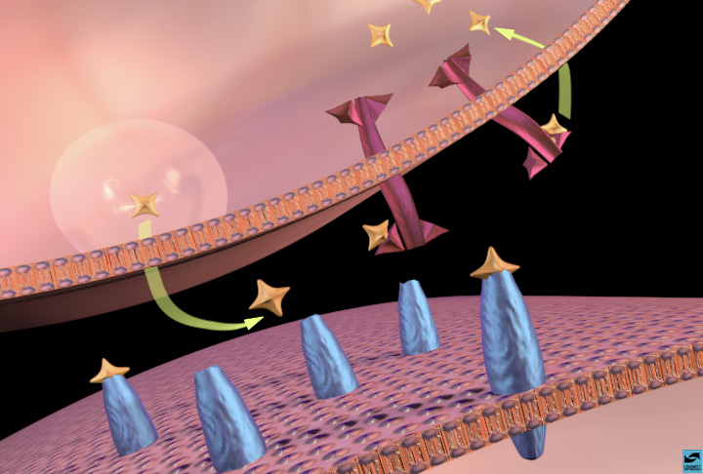
Notes:
Slide 12: Dopamine binding to receptors and uptake pumps in the nucleus accumbens
Explain that cocaine concentrates in areas of the brain that are rich in dopamine synapses. Review dopamine transmission in the nucleus accumbens. Point to dopamine in the synapse and to dopamine bound to dopamine receptors and to uptake pumps on the terminal.

Slide 38
Natural Rewards Elevate Dopamine Levels
FOOD
SEX
200
200
NAc shell
150
150
DA Concentration (% Baseline)
100
100
15
% of Basal DA Output
Empty
10
50
Copulation Frequency
Box
Feeding
5
0
0
0
60
120
180
Scr
Scr
Scr
Scr
Time (min)
Bas
Female 1 Present
Female 2 Present
Sample
Number
1
2
3
4
5
6
7
8
9
10
11
12
13
14
15
16
17
Mounts
Intromissions
Ejaculations
(Di Chiara, Acquas, Tanda, & Cadoni, 1992)
(Fiorino & Phillips, 1999)

Slide 39
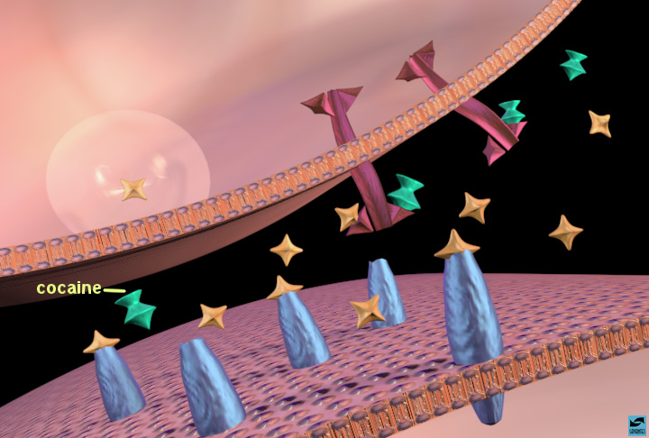
Notes:
Cocaine binding to uptake pumps; inhibition of dopamine uptake
Now, show what happens when cocaine is present in the synapse. Cocaine (turquoise) binds to the uptake pumps and prevents them from removing dopamine from the synapse. This results in more dopamine in the synapse, and more dopamine receptors are activated.

Slide 40
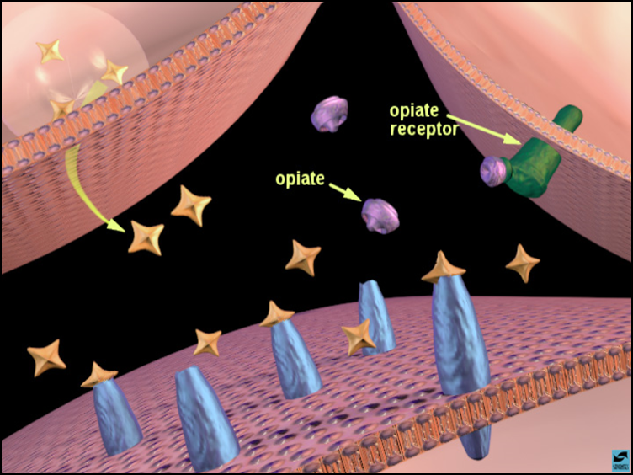

Notes:
Slide 18: Opiates binding to opiate receptors in the nucleus accumbens: increased dopamine release
Show how opiates activate the reward system using the nucleus accumbens as an example. Explain that the action is a little more complicated than cocaine's because more than two neurons are involved. Point out that three neurons participate in opiate action: the dopamine terminal, another terminal (on the right) containing a different neurotransmitter (probably GABA for those that would like to know), and the post-synaptic cell containing dopamine receptors. Show that opiates bind to opiate receptors (green) on the neighboring terminal and this sends a signal to the dopamine terminal to release more dopamine. [In case an inquisitive student asks how, one theory is that opiate receptor activation decreases GABA release, which normally inhibits dopamine release, so dopamine release is increased.]

Slide 41
Effects of Drugs on Dopamine Release
AMPHETAMINE
COCAINE
1100
Accumbens
Accumbens
1000
400
900
800
DA
300
DA
700
DOPAC
DOPAC
% of Basal Release
HVA
HVA
600
% of Basal Release
500
200
400
300
200
100
100
0
0
0
1
2
3
4
5 hr
0
1
2
3
4
5 hr
Time After Amphetamine
Time After Cocaine
250
NICOTINE
MORPHINE
250
Accumbens
200
Dose (mg/kg)
Accumbens
200
0.5
Caudate
1.0
% of Basal Release
2.5
150
% of Basal Release
10
150
100
100
0
0
0
1
2
3 hr
0
1
2
3
4
5hr
Time After Nicotine
Time After Morphine
(Di Chiara & Imperato, 1988)

Slide 42
Science Has Generated A Lot of
Evidence Showing That…
Prolonged Drug Use Changes
the Brain In Fundamental
and Long-Lasting Ways

Slide 43
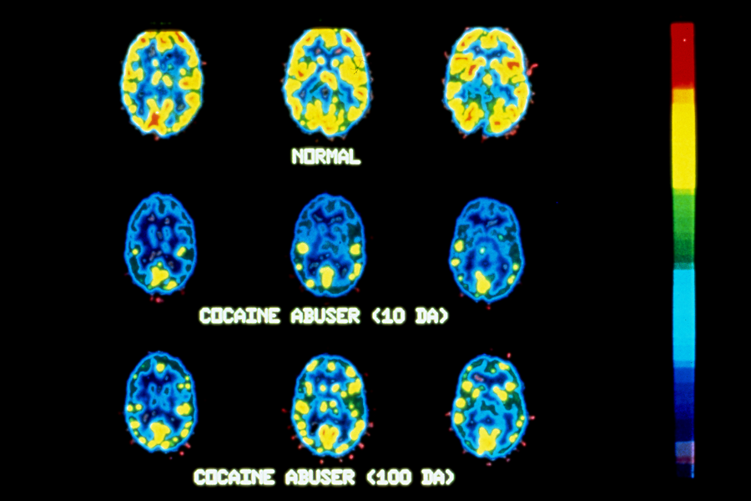
Normal
Cocaine Abuser (10 Days)
Cocaine Abuser (100 Days)
(Volkow et al., 1992; 1993)
Notes:
Sources: Volkow, et al., Synapse, 11:184-190, 1992
& Volkow, et al., Synapse, 14:169-177, 1993

Slide 44

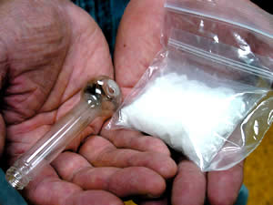
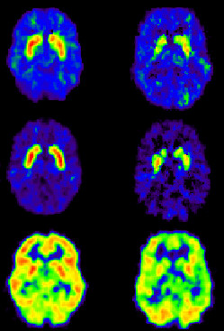
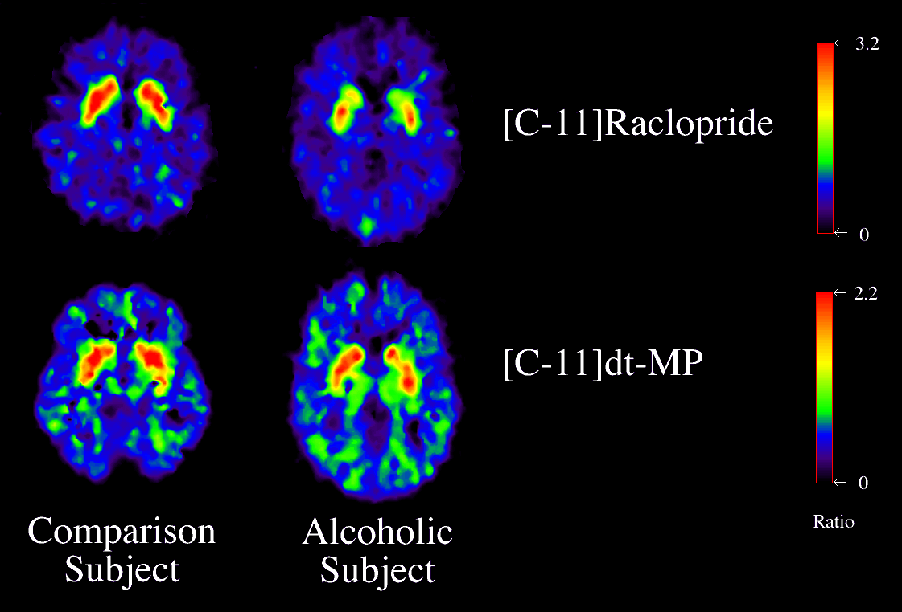
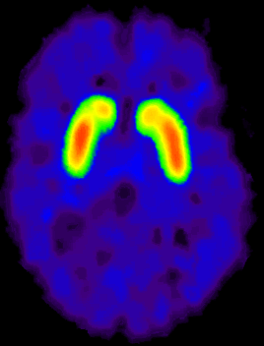
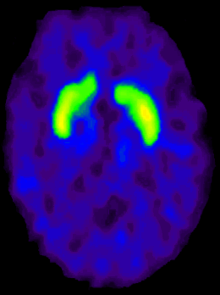
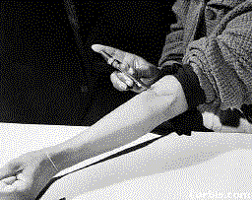
Dopamine D2 Receptors are Lower in Addiction
Cocaine
DA
DA
DA
DA
DA
DA
DA
DA
DA
DA
DA
DA
Meth
Reward Circuits
Non-Drug Abuser
DA D2 Receptor Availability
Alcohol
DA
DA
DA
DA
DA
DA
Heroin
Control
Addicted
Reward Circuits
Drug Abuser

Slide 45
Prolonged Drug Use Changes
The Brain In Fundamental and
Long-Lasting Ways

Slide 47
AND…
We Have Evidence that
these Changes Can Be Both
Structural and Functional

Slide 48
Implication:
Brain changes resulting from
prolonged use of drugs
may be reflected in compromised
cognitive functioning
Is there recovery?

Slide 49
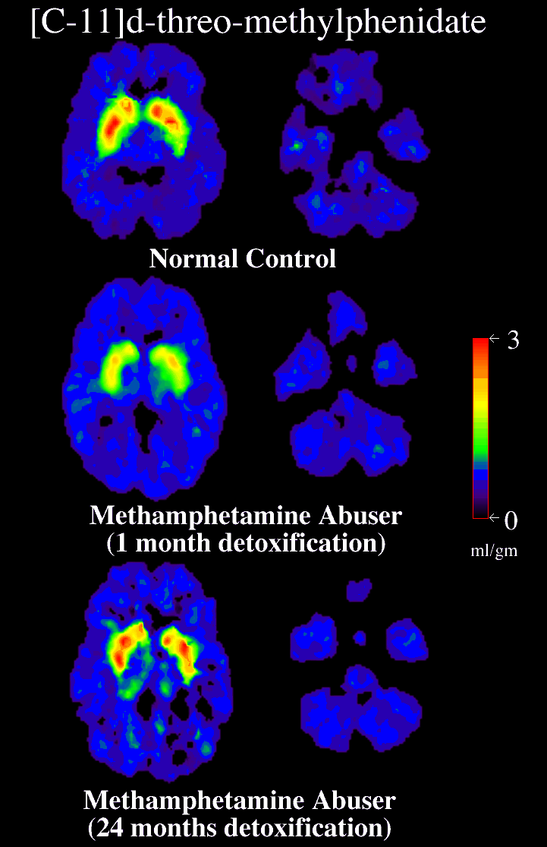
[C-11]d-threo-methylphenidate
Normal Control
DAT Recovery
with prolonged
abstinence from
methamphetamine
Methamphetamine Abuser
(1 month detoxification)
Methamphetamine Abuser
(14 month abstinent)
Volkow, N.D. et al., Journal of Neuroscience, 21(23), December 1, 2001.
Notes:
Source: Volkow, N.D. et al., Journal of Neuroscience, 21(23), pp. 9414-9418, December 1, 2001.
Figure 1. Brain images of the distribution volume of [11C]d-threo-methylphenidate in a control and a METH abuser. Images shown were obtained at the level of the striatum (images to the left) and the cerebellum (images to the right), and they are from a normal control and a METH abuser evaluated twice, during short and protracted abstinence. Notice the significant increases in binding in striatum in the METH abuser with protracted abstinence.

Slide 50
As We’ve Seen, Drug Use Can Lead to Structural and Functional Changes in the Brain…

Slide 51
Addiction is, Fundamentally, a Brain Disease

Slide 52
Addiction is Not
Just a Brain Disease

Slide 53
Addiction Is a Brain Disease
Expressed as Compulsive Behavior
Both Developing and
Recovering From It Depend on
Behavior and Social Context

Slide 54
CRAVING INDUCTION IN PET SETTING
N = 13
5
4
3
2
1
0
-1
CRAVING
Neutral
Cocaine
STIMULI

Slide 55
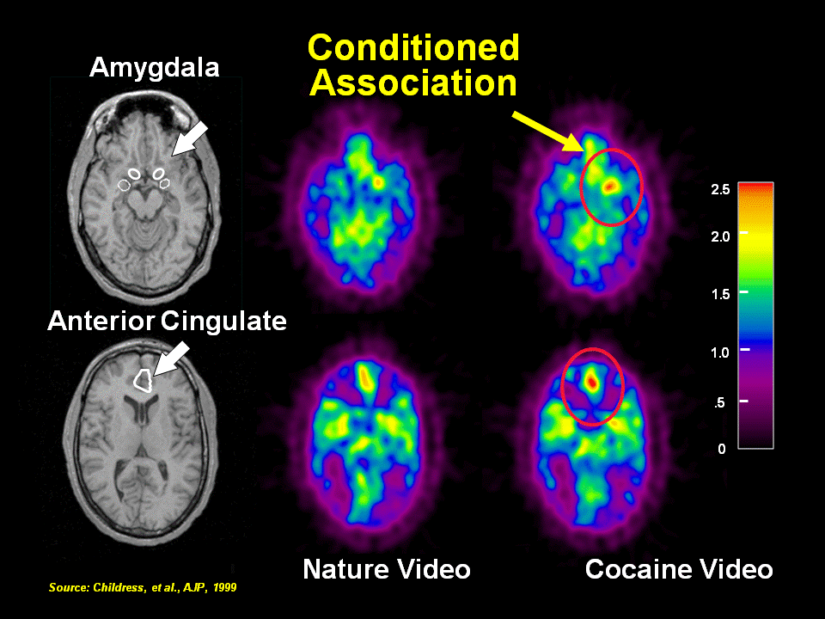

Slide 56
Memories Appear to Be a
Critical Part of Addiction

Slide 57
“People, Places and Things…”

Slide 58
But Not Just Memories…

Slide 59
Drugs Are Usurping
Brain Circuits
and
Motivational Priorities

Slide 60
We Don’t Know the Exact Switch
BUT…
We Do Know that the Brain
Circuitry Involved in Addiction
Has Similarities to that of
Other Motivational Systems

Slide 61
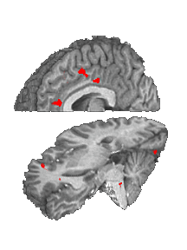
Cocaine Craving:
Population (Cocaine Users, Controls) x Film (cocaine )
Cingulate
Ant Cing
Signal Intensity (AU)
Cocaine Film
IFG
Controls Cocaine Users
Notes:
Garavan et al A .J. Psych 2000

Slide 62
Cocaine Craving:
Population (Cocaine Users, Controls) x Film (cocaine, erotic)
Cingulate
Ant Cing
Signal Intensity (AU)
IFG
Controls Cocaine Users
Garavan et al , A. J. Psych 2000
Notes:
Garavan et al A .J. Psych 2000

Slide 63
This Results in
“Motivational Toxicity”
and Compulsive Drug
Use (Addiction)

Slide 64
Their Brains
have been
Re-Wired
by Drug Use
Because…

Slide 65
Addiction is the
Quintessential
Biobehavioral Disorder

Slide 66
The Brains of Addicts
Are Different From the Brains of Non-Addicts
…And Those Differences
Are An Essential Element of Addiction

Slide 68
Non Addicted Brain
Addicted Brain
Control
STOP
Control
Drive
Reward
Drive
Reward
GO
Memory
Memory

Slide 69
We Have a Variety of Effective Treatment Options in the Clinical Toolbox

Slide 70
Available Pharmacotherapies
Opiates
Nicotine
Alcohol
Methadone
Naltrexone
Buprenorphine
Buprenorphine/
Naloxone
Depot Naltrexone (Vivitrol)
Bupropion
NRT
Varenicline
Disulfiram
Oral Naltrexone
Injectible extended release naltrexone: Vivitrol
Acamprosate
Alcohol Withdrawal
Valium
Librium
Tranxene

Slide 71
Some Efficacious Behavioral Treatments
For Drug Dependence
    Cognitive Behavioral Therapy
    Community Reinforcement Approach (CRA) with Vouchers
    Contingency Management (Without CRA)
    Lower-cost Contingency Management
    Brief Strategic Family Therapy
    Multidimensional Family Therapy
    Behavioral Couples Therapy
    Motivational Interviewing / Motivational Enhancement Therapy
Notes:
Touch on this, but Redonna should really explore these more completely.
NIDA has generated its own list of probably effiacious treatments:
COGNITIVE BEHAVIORAL THERAPY (cocaine dependence)- also for benzodiazepine withdrawal in panic disorder patients.
COMMUNITY REINFORCEMENT APPROACH (CRA) WITH VOUCHERS (cocaine dependence)
CONTINGENCY MANAGEMENT (WITHOUT CRA) (methadone-maintained opiate & cocaine abusers)
LOWER-COST CONTINGENCY MANAGEMENT (cocaine dependent people in methadone-maintenance)
BRIEF STRATEGIC FAMILY THERAPY (certain sub-populations of Hispanic adolescent polydrug abusers)
MULTIDIMENSIONAL FAMILY THERAPY African-American polydrug-abusing adolescents)
BEHAVIORAL COUPLES THERAPY (methadone-maintained opioid-addicted men; drug-abusing women)
COMBINED SCHEDULED REDUCED SMOKING & CBT (adult smokers)
COMBINED BEHAVIORAL & NICOTINE REPLACEMENT THERAPY (adult smokers).

Slide 72
Treating a Biobehavioral Disorder Must Go beyond just Fixing the Chemistry

Slide 73
The Most Effective Treatment Strategies Will Attend to all Aspects of Addiction:
Biology
Behavior
Social Context

Slide 74
The Acute Care Treatment Model
Substance Abusing Patient
Treatment
NTOMS Sample of
Non- Substance Abusing Patient
Notes:
_______________________________________________________
_______________________________________________________
________________________________________________________
________________________________________________________
________________________________________________________
________________________________________________________
________________________________________________________
________________________________________________________
________________________________________________________

Slide 75
A Continuing Care Model
Primary Care
Specialty Care
Primary
Continuing Care
Notes:
_______________________________________________________
_______________________________________________________
________________________________________________________
________________________________________________________
________________________________________________________
________________________________________________________
________________________________________________________
________________________________________________________
________________________________________________________

Slide 76
Detox is NOT Treatment

Slide 77
Detox is NOT Treatment
It is a part of treatment

Slide 78
Drug Abuse Treatment Core Components and Comprehensive Services
Medical
Financial
Mental Health
Group/Individual Counseling
Housing &
Transportation
Core
Treatment
Vocational
Urine Monitoring
Abstinence
Based
Intake
Assessment
Case Management
Child Care
Pharmaco-therapy
Educational
Treatment
Plans
Continuing Care
Self-Help
(AA/NA)
Family
Legal
AIDS / HIV Risks
Etheridge, Hubbard, Anderson, Craddock, & Flynn, 1997 (PAB)

Slide 79

We Need to Treat the
Whole Person!

Slide 80
We Need to View and
Treat Addiction as a
Chronic, Relapsing Illness

Slide 81
Relapse Rates Are Similar for Drug Dependence and
Other Chronic Illnesses
100
90
80
70
60
Percent of Patients Who Relapse
50 to 70%
50 to 70%
50
40
40 to 60%
30
30 to 50%
20
10
0
Drug
Dependence
Type I
Diabetes
Hypertension
Asthma
Source: McLellan, A.T. et al., JAMA, Vol 284(13), October 4, 2000.

Slide 82
Outcome In Diabetes
Pre - During - Post
Notes:
Treatment Research Institute

Slide 83
Outcome In Addiction
Pre - Post
Notes:
Treatment Research Institute

Slide 84
If we treat a diabetic and symptoms don’t subside….what do we do?
Would we increase the dose?
Would we change medications?
Would we change treatment approaches?
Would we fail to provide ongoing
treatment for a diabetic?

Slide 85
A Continuing Care Model
Primary Care
Specialty Care
Primary
Continuing Care
Notes:
_______________________________________________________
_______________________________________________________
________________________________________________________
________________________________________________________
________________________________________________________
________________________________________________________
________________________________________________________
________________________________________________________
________________________________________________________

Slide 86
In Treating Addiction…
We Need to Keep Our Eye on
the Real Target
Abstinence
Functionality in
Family, Work
and Community
Reduced Criminal Behavior

Slide 87
Ineffective System for Addressing Drugs and Crime
Public Health Approach
-disease
-treatment
Public Safety Approach
-illegal behavior
-punish
High Attrition
High Recidivism

Slide 88
Integrated Public Health-Public Safety Strategy
Community-based treatment
Close supervision
Blends functions of criminal justice and treatment systems to optimize outcomes
Consequences for noncompliance are certain and immediate
Opportunity to avoid incarceration or criminal record

Slide 89
Where do we go from here?
Provide upfront alternative to incarceration for individuals with SUDs
Provide treatment while incarcerated for individuals with SUDs
Embrace all forms of treatment including medication assisted treatment ( MAT)
Treat addiction as the chronic disease that it is!
Expand enrollment of CJ populations in care
Tcondon@unm.edu

Slide 90
So….Advances in Science
Have Revolutionized Our Fundamental Views of
Substance Abuse and Addiction

Slide 91
And these advances have the potential to help improve both the
CRIMINAL JUSTICE
HEALTH
and
Approaches to Addressing
Drug Abuse and Addiction

Slide 92
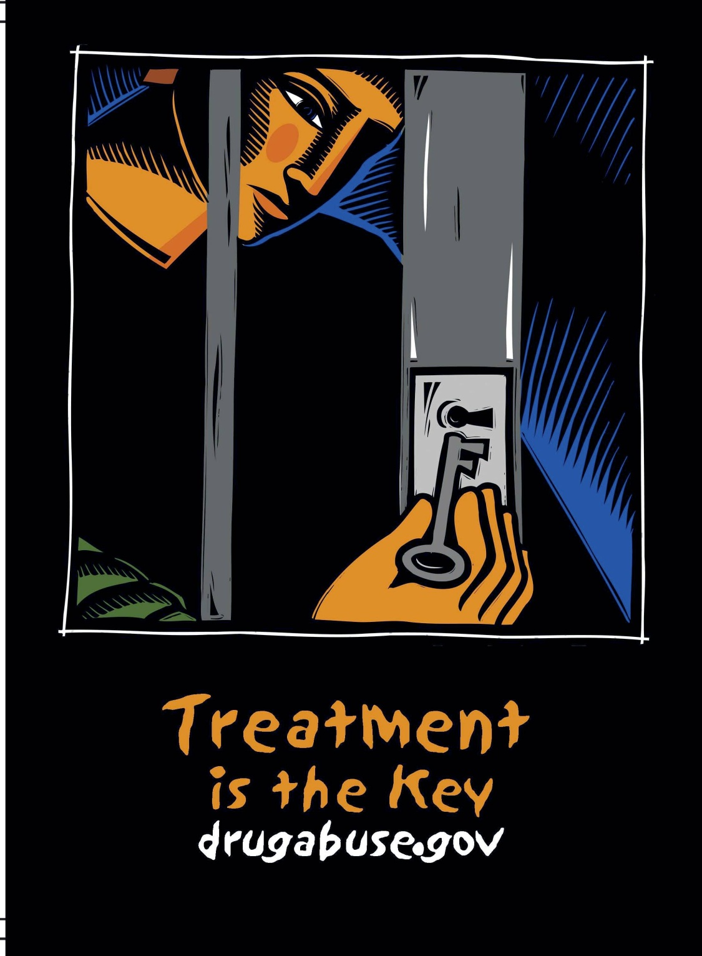
Reduce Crime
Save Money
Improve Lives

Slide 93

A New Day is here for the field of addictions
Thank you for what you do!

Slide 94

Thank You
Tcondon@unm.edu
Center on Alcoholism, Substance Abuse & Addictions

