Slide 1
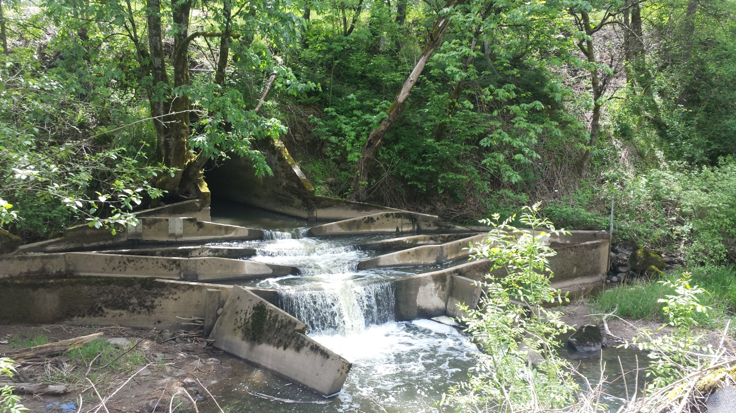
Stark St Beaver Creek Culvert Project Updates
Riad Alharithi
5/20/2017

Slide 2
Staff Introductions
Road Engineering Program Manager
Riad Alharithi
Transportation Planning Manager
Joanna Valencia
Structural Engineer
Ken Huntley
Water Quality Specialist
Roy Iwai
Communications Office
Mike Pullen
Project Manager
Sara Jeffrey

Slide 3
Concerns/Questions from the Public
Why does the road need to be closed?
Public notice?
Why does this work take so long?
Impact on local businesses?
Traffic movement during construction?
Vehicles (trucks and passengers vehicles),
Pedestrians, Bikes?
TriMet?
If there are any other concerns or questions during construction, feel free to contact us via email/phone sara.jeffrey@multco.us (503) 988-0215
or the project website comment form:
https://multco.us/roads/webform/stark-street-culvert-replacement

Slide 4
Overview
Project background
Project Purpose
Community Improvements
Continuity of future Stark St
Funding
Public Outreach
Design Overview
Construction Update
Traffic Control
Questions

Slide 5
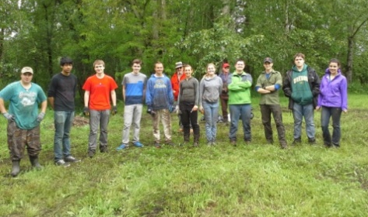
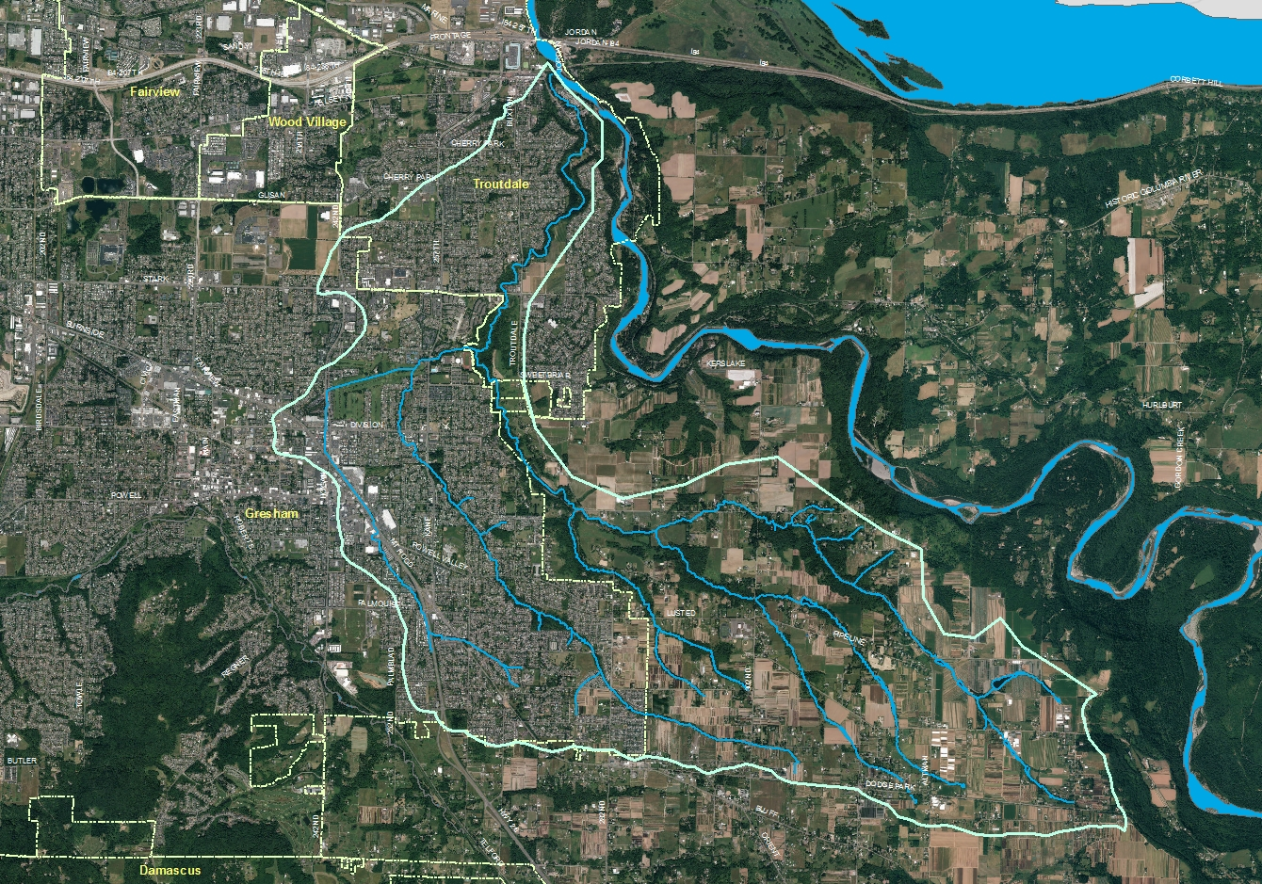
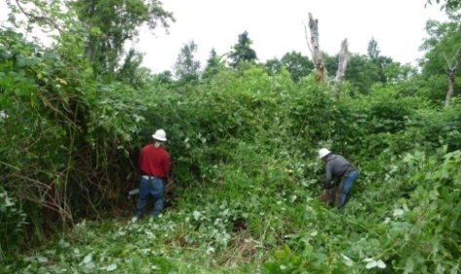
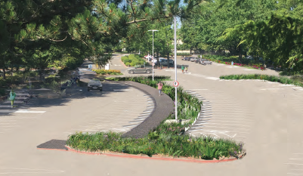
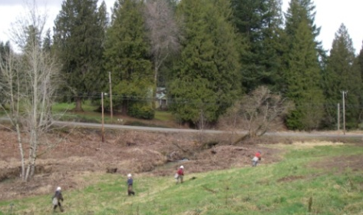
Community Improvements
SOLVE
Troutdale
MHCC
Metro
East Mult SWCD
Notes:
Beaver Creek is an important salmon stream in the Sandy River basin. It is the lowest tributary of the Sandy River.

Slide 6
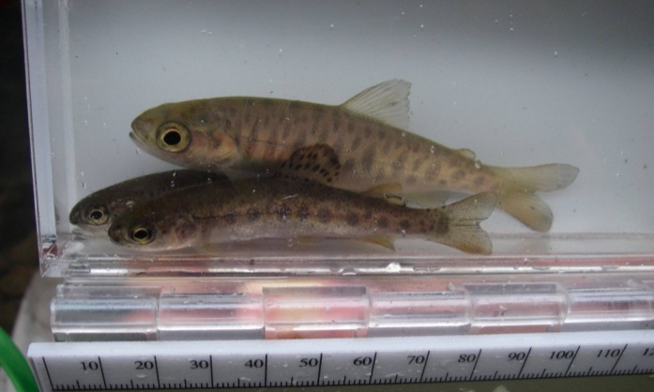
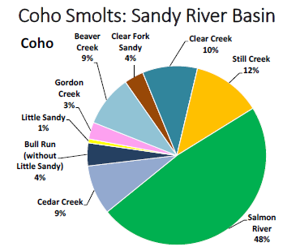
Project Purpose Why are we doing this project?
Threatened coho and Chinook salmon, steelhead trout, and 10 other species
Beaver Creek is an important tributary of the Sandy River
Stark St culvert is a priority fish barrier
Juvenile coho and steelhead trout (2010)
Burke Strobel, Portland Water Bureau. Feb 2015
Notes:
I conducted a fish survey in 2010-2011 and found fish in nearly every habitat we surveyed.

Slide 7
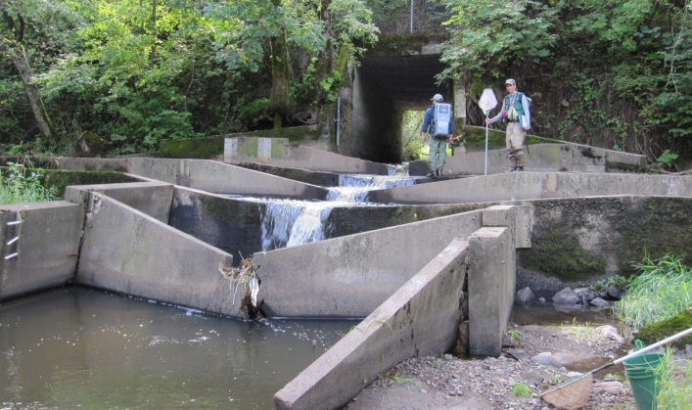
Project Purpose Why are we doing this project?
Culvert and fish ladder at Stark St
Notes:
While our partners are working to restore the stream, how can fish get up this broken fish ladder? This culvert has been on the state priority list of fish migration barriers for many years. This is considered a 100% barrier, but some fish find there way up at certain flows.

Slide 8
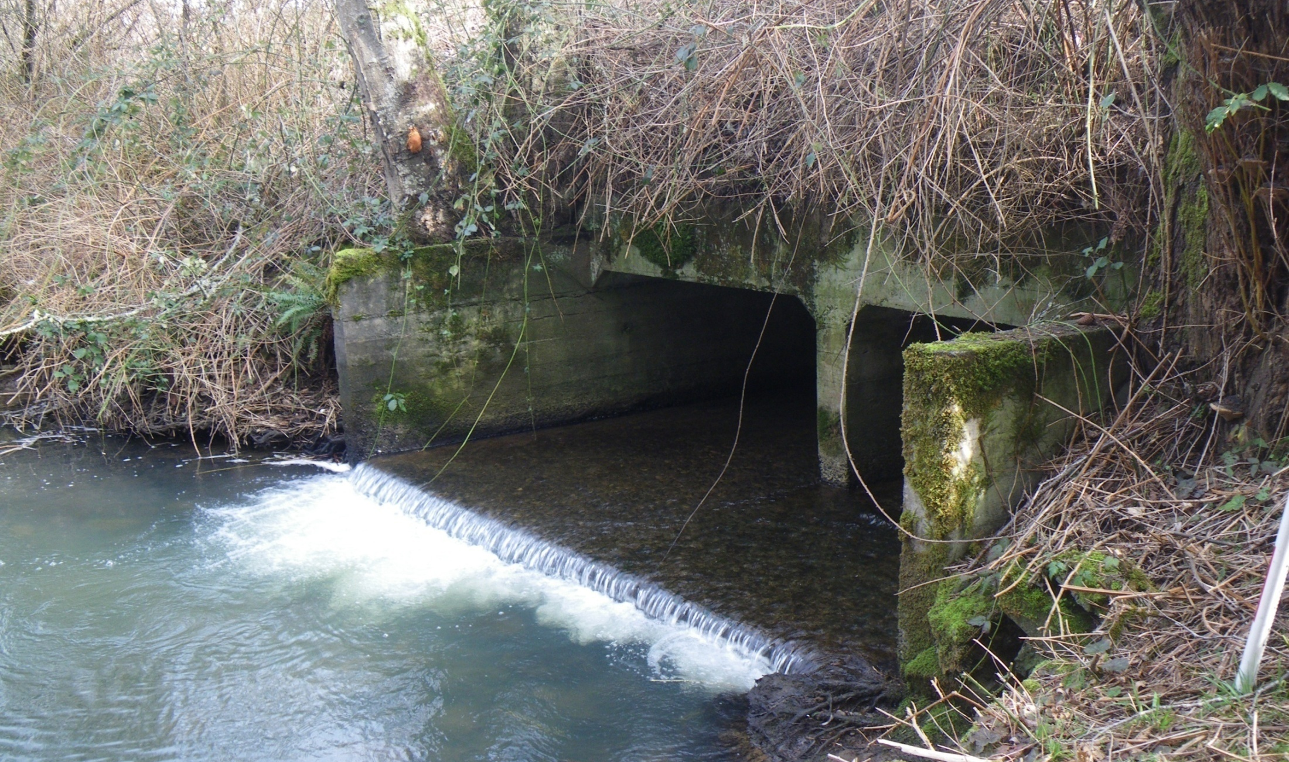
Project Purpose Why are we doing this project?
Culvert at Cochran Road
Notes:
The Cochran Rd culvert is a partial barrier – Only 33% passable due to flow velocity. Grant funds were secured and construction will be in 2018.

Slide 9
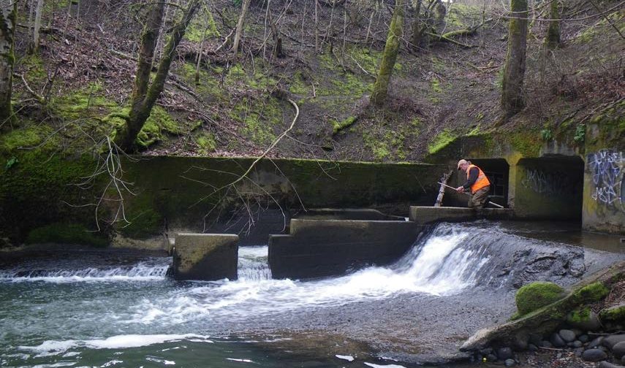
Project Purpose Why are we doing this project?
Culvert and fish ladder at Troutdale Rd
Notes:
Retrofit of this fish ladder with ODFW – work will be in 2018

Slide 10
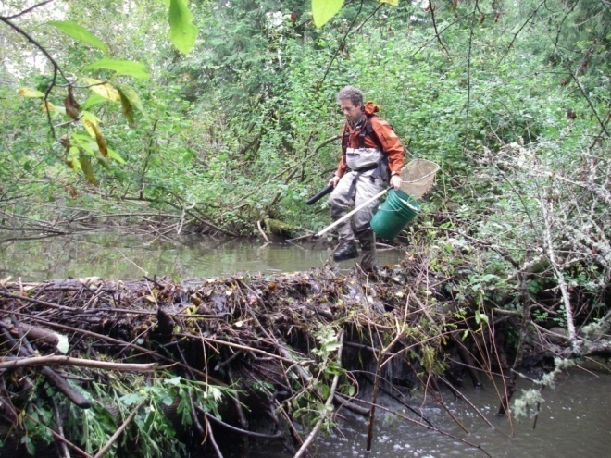
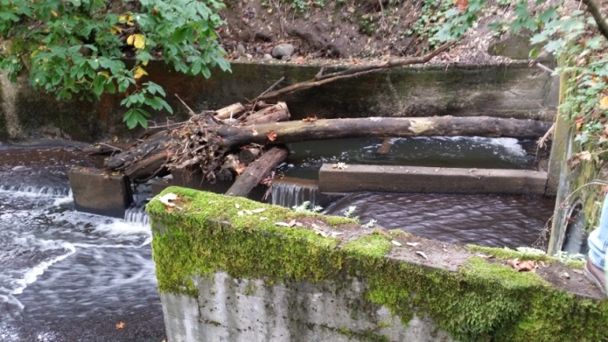
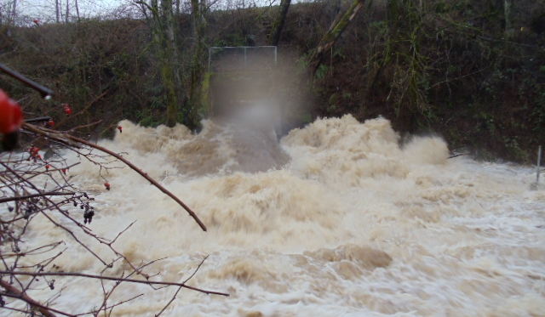
Project Purpose Why are we doing this project?
Supports passage of:
Beaver dam debris
Large wood
Sediment
Wildlife
The current culvert is undersized for the amount of rainfall we get

Slide 11
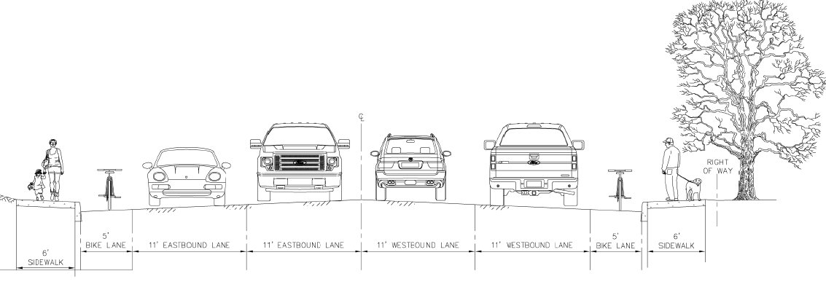
Future Stark St. Why are we doing this project?
Supports future plans to widen Stark Street to accommodate traffic, bicycles, and pedestrians

Slide 12
Funding(FHWA, County, City)
obligated
in 2014
Construction funds need to be spent by this year

Slide 13
Previous Public Outreach
7/19/14 – Article in Oregonian
12/2015 – Project Webpage
Sandy River Basin
City of Troutdale Public Works Webpage
Watershed Council Website Article
Gresham Outlook Article
12/9/15 – Public Meeting at MHCC
4/16/16 – Gresham Saturday Market
8/24/16 – City of Troutdale Facebook Article
8/27/16 – Gresham Saturday Market
4/15/17 – Gresham Saturday Market
6/18/17 – MHCC Strawberry Short Course Stream Tour and Tabling

Slide 14
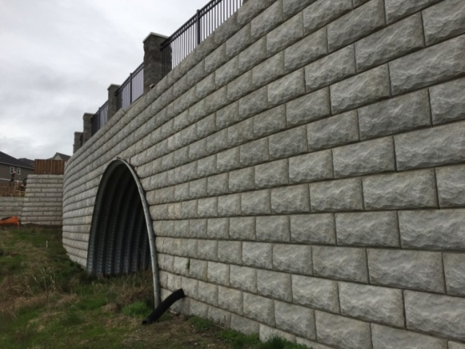
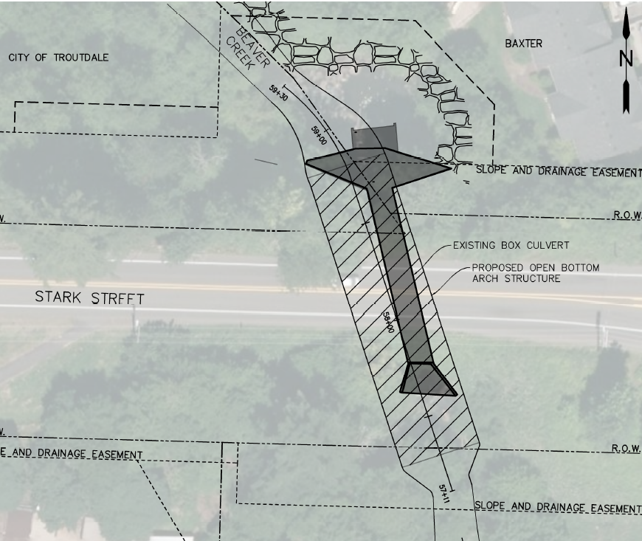
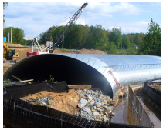
Design Overview Why is this work going to take so long?

Slide 15
Design Overview Why is this work going to take so long?
Habitat Improvements
Stream Restoration

Slide 16
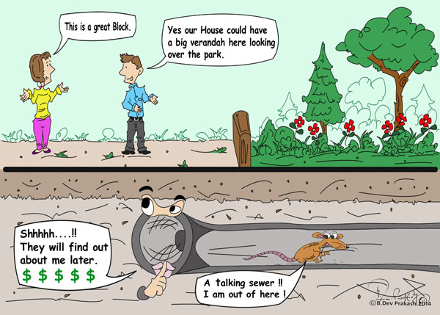
Utility Coordination Why is this work going to take so long?
Utility Conflicts:
Gas (NW Natural)
Relocation completed
Water (City of Troutdale)
No impact to services
Sanitary Sewer (City of Troutdale)
Bypass plan
No impact to services
PGE Power Poles
Outer edge of project limits
Frontier/Communications – Concrete encased Fiber
one week to build a suspension system to keep the duct bank in place during construction

Slide 17
Design Overview Why does the road need to be closed?
Why does the road need to be closed?
37’ of excavation
Stream bypass In-water work window July 15th-August 31st

Slide 18
Traffic Control – Vehicle Detour Will the route change?
Vehicle detour
NE Kane Dr. to SE Cochran Rd. to S. Troutdale Rd.
route

Slide 19
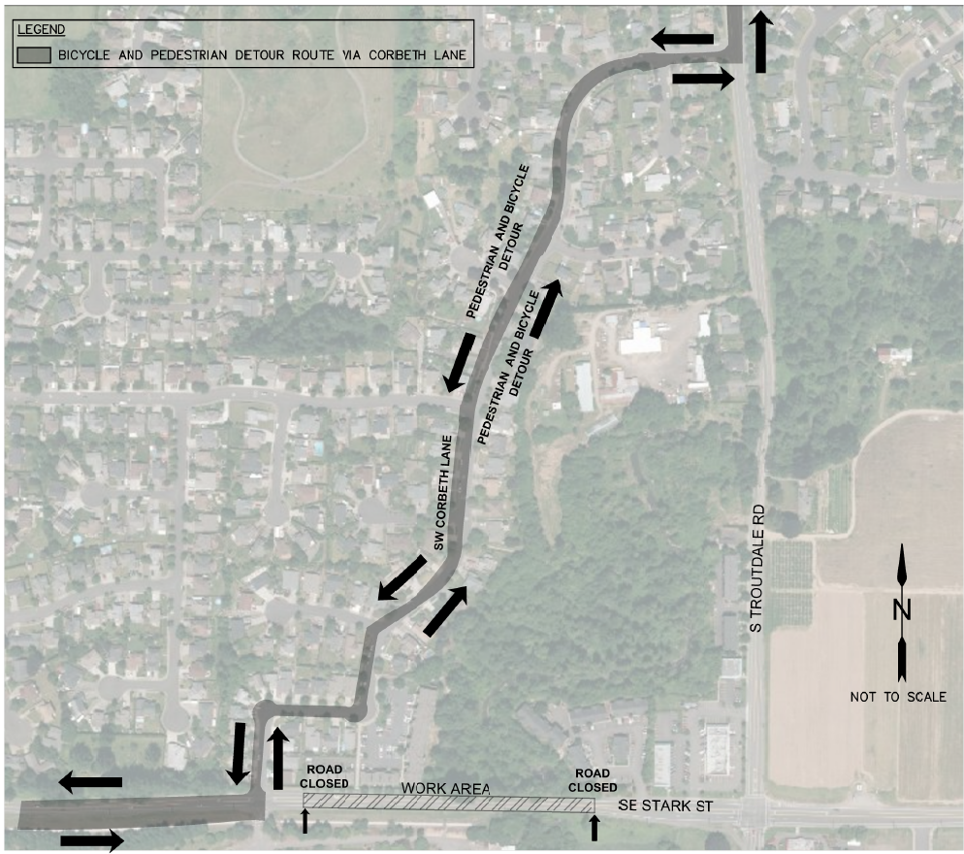
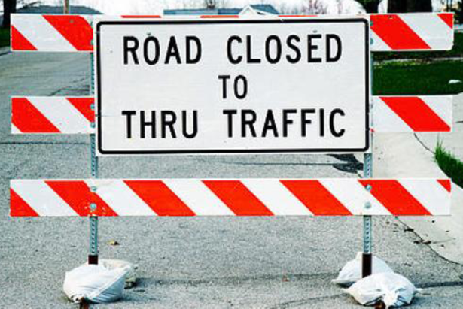
Traffic Control – Bike/Ped Detour Will traffic be detoured through Corbeth Lane?
Pedestrian/ Bicycle Detour
SW Corbeth Ln

Slide 20
Construction Update
Contractor selected:
Pre construction conference was May 8th
Construction schedule
Begin Construction mid June
Completed by the end of October

Slide 21
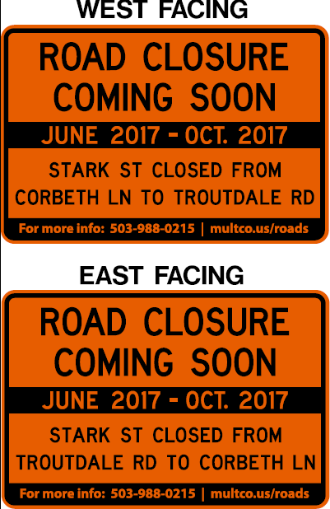
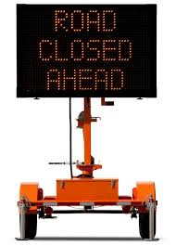
Communication Before and During Construction
Before Construction
Today’s meeting
Thank you to Skyland Pub
Signage
Fixed signs (very shortly)
Variable message boards (5 days before construction start)
Business Open signs when road is closed
During Construction
Weekly updates https://multco.us/roads/webform/stark-street-culvert-replacement

Slide 22
Questions?
If there are any other concerns or questions during construction, feel free to contact us via email/phone
sara.jeffrey@multco.us (503) 988-0215
or the project website comment form:
https://multco.us/roads/webform/stark-street-culvert-replacement

