Slide 1
Multnomah County
West Hills Road Projects Update
NW Germantown Rd.
NW Newberry Rd.
NW Cornelius Pass Rd.
October 8, 2018
Skyline Elementary School
MULTNOMAH COUNTY
Mike Pullen
Carrie Warren
Storm Beck
Alma Pradeepan
MURRAYSMITH
Gabe Crop
Tyler Nord

Slide 2
Agenda
NW Germantown Road Slide Repair Update
Project description
Schedule and traffic plan
NW Newberry Road Slide Repair Update
Project description
Schedule and traffic plan
NW Cornelius Pass Road Safety Improvement Update
Jurisdiction transfer to ODOT
Project description
Schedule and traffic plans
Questions / Comments
Notes:
JD

Slide 3
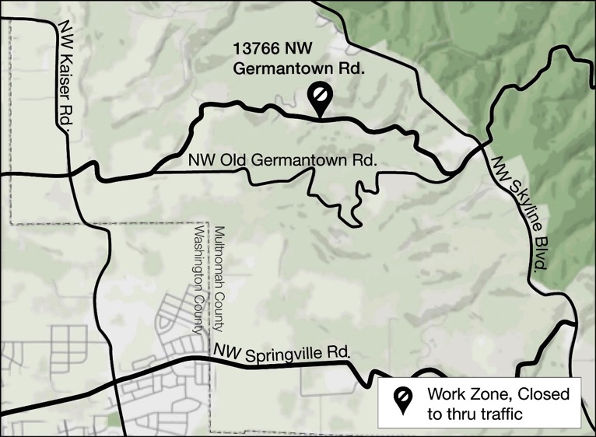
NW GERMANTOWN ROAD // Slide Location and Damage Description
Project Location
13766 NW Germantown Rd.
Between Skyline Blvd. & Kaiser Rd.
Project Description
Failed culvert
Undermined slope on downhill side
Loss of shoulder

Slide 4
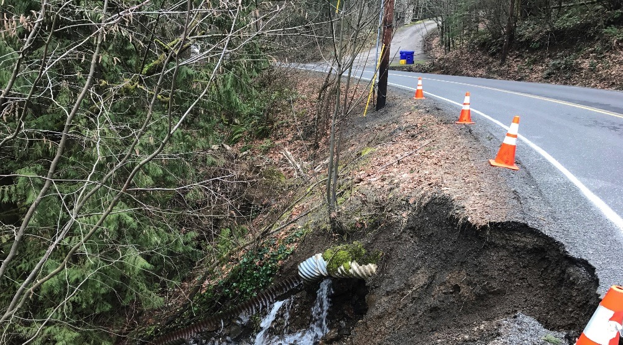
NW GERMANTOWN ROAD // Repair Plan
Project Plan
Close road
Replace culvert
Increase diameter from 18 to 36 inches
Include erosion control rocks at either end
Repair slope
Realign road away from slide

Slide 5
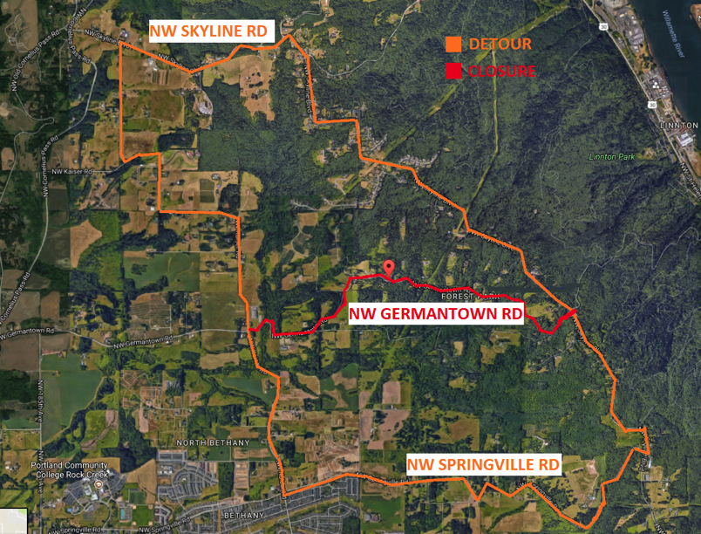
NW GERMANTOWN ROAD // Repair Schedule and Alternate Routes
Construction Schedule
7-day road closure
Mid-October, 2018
Traffic Plan
Road too narrow to keep open during repairs
Close to through traffic from Skyline to Kaiser
Alternate routes: Skyline and Springville
Access maintained for residents and first responders

Slide 6
NW Germantown Road Questions
For more information: Web: multco.us/germantown Twitter: @MultCoRoads

Slide 7
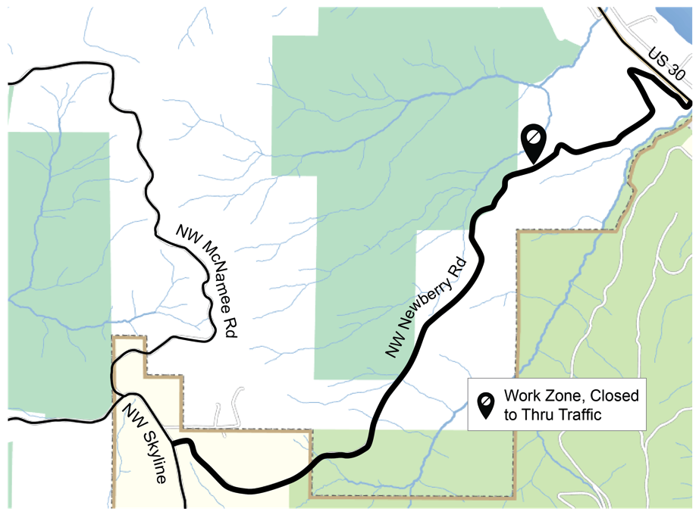
NW NEWBERRY ROAD // Slide Location
Project Location
Near 13342 NW Newberry Rd.
Between Skyline Blvd. & US30

Slide 8
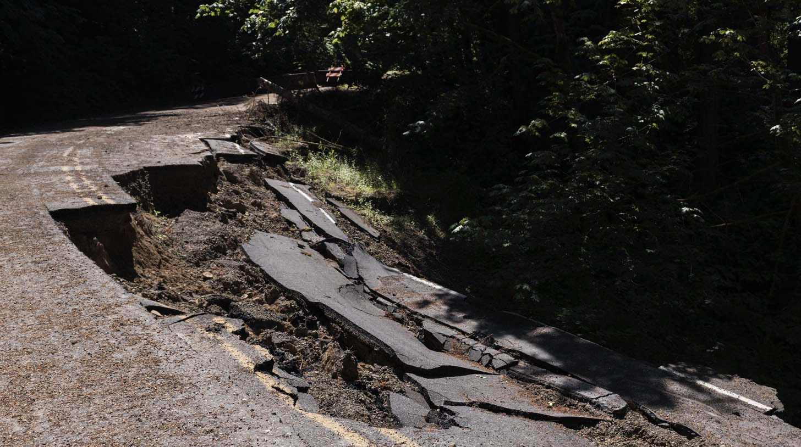
NW NEWBERRY ROAD // Damage Description
Project Description
Large landslide undermined road following snowstorm
Road has been closed since January 2017

Slide 9
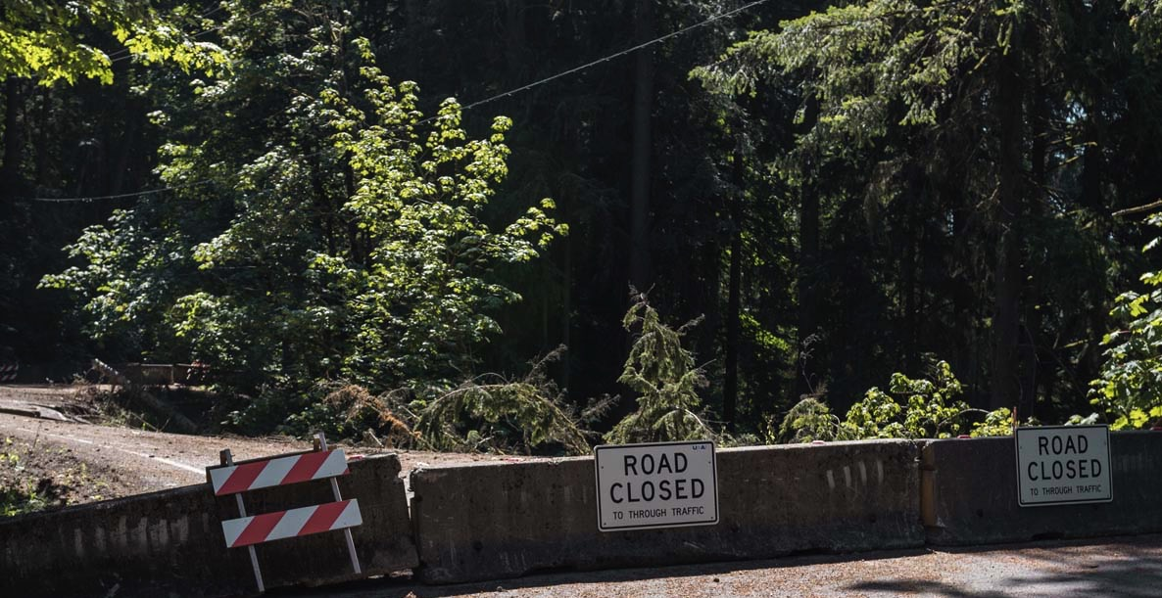
NW NEWBERRY ROAD // Repair Plan
Project Plan
Road will remain closed to all users
Temporary water management
Retaining wall contain all weather backfill
Rebuild and pave road

Slide 10
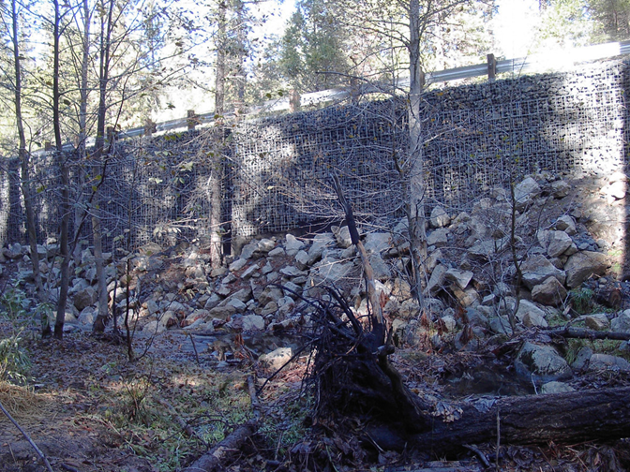
NW NEWBERRY ROAD // Repair Plan
Example of reinforced retaining wall to be used in project
Example of Hot-Dip Galvanized Welded Wire Wall. Photo of the Hilfiker Retaining Wall at Evergreen Road Bridge Replacement. Photo Source: http://projects.hilfiker.com/WWW/i-tkrF7zT/

Slide 11
NW NEWBERRY ROAD // Repair Schedule and Alternate Routes
Construction Schedule
Work begins November 2018 after Germantown
Road open to traffic late March 2019
Final paving in May 2019
Traffic Plan
Road to remain closed during construction
Local traffic will have access up to slide area on both sides
NW Cornelius Pass used as alternate route

Slide 12
NW Newberry Road Questions
For more information: Web: multco.us/newberry Twitter: @MultCoRoads

Slide 13
NW CORNELIUS PASS ROAD // Jurisdictional Transfer
Cornelius Pass Road Transfer
HB2017 transfers Cornelius Pass Road between US26 and US30 from Washington and Multnomah Counties to ODOT
Timing of transfer will be after completion of current project, no firm date yet
ODOT is currently gathering information about the road
Multnomah County in process of sharing available information

Slide 14
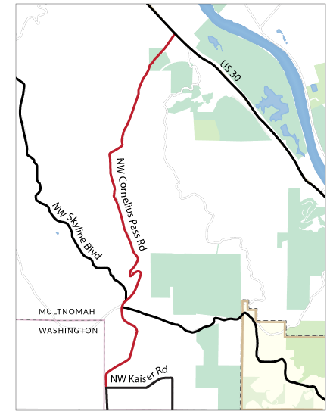
NW CORNELIUS PASS ROAD // Project Overview
Project Description
Safety improvements are needed to Cornelius Pass Rd between Highway 30 and NW Kaiser Rd
The Oregon Legislature allocated funding to Multnomah County for the enhancements
Landslides on alternate routes delayed project

Slide 15
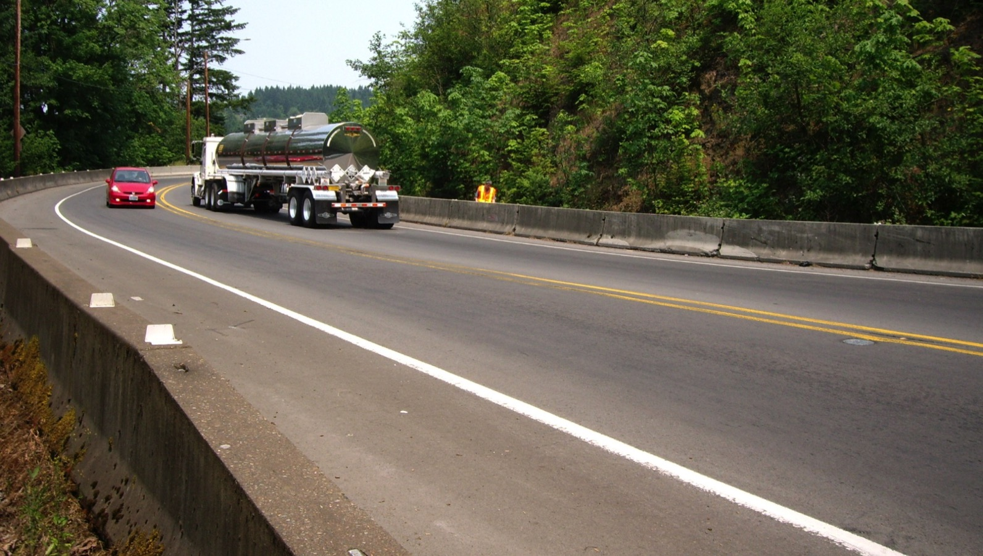
NW CORNELIUS PASS ROAD // Project Overview
Corridor-Wide Improvements
Signage
Vehicle pullouts
Barriers and guardrails
Reduce pavement drop-offs with gravel shoulder wedge

Slide 16
NW CORNELIUS PASS ROAD // Project Details and Locations
8th Ave minor curve realignment and shoulder widening
“S” curves reconstruction and realignment
Curves south of Plainview Rd signage and sight distance improvements
Kaiser Rd signage, sight distance, and shoulder widening

Slide 17
NW CORNELIUS PASS ROAD // 2019 Construction Stages and Timelines

Slide 18
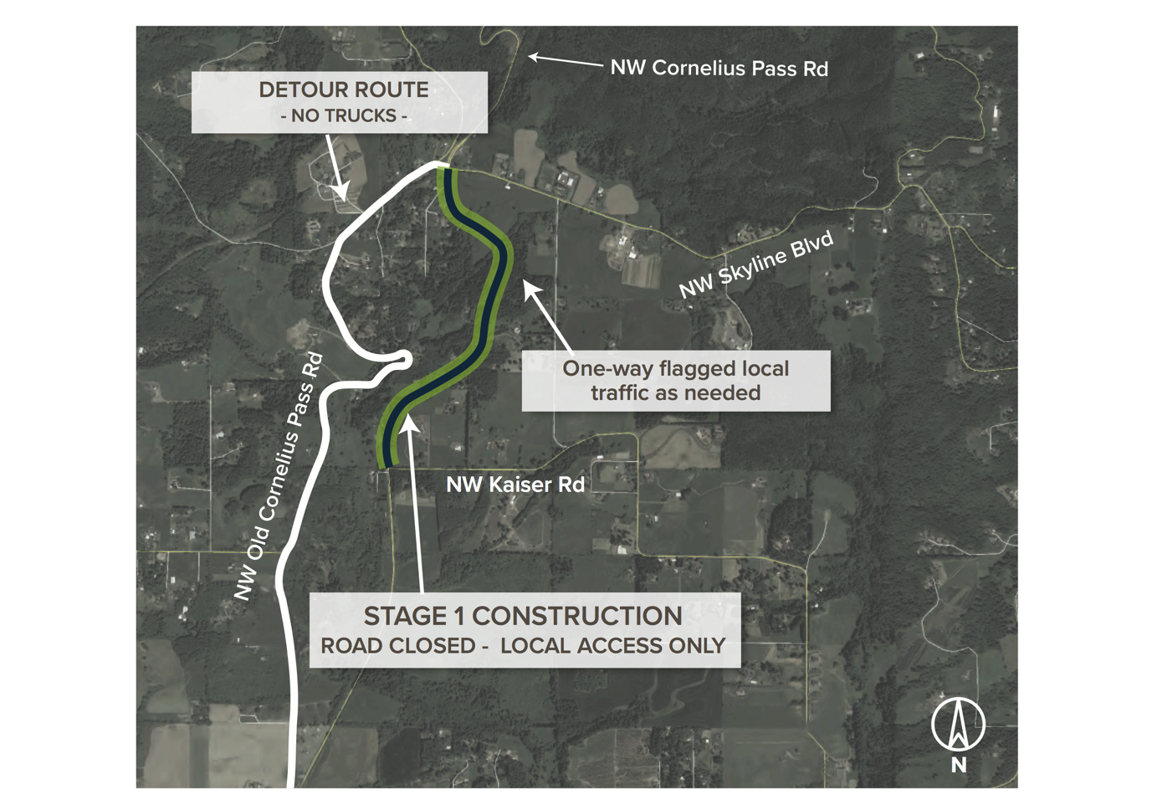
NW CORNELIUS PASS ROAD // Stage 1 Traffic Plan

Slide 19
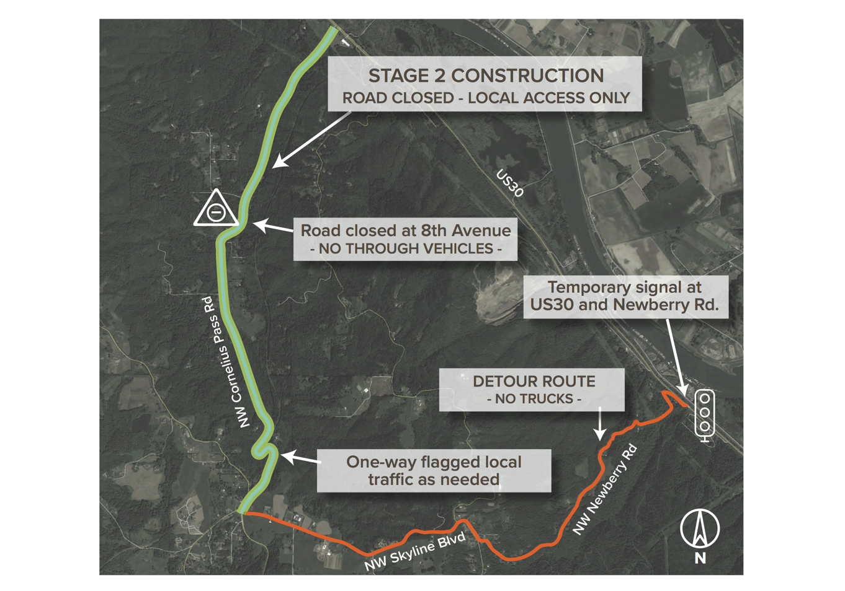
NW CORNELIUS PASS ROAD // Stage 2 Traffic Plan

Slide 20
NW CORNELIUS PASS ROAD // Next Steps
Detour Plan
Outreach to freight, Washington and Columbia counties
Pre-construction public meeting: Spring 2019
Other issues/actions needed?

Slide 21
NW Cornelius Pass Road Questions
For more information: Web: multco.us/cornpass Twitter: @MultCoRoads

