Slide 1

JEOPARDY!

Slide 2
Jeopardy
Sweat the small stuff | Reinvent the wheel | Treat others the way they want to be treated | Find common ground | Lead the way | Get involved
100 | 100 | 100 | 100 | 100 | 100
200 | 200 | 200 | 200 | 200 | 200
300 | 300 | 300 | 300 | 300 | 300
400 | 400 | 400 | 400 | 400 | 400

Slide 3
A _______ is often contagious
Answer

Slide 4

Smile!
Categories

Slide 5
You can make someone’s day by saying this
Answer

Slide 6

Categories

Slide 7
After you receive something from someone what should you always say?
Answer

Slide 8
Categories

Slide 9
When someone is telling a story they often feel respected when you do this
Answer

Slide 10
Listen
Categories

Slide 11
The opposite of be closed
Be ______
Answer

Slide 12

Categories

Slide 13
The opposite of being single is this word
So be a ____________ builder
Answer

Slide 14
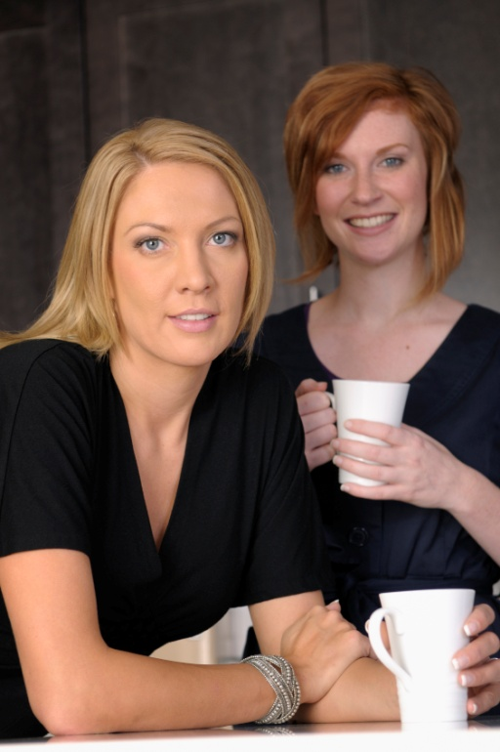
Be a relationship builder
Categories

Slide 15
There is no “I” in this word so you must join the ______
Answer

Slide 16
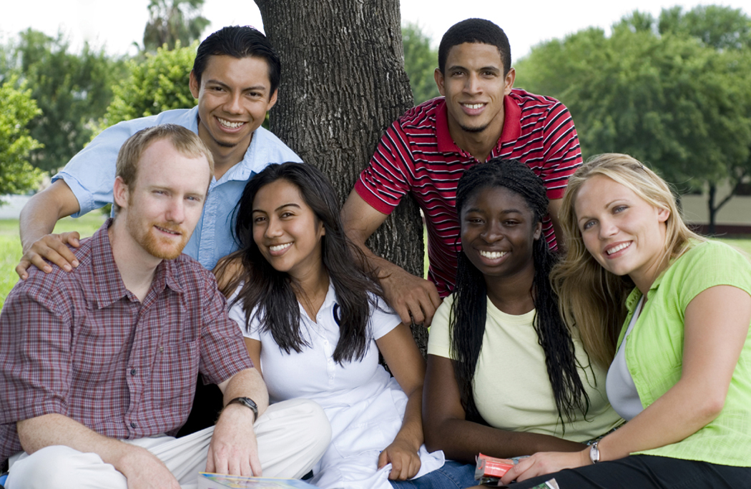
Join the team
Categories

Slide 17
Adapting to changing conditions when necessary is known as being _________
*Hint: Another word for bendable
Answer

Slide 18
Being flexible
Categories

Slide 19
It’s okay to____ when you’re not sure
Answer

Slide 20
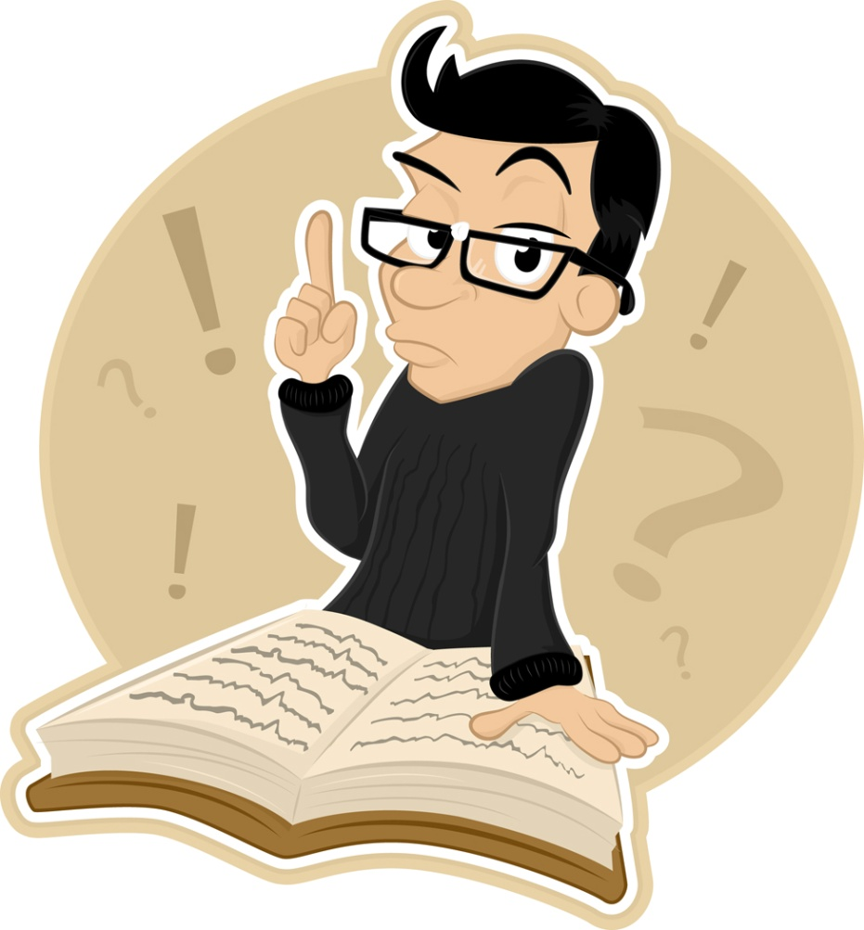
Ask
Categories

Slide 21
Starting a conversation with someone new is known as breaking ___ ___
Answer

Slide 22
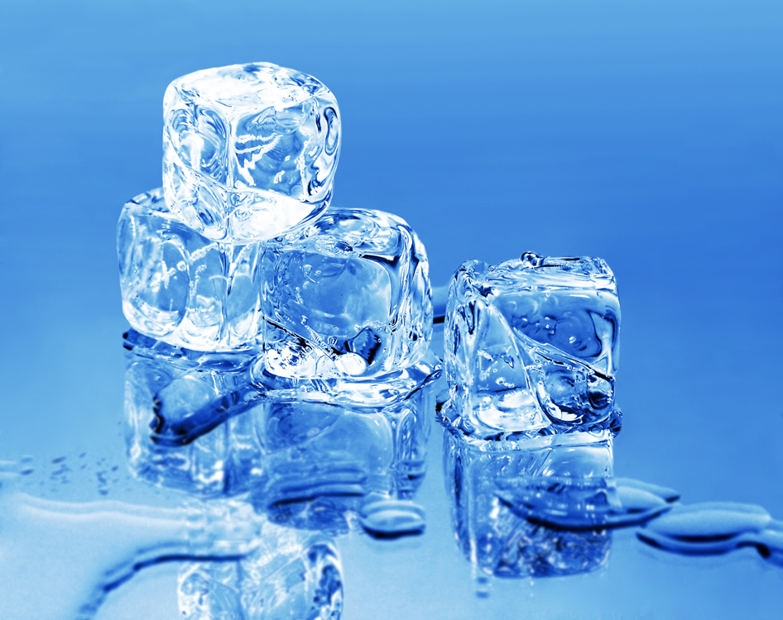
Breaking the ice
Categories

Slide 23
Having the capacity to agree/disagree and work towards a common cause is known as demonstrating ___________ _____________
Answer

Slide 24
Demonstrating mutual respect
Categories

Slide 25
Having the ability to work and interact effectively with those who are different from myself demonstrates being
Answer

Slide 26

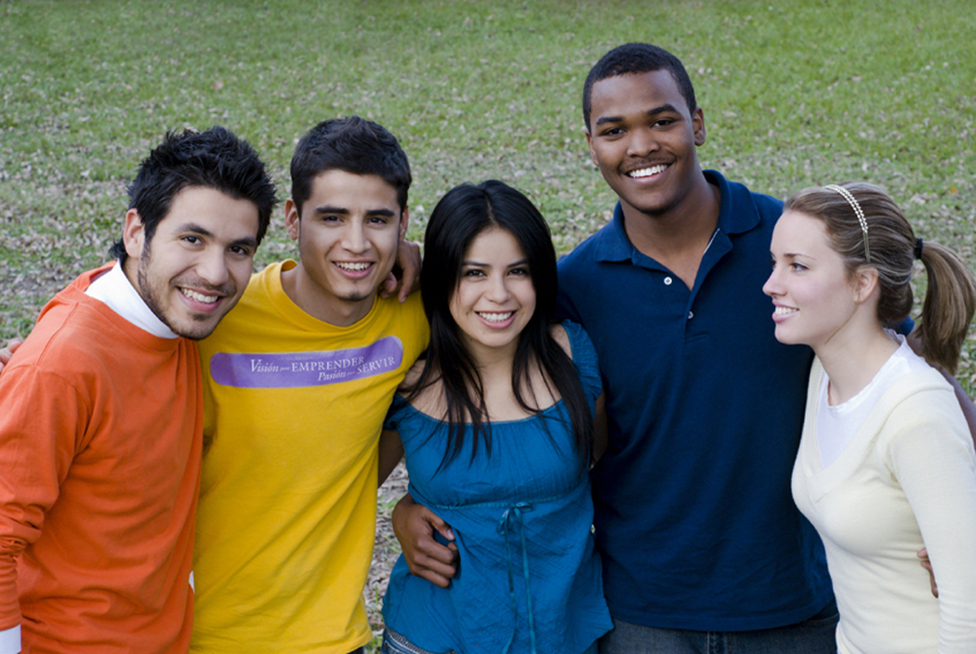
Culturally competent
Categories

Slide 27
Seek under_________
Answer

Slide 28
Seek understanding
Categories

Slide 29
Get someone else’s _____ of _____
Answer

Slide 30

Get someone else’s point of view
Categories

Slide 31
Share your _____of _____
Answer

Slide 32
Share your point of view
Categories

Slide 33
When you wait your turn, you are practicing
___________
Answer

Slide 34
Practicing patience
Categories

Slide 35
To communicate Aretha Franklin’s way you must communicate
____________
Answer

Slide 36

Communicate Respectfully
Categories

Slide 37
Remember, we all make __________
Answer

Slide 38

Remember we all make mistakes
Categories

Slide 39
This tip has the same name as the 1989 Spike Lee movie
Answer

Slide 40
Do the right thing
Categories

Slide 41
Unscramble the word
Your words & actions affect others so
Be istedecoarn
Answer

Slide 42
Be considerate
Categories

Slide 43
The opposite of taking an unhealthy step
Answer

Slide 44
Take a healthy step
Categories

Slide 45
The opposite of becoming a mentee
Answer

Slide 46
Become a mentor
Categories

Slide 47
Be a champion of ________& ________
Answer

Slide 48
Be a champion of dignity and respect
Categories

Slide 49
You can help others by _____a hand
Answer

Slide 50
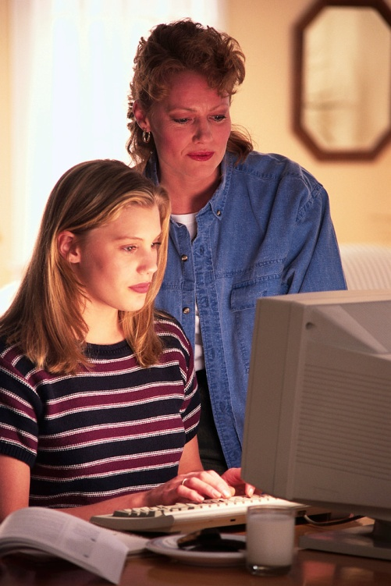
You can help others by lending a hand
Categories

Slide 51
Game over

