Slide 1
www.socialsecurity.gov
IT’S YOUR FUTURE,
IT’S YOUR BENEFIT

Slide 2
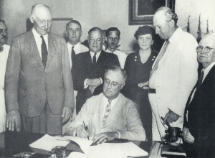
History of Social Security
1935 – Retirement Insurance
1939 – Survivors Insurance
1956 – Disability Insurance

Slide 3
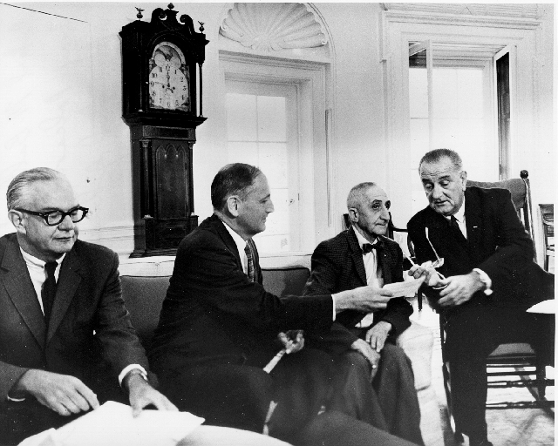
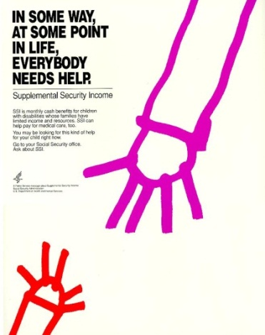
History of Social Security
1965 – Medicare Program
1974 – Supplemental Security Income
2003 – Medicare Part D
2010 - Patient Protection and Affordable Care Act

Slide 4
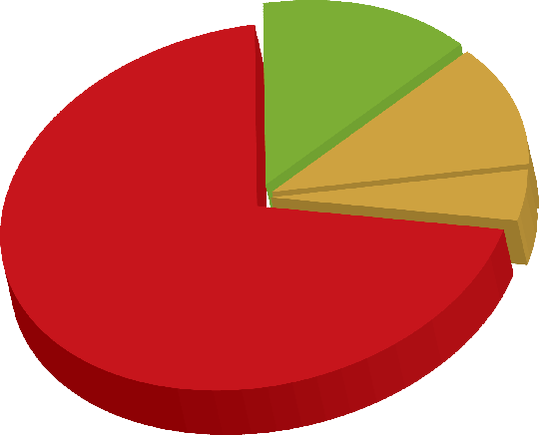
Who Gets Benefits from Social Security?
ABOUT 57 MILLION PEOPLE
8.8 million Disabled Workers, 2.1 million Dependents
4.3 million
Widows/ Widowers
1.9 million
Children of Deceased Workers
36.7 million Retired Workers
2.9 million Dependents

Slide 6
Social Security Trust Funds Will Be Able to Pay Only About 75 Cents for Each Dollar of Scheduled Benefits in 2033
Calendar Year

Slide 7
You Need to Work to Earn Social Security Credits
Each $1,200 in earnings
gives you one credit
You can earn a maximum
of 4 credits per year
Example: To earn 4 credits in 2014, you must earn at least $4,800. Earning 40 credits throughout your working life will qualify you for a retirement benefit.

Slide 8
How Are Benefits Determined?
Social Security benefits are based on earnings
Step 1 – Your wages are adjusted for inflation
Step 2 – Find the average of your highest 35 years
Step 3 – Result Average Indexed Monthly Earnings

Slide 9
What You Can Expect at Full Retirement Age
56%
56%
42%
41%
34%
35%

Slide 10
Full Retirement Age
Year of Birth Full Retirement Age
1937 or earlier 65
1938 65 & 2 months
1939 65 & 4 months
1940 65 & 6 months
1941 65 & 8 months
1942 65 & 10 months
1943 – 1954 66
1955 66 & 2 months
1956 66 & 4 months
1957 66 & 6 months
1958 66 & 8 months
1959 66 & 10 months
1960 or later 67

Slide 11
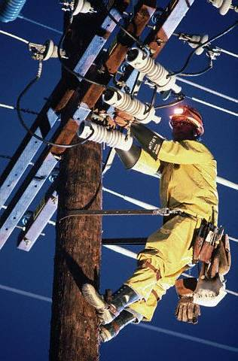
Deciding When To Retire
As early as age 62, (benefit will be
permanently reduced)
At Full Retirement Age (FRA)
(no benefit reduction—100%)
Delayed retirement (benefit
increased by 8% per year between
FRA and age 70)

Slide 12
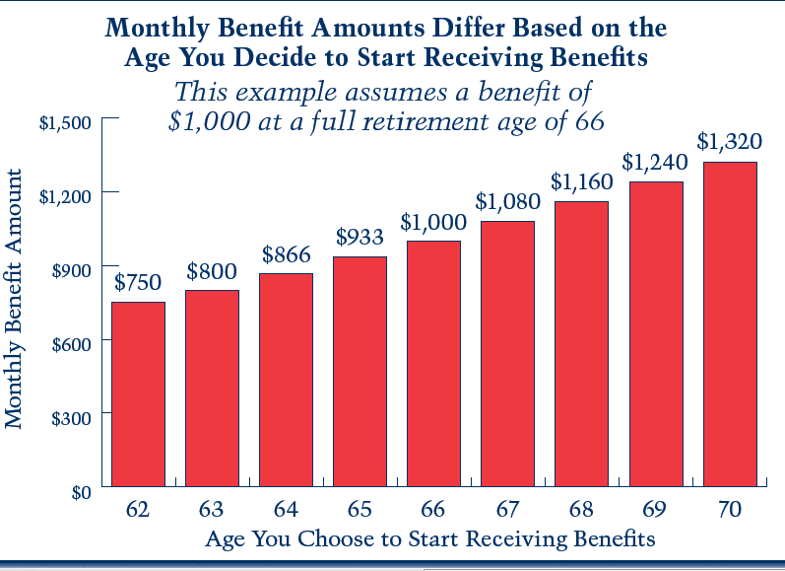
Notes:
12

Slide 13
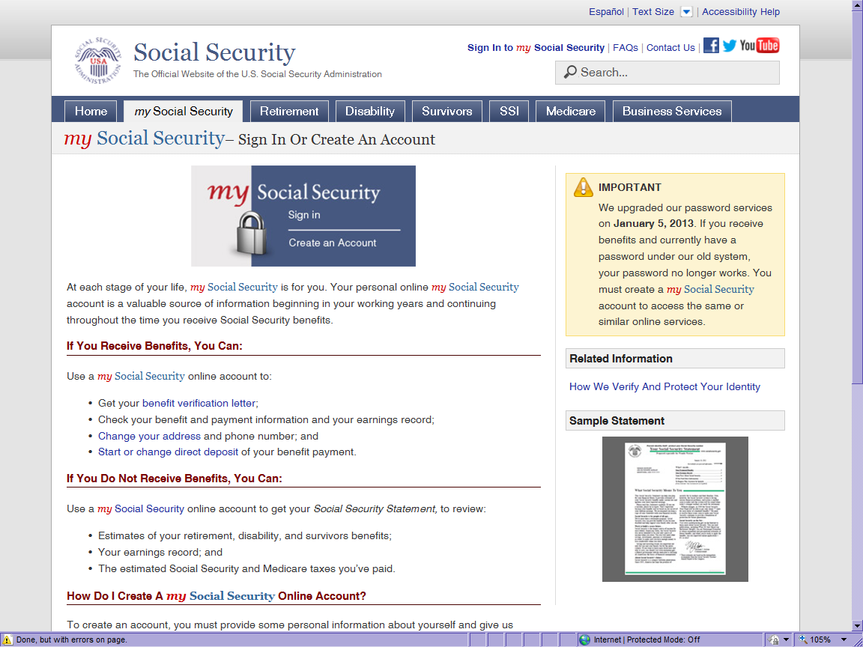
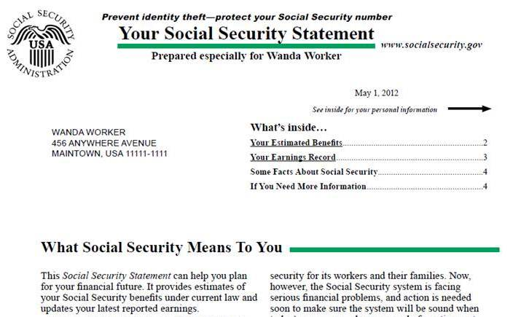
The Social Security Statement – Online!
http://www.socialsecurity.gov/myaccount/

Slide 14
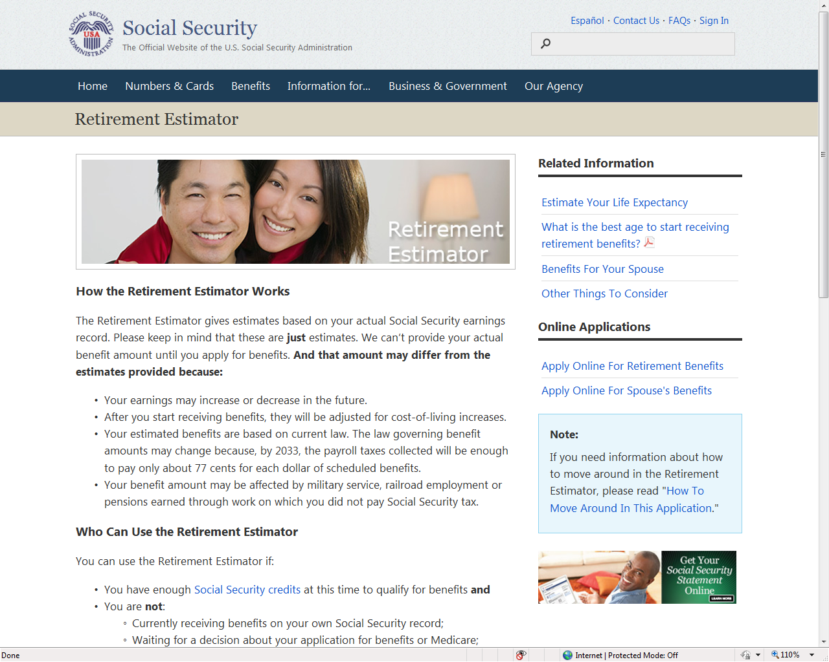
Use the New Retirement Estimator

Slide 15
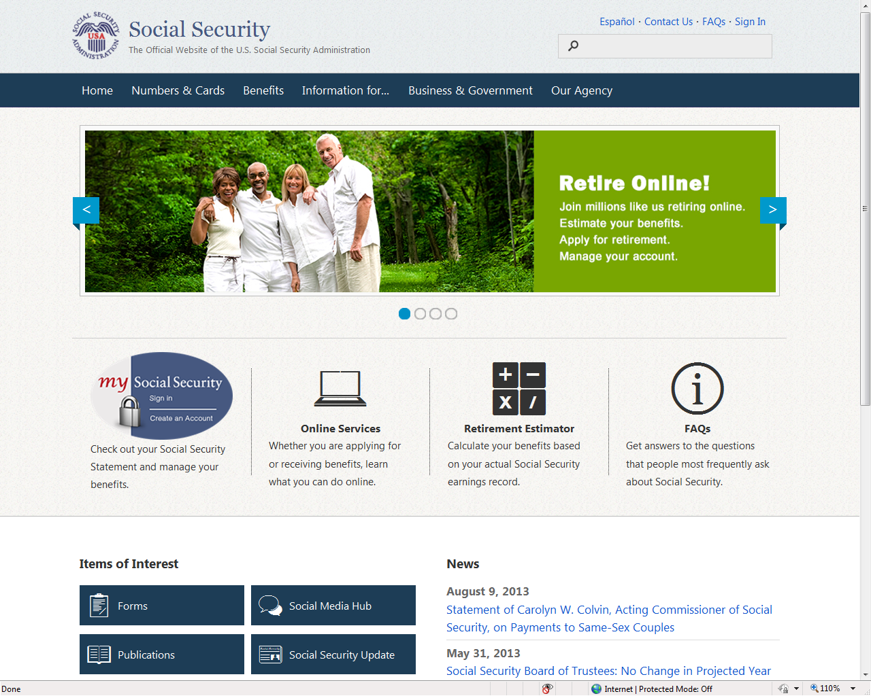
Apply Online for Retirement Benefits
www.socialsecurity.gov

Slide 16
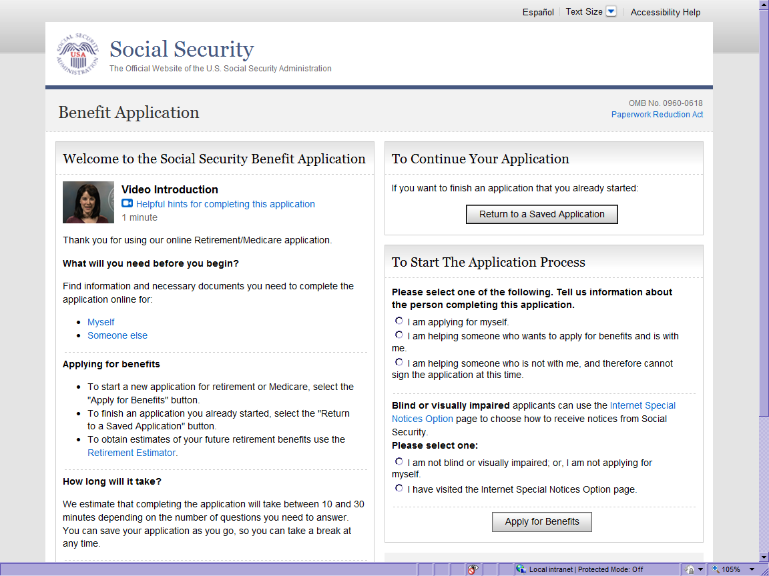
Apply Online for Retirement Benefits

Slide 17
You Can Work & Still Receive Benefits
You Can If You Make More,
If You Are Make Up To Some Benefits Will
Be Withheld
Under Full
Retirement Age $15,480/yr. ($1,290/mo.) $1 for $2
The Year Full
Retirement Age $41,400/yr. ($3,450/mo.) $1 for $3
Month of Full
Retirement Age & Above No Limit No Limit

Slide 18
Your Family Can Receive Benefits
Your Spouse
At age 62
At any age if caring for child under 16 or disabled
Divorced spouses may qualify:
marriage lasted at least 10 years
2 years since divorce
currently unmarried
Your Child
Not married under 18
(under 19 if still in high school)
Not married and disabled before age 22

Slide 19
Spouse’s Benefit Computation
Example: Spousal-only benefit
Mrs. Martinez, applies for Spouse’s benefits the month she is Full Retirement Age (FRA).
Mrs. Martinez does not have enough quarters under her own social security earnings record.
Her husband's Full Retirement Benefit Amount is $1422
$1422 divided by 2 = $711

Slide 20
Spouse’s Benefit Computation
Example: Combined own and spousal benefit
Mary’s Full Retirement Amount at FRA = $542
Her Spouse’s Full Retirement Amount at FRA= $1678
½ of husbands FRA = $1678 divide by 2 = $839
$839 Mary’s unreduced Spouse’s benefit
-$542 Mary’s own unreduced benefit
$297 Mary’s spousal payment
Mary’s spousal benefit, $297 is added to her own FRA benefit, $542. Total benefit = $839

Slide 21
Who Can Get Survivors Benefits?
Widow or Widower
Reduced benefits at age 60
Full benefit at age 50 if disabled
At any age if caring for child under 16 or disabled
Divorced spouses may qualify as long as the
marriage lasted 10 years & if remarried
after age 60 (50 if disabled)
Your Child
Not married under age 18 (under 19 if still in high school)
Not married and disabled before age 22

Slide 22
Social Security’s Disability Definition:
A medical condition preventing substantial
work for at least 12 months, or expected to
result in death. The determination also
considers age, education & work experience.
Fully & Currently Insured Tests
Must have paid into Social Security five out of last 10 years
For workers under age 31, less work is required

Slide 23
Supplemental Security Income (SSI)
Who Can Get SSI?
Age 65 or older
Blind—any age
Disabled—any age
Limited income
Limited resources
Noncitizens must meet special requirements to qualify

Slide 24
Who Can Get Medicare ?
65 & older
-or-
24 months after entitlement to Social Security disability benefits
-or-
Amyotrophic Lateral Sclerosis
-or-
Permanent kidney failure and receive maintenance dialysis or a kidney transplant
-or-
Exposure to Environmental Health Hazards

Slide 25
Medicare Has Four Parts
Part A - Hospital Insurance
Covers most inpatient hospital expenses
2014 deductible $1,216
Part B - Medical Insurance
Covers 80% doctor bills & other outpatient medical expenses after 1st $147 in approved charges
2014 standard monthly premium $104.90

Slide 26
Medicare Has Four Parts
Part C – Medicare Advantage Plans
Health plan options offered by Medicare-approved private insurance companies
When you join a Medicare advantage plan, you can get the benefits and services covered under Part A, Part B, and in most plans, Part D
Part D – Medicare Prescription Drug Coverage
Covers a major portion of your prescription drug costs
Your out-of-pocket costs—monthly premiums, annual deductible and prescription co-payments—will vary by plan
You enroll with a Medicare-approved prescription drug provider not Social Security

Slide 27
When Can I Sign Up for Medicare?
Medicare Enrollment Periods:
Initial –after 24 months Social Security DIB or at age 65
Special - if still working
General - January-March

Slide 28
Extra Help for
Medicare Prescription Drug Costs
Extra Help is available for beneficiaries with limited resources and income to help pay for the costs—monthly premiums, annual deductibles and prescription co-payments—related to a Medicare prescription drug plan. The Extra Help could be worth an average of $4,000 per year.

Slide 29
For More Medicare Information
1-800-MEDICARE
(1-800-633-4227)
TTY 1-877-486-2048
www.medicare.gov

Slide 30
www.SocialSecurity.gov
Estimate future benefits
Apply for Retirement & Disability
Apply for Extra Help
Request and view your Statement
Change Address
Replace Medicare Card
Request a Benefit Verification Letter
Start or Change Direct Deposit

