Slide 1
21-25 Area Plan Listening Sessions // Language Access
Welcome!
Set your language channel - Select the language channel to best support your participation.
2

Slide 2
2021 - 2025 Area Plan
Community Listening Session
Multnomah County
Aging, Disability, and Veterans Services Division
March 23 & 25, 2021
Via Zoom
Robyn Johnson, Planner

Slide 3
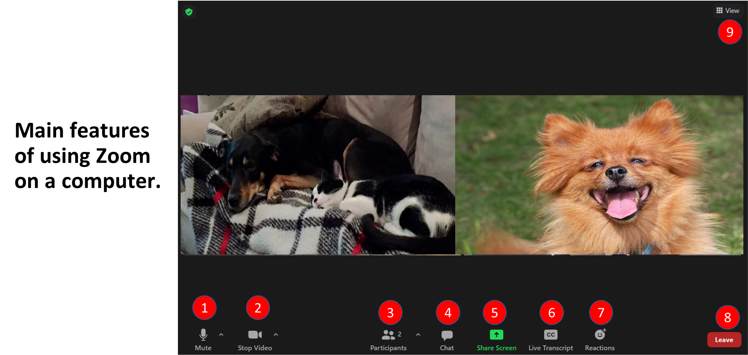
Zoom // Using Zoom on a computer
Basic functions

Slide 4
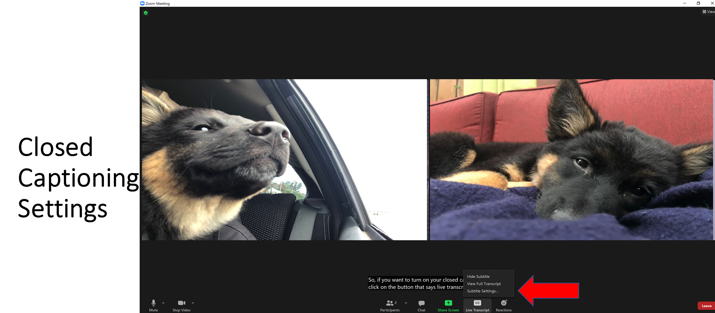
Zoom // Using Zoom on a computer
Closed captioning

Slide 5
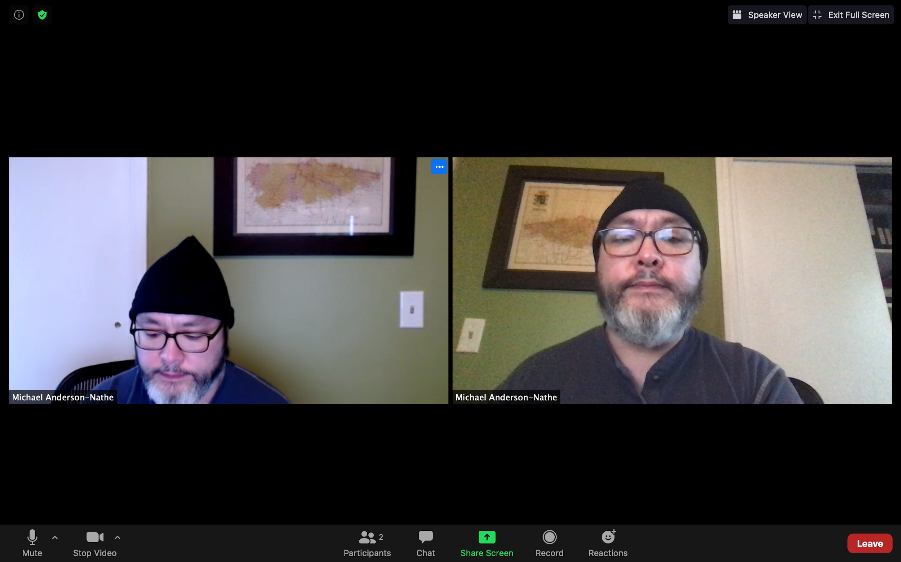
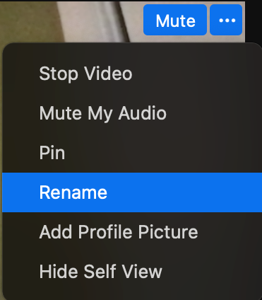
Zoom // Using Zoom on a computer
Renaming yourself, adding pronouns

Slide 6
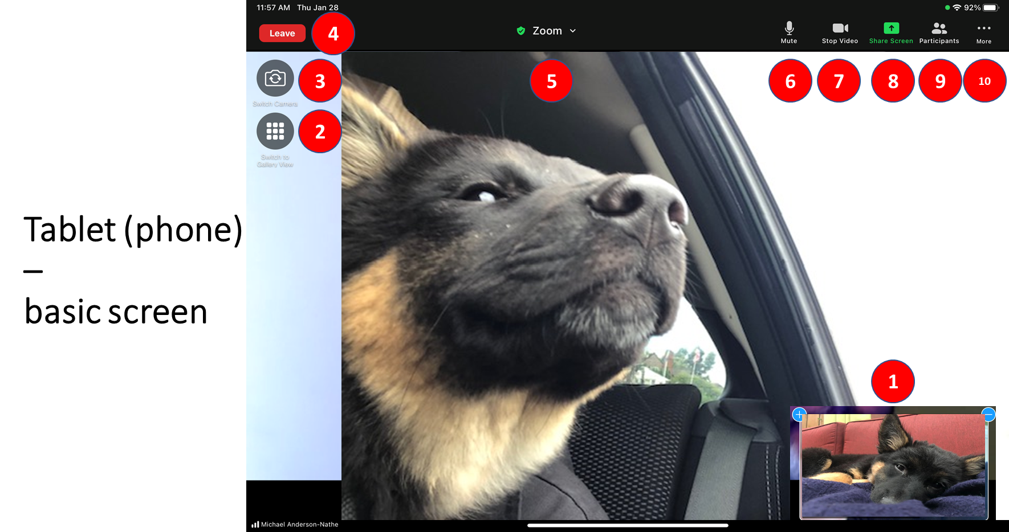
Zoom // Using Zoom on a tablet/phone
Basic functions
Notes:
Zoom on iPad:
This is where your image will show up – so you can see what your camera is showing
This is how you switch views: click on gallery link to see multiple people on your screen. Speaker view will how you the person who is talking
Switch Camera – this will flip between your front camera and your back camera. One showing you and the other showing what is behind your iPad
Leave – this is where you can exit the meeting or where you will exit a breakout room
Zoom – click on this and it will show you the details of the meeting
Mute/unmute – click this button to mute or unmute yourself
Video – click this to turn your camera on or off
Share screen – click this to share your screen
Participants – click this to see who all is in the meeting
More – click this for additional options: see next few slides.

Slide 7
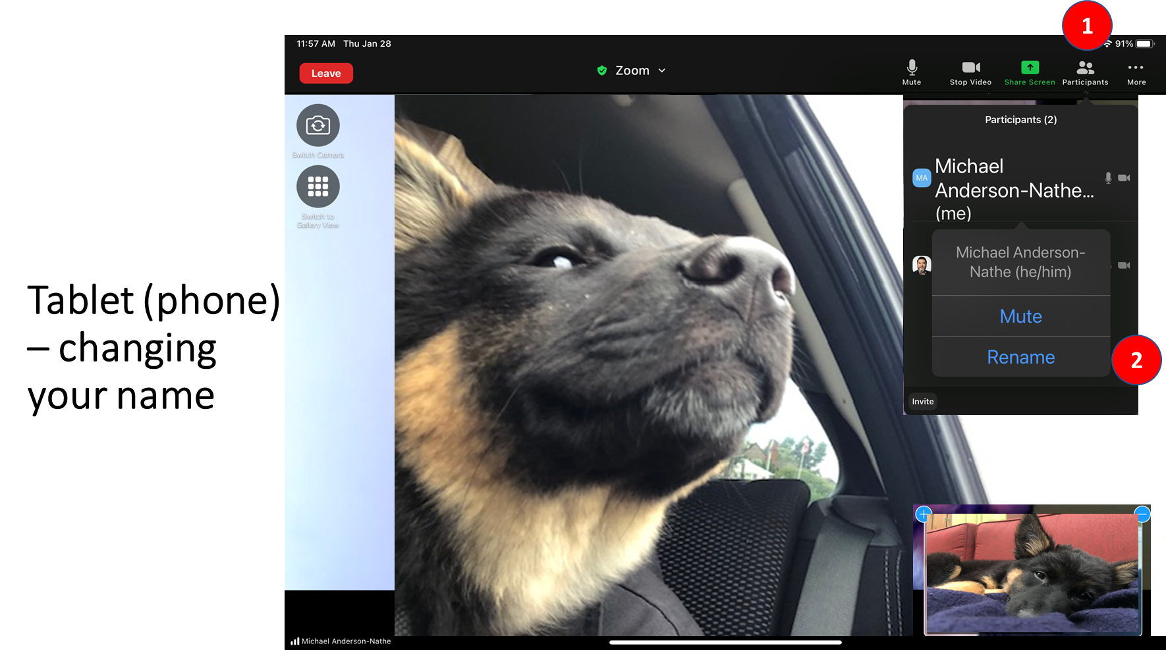
Zoom // Using Zoom on a tablet/phone
Renaming yourself
Notes:
1: click on participants
2. Click on rename

Slide 8
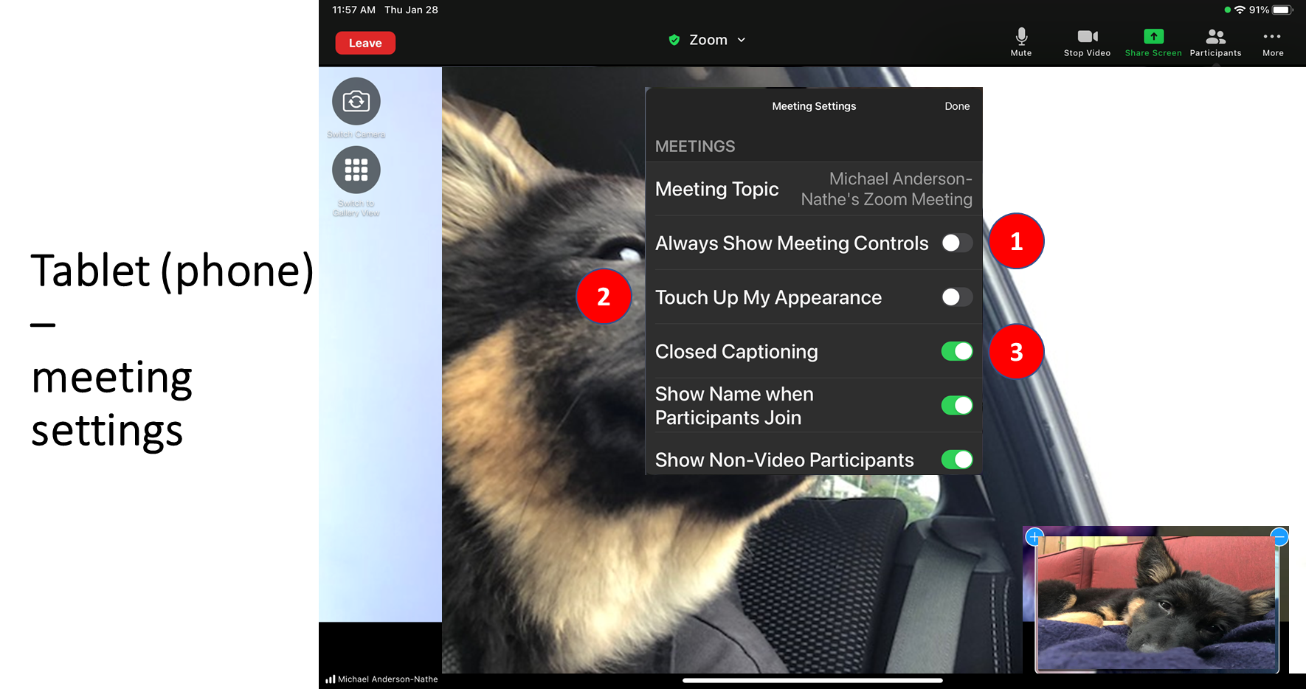
Zoom // Using Zoom on a tablet/phone
Closed captioning
Notes:
More button, Meeting Settings:
Toggle this until it shows green (slide it to the right) if you want your meeting controls (menu or icons) to always stay on your screen (the default setting is for them to fade away and only come back when you touch your screen)
Touch up my appearance does a little lighting trick to “enhance your appearance” but please know you are beautiful the way you are
Closed captioning – toggle this to the right or until it shows green to turn on closed captioning – or slide left to turn it off

Slide 9
21-25 Area Plan Listening Sessions // Agenda
Opening
Land Acknowledgement
Welcomes
Housekeeping
Introductions
Name, pronouns, Why did you join the meeting tonight?
Area Plan Overview
Public Comment
Elders, community members, community partners will be prioritized
Sign up by putting your name in the chat
Three (3) mins per person
2

Slide 10
21-25 Area Plan Listening Sessions // Opening
Housekeeping
Interpretation channel set!
Keep yourself on mute
Camera open/closed
2

Slide 11
Welcome // Introductions
Please share
Your name
Your pronouns
Why you joined today’s meeting?
Notes:
Show at the start of introduction section of meeting so folks can follow the instructions

Slide 12
21-25 Area Plan Listening Sessions // Area Plan Overview
Area Plan Overview

Slide 13
21-25 Area Plan // Area Plan Overview
Aging, Disability, & Veterans Services Division (ADVSD) has three overarching responsibilities:
1) Advocate for all older adults within its planning and service area (PSA);
2) Identify the needs of older adults in its PSA and create a multi-year (4-year) plan known as the Area Plan. The Area Plan outlines comprehensive, coordinated, and community-based services that meet the identified needs;
3) Administer Older Americans Act (OAA) funds and other funds available to implement the Area Plan. ADVSD administers the funds largely through contracts with local service providers that offer these services at the community level.

Slide 14
21-25 Area Plan // Area Plan Overview
Area Plans
Area Agency on Aging requirement per Older Americans Act
Focus areas and format determined by the State of Oregon - Community Services and Supports Unit
Describes local region, needs and services
The next plan will be in action July 2021 - June 30, 2025.
Updated annually

Slide 15
21-25 Area Plan // Needs Assessment Overview
Overview
Aging Services Advisory Council and Disability Services Advisory Council served as the steering committee for the Area Plan and Needs Assessment.
Provided input on the approach, focus populations, additional areas, and data collection tools.
COVID-19 Impacts

Slide 16
21-25 Area Plan // Needs Assessment Overview
Overview
Online survey
Community interviews
Population data and other research

Slide 17
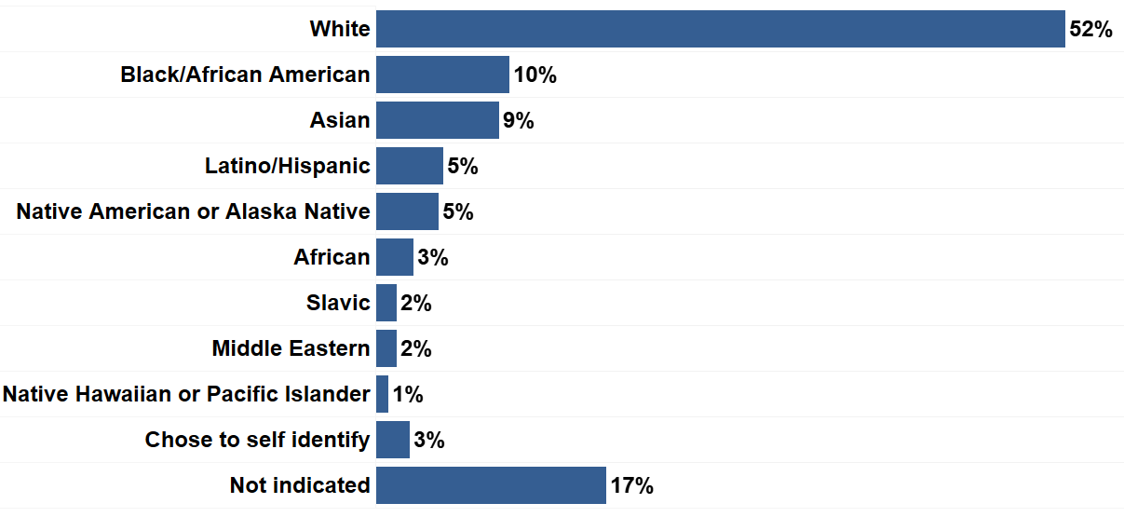
21-25 Area Plan // Survey Participants by Race/ Ethnicity
Total Number of Responses: 1,392
*Total % exceeds 100% as respondents were able to select more than one race or origin.
Notes:
Respondents identifying as multiracial or listed multiple race/origins
Respondents not identifying with a race/origin based label
“human”, “she/her”, or “disabled”

Slide 18
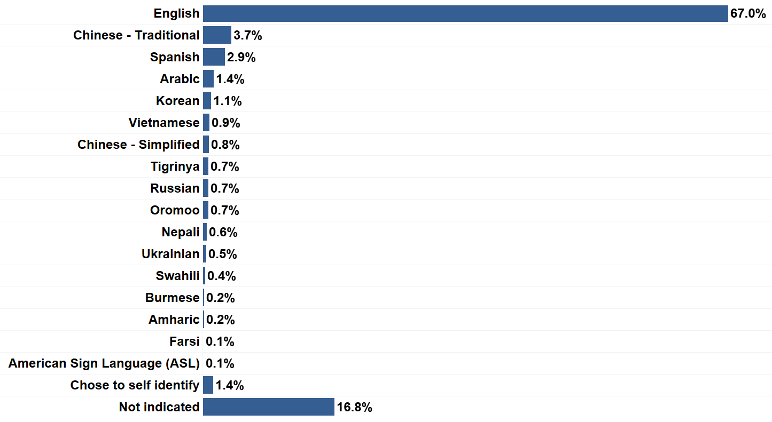
21-25 Area Plan // Survey Participants by Language
Total Number of Responses: 1,392

Slide 19
21-24 Area Plan // Needs Assessment Background
Response Rate from Priority Populations:
Out of those who responded to each question
40%¹ People with disabilities (n= 460 / 1145)
23%² People with addiction or mental health diagnosis (n= 259 / 1141)
12%³ Black/African Americans (n= 140 / 1153)
12%⁴ Veterans or people with military service (n= 140 / 1156)
6%⁵ Native Americans and Alaska Natives (n= 66 / 1153)
5%⁶ People with history of incarceration or felony (n= 58 / 1148)
3%⁷ People who are Transgender and Nonbinary (n= 34 / 1140)
1%⁸ Native Hawaiian or Pacific Islanders (n= 14 / 1153)
3%⁹ People who are unhoused (n= 37 / 1176)
% of total responses: ¹33% ²19% ³10% ⁴10% ⁵5% ⁶4% ⁷2% ⁸1% ⁹3%
Notes:
Caveat:

Slide 20
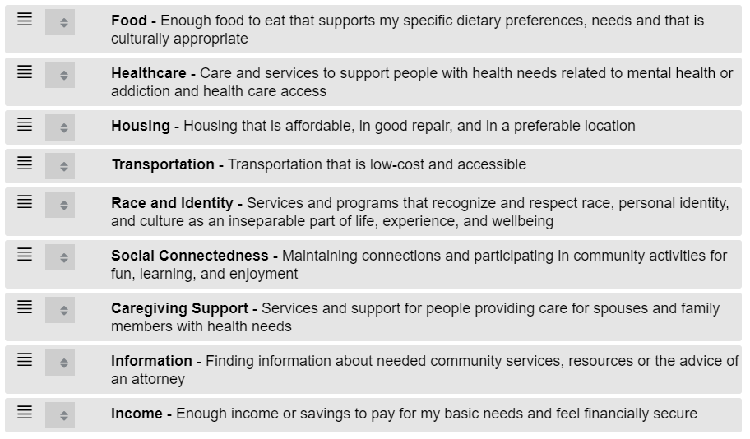
21-24 Area Plan // Needs Ranking
Notes:
Income, housing, food, and healthcare were resoundingly ranked among the top four needs among all respondents to the survey. Among the top four needs, food access is the only need directly addressed by ADVSD through Older American’s Act programs and services.
Transportation remains a high need among the overall population of respondents.

Slide 21
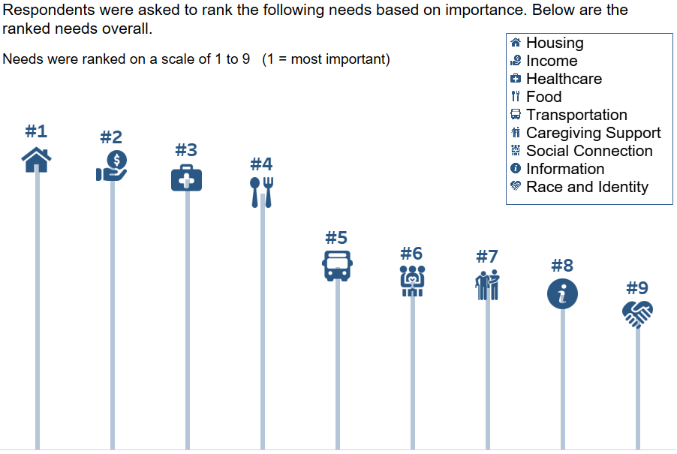
21-25 Area Plan // Needs Ranking
Total # of responses to this question: 1,288
Notes:
All needs

Slide 22
21-24 Area Plan // Population Estimate 60+ by Race/ Origin
Characteristic | Population Estimate | Percent of 60+ Population
African | 973 | 0.64%
American Indian or Alaska Native | 2,419 | 1.59%
Asian | 10,615 | 6.99%
Black / African-American | 7,683 | 5.06%
Decline to State | 941 | 0.62%
Latino/Latinx/Hispanic | 4,978 | 3.28%
Middle Eastern | 966 | 0.64%
Native Hawaiian or Pacific Islander | 732 | 0.48%
Slavic | 5,011 | 3.30%
White | 132,026 | 86.96%
Total 60+ Population: 151,827

Slide 23
21-24 Area Plan // Population Estimate 60+ with a disability
Characteristic | Population Estimate | Percent of 60+ Population
Persons 18-59 | 48,767 | -
Persons 60+ | 47,865 | 31.53%
African | 154 | 0.10%
American Indian or Alaska Native | 1,436 | 0.95%
Asian | 3,458 | 2.28%
Black or African American | 2,932 | 1.93%
Latino/Latinx/Hispanic | 1,526 | 1.01%
Middle Eastern | 419 | 0.28%
Native Hawaiian or Pacific Islander | 347 | 0.23%
Slavic | 1,597 | 1.05%
White | 40,448 | 26.64%

Slide 24
21-25 Area Plan // Definitions
Pause for comments.
CuCu

Slide 25
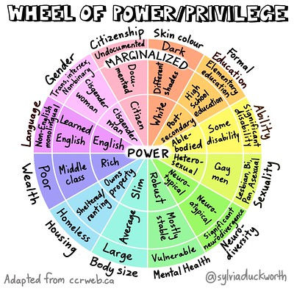
21-25 Area Plan // Definitions
Marginalization means to be excluded from full participation in community and systems based on relationship to White, male, cisgender, English-speaking, heterosexual power structures.

Slide 26
21-25 Area Plan // Definitions
Marginalization can happen based on any identity or life circumstance or intersection of identities or life circumstance. Multnomah County is committed to Leading with Race in our approaches to addressing systems of oppression.

Slide 27
21-25 Area Plan // Definitions
Culturally specific - Informed by a specific community’s language, cultural constructs, institutions, experiences with racism and intergenerational trauma, and social mores to create an environment of belonging and safety in which individuals can thrive.
These services and programs are designed and continually shaped by community input to exist without the barriers present in dominant culture services or organizations.
Culturally specific services aim to improve overall community well-being and to address root causes.
CuCu

Slide 28
21-25 Area Plan // Definitions
Culturally responsive - The ability to respond to the issues of diverse communities.
Cultural responsiveness:
is building knowledge and capacity at systemic, organizational, professional and individual levels.
services are respectful of and relevant to the beliefs, practices, culture and linguistic needs of diverse populations and communities whose members identify as having particular cultural or linguistic affiliations because of their place of birth, ancestry or ethnic origin, preferred language or language spoken at home.
CuCu

Slide 29
21-25 Area Plan // Definitions
Pause for comments.
CuCu

Slide 30
21-25 Area Plan // Goals and Objectives
Goals and Objectives
CuCu

Slide 31
21-25 Area Plan // Goals and Objectives
Native American Elders
Serve Native American elders living in urban areas by supporting agencies that serve them.
The priorities of Native elders, related to their care and well-being, as well as that of their families, tribes, and tribal communities, are understood and prioritized by ADVSD.
More Native American elders utilize programs and services funded by ADVSD.

Slide 32
21-25 Area Plan // Goals and Objectives
The Care of Transgender & Nonbinary Older Adults & Two-Spirit Elders
Transgender and Nonbinary older adults and Two Sprit elders are well-connected to a caring community and use services and programs to support their well-being, independence, and self-determination as they age.
Increase the number of Transgender and Nonbinary older adults and Two Sprit elders seeking and accessing services from ADVSD and the aging services network.
Transgender and Nonbinary older adults and Two Spirit elders lead a community-centered process on access to services for older adults and people with disabilities.
Transgender and Nonbinary older adults and Two Spirit elders identify, prioritize, and make recommendations related to their needs related to home and community-based services.

Slide 33
21-25 Area Plan // Goals and Objectives
Aging & Disability Resource Connection (ADRC) and Information & Assistance (I&A)
Older adults, people with disabilities, and their caregivers recognize and utilize the ADRC as a tool for accessing information, resources, and services.
Increase utilization of the ADRC to decrease isolation and barriers to access experienced by physically, culturally, or linguistically isolated older adults.
Older adults, people with disabilities, their families and caregivers are well connected to resources and services through the information, referral, and assistance network.
Community partners and entities with community connections to historically and systemically marginalized identities know about and use the ADRC and the I & A network.

Slide 34
21-25 Area Plan // Goals and Objectives
Nutrition Services
Older adults will have enough food that is affordable, culturally appropriate, and that supports their health.
Increase utilization of federally funded nutrition programs, such as the Supplemental Nutrition Assistance Program or SNAP, by older adults.
Provide access to low or no-cost food in a variety of settings to meet the diverse needs of older adults.
Support community-led efforts to increase food access for older adults and people with disabilities, prioritizing people with historically and systemically marginalized identities.
Food access and nutrition resources are prioritized for older adults with identities that are historically and systemically marginalized.

Slide 35
21-25 Area Plan // Goals and Objectives
Transportation
Older adults understand transportation resources available to them.
Transportation resources are distributed to older adults with the highest need, prioritizing historically and systemically marginalized community members.
Transportation resources are coordinated across the older adult service system.
Transportation resources prioritize community preference and comply with covid safety protocols.
Transportation-related needs and preferences of older adults related to ongoing service provision and COVID-19 are understood and addressed by ADVSD.

Slide 36
21-25 Area Plan // Goals and Objectives
Family Caregivers
Promote family caregiver services and resources to family and informal caregivers prioritizing services to historically and systemically marginalized communities.
Increase participation by family and informal caregivers, prioritizing services to caregivers from historically and systemically marginalized communities.
Family caregivers receive person-centered and culturally specific services.
Increase in the number of family caregivers that receive services that are culturally relevant and responsive.

Slide 37
21-25 Area Plan // Goals and Objectives
Health Promotion
Older adults and people with disabilities are strongly connected to their community in support of their well-being and physical and mental health.
Increase availability of health promotion classes and activities for older adults through partnership and network development.
Older adults actively participate in health promotion activities to address chronic conditions, improve health, and decrease isolation.
More older adults participate in activities to support their health and well-being.

Slide 38
21-25 Area Plan // Goals and Objectives
Legal Services & Elder Rights Protection
Older adults access legal consultation through the Senior Law Project with an emphasis on expanded access for historically and systemically marginalized communities.
Legal assistance is provided to an average of 900 older adults each year.
Increase capacity to serve historically and systemically marginalized elders through the Senior Law Project.
Older adults have community-based resources for peer support and self-advocacy.
Develop an outreach campaign to promote existing self-advocacy resources and peer networks.

Slide 39
21-25 Area Plan // Ways to Comment
Provide public comment today!
Email: areaplan@multco.us
Call: (503) 988-3646
Written: Area Plan, Multnomah County ADVSD, 209 SW 4th Ave Ste 510, Portland OR 97204

Slide 40
21-25 Area Plan Listening Sessions // Public Comment
Public Comment
Elders, community members, community partners will be prioritized
Sign up by putting your name in the chat
When you’re called on you’ll have three (3) mins to provide your comments
2

Slide 41
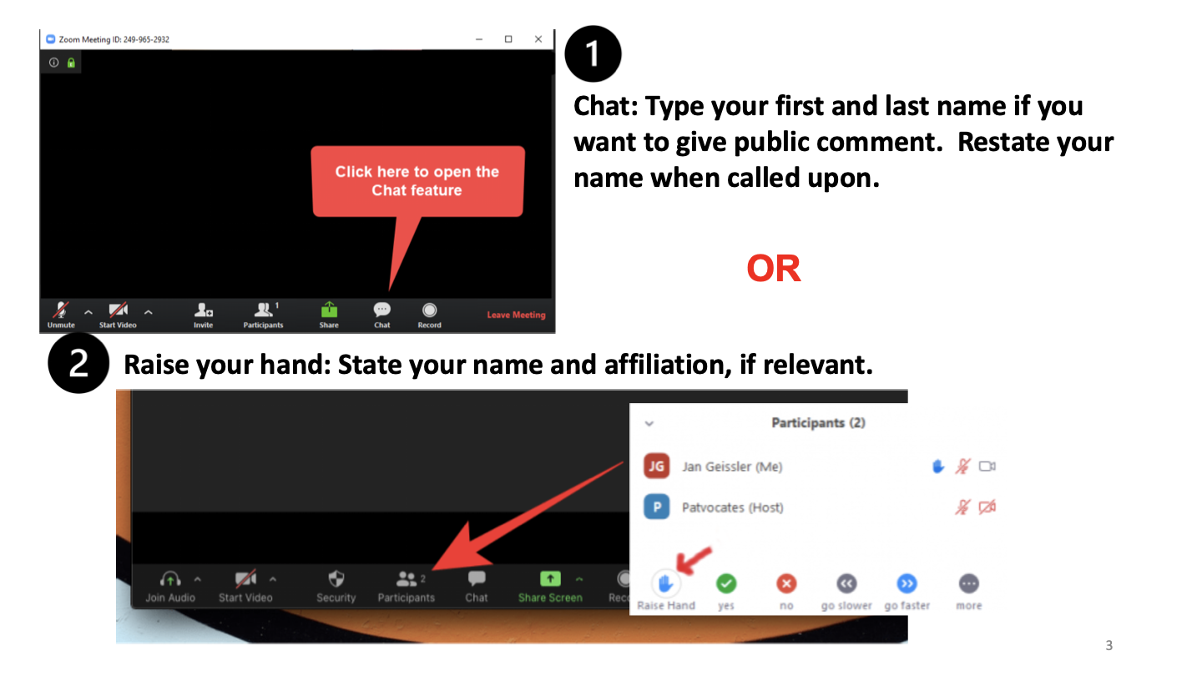
21-25 Area Plan Listening Sessions // Public Comment
2

Slide 42
21-25 Area Plan // Definitions
Comments.

Slide 43
21-25 Area Plan // Next Steps
Community Listening Sessions March 23rd & 25th
Approval by the ASAC and DSAC March 30th & 31st
Adoption by the Board of County Commissioners on April 1st
Submit draft plan to the State of Oregon on April 2nd.

Slide 44
21-25 Area Plan // Closing
Thank you !
https://multco.us/ads

