Slide 1

Universal Goal: Contribute to Climate Justice
Climate Justice Plan
Every community member has the opportunity to contribute to climate justice in Multnomah County.
Community Forum #5
November 13, 2025

Slide 2
Purpose of Today's Meeting
Review Metrics: Ensure the metrics measure progress toward the goal and that one or metrics can be disaggregated to measure for disparate impacts.
Review Strategies: Ensure strategies are S.M.A.R.T (Specific, Measurable, Attainable, Relevant, Timely) and effectively balance recommendations.
Deepen Collaboration: Ensure the process of the Climate Justice Plan is inclusive of diverse perspectives
Gather Technical Input: Gather specific and technical feedback on proposed metrics and strategies.

Slide 3
Core Values
Climate change is real and driven by fossil fuel combustion.
Climate change impacts public health and well-being.
Climate justice links the climate crisis to social, racial, and environmental equity.
We must center frontline communities—those most impacted—to drive efficient and equitable solutions.

Slide 4
Shared Agreements
Tell us your name and affiliation (if any) when talking
Respect each other
Listen to understand, not to respond. Don’t interrupt.
Make space, take space/share airtime. Balance participation in the room.
Expect and accept discomfort (and joy!)
Practice community and self-care
“Bike rack” to capture off topic or detailed questions or ideas that arise
Never a failure, always a lesson
Others?
Notes:
-Respect each other. Practice deep listening and continuous learning.
-Listen to understand, not to respond. Don’t interrupt while someone is talking, let them finish speaking their sentences and sharing their thoughts.
-Make space, take space. Balance participation in the room. In dialogue it can be easy for those participants who feel most comfortable speaking up in large groups to dominate the conversation and for those who are more introverted to stay quiet. However, in order for everyone to grow and learn, it is important to balance who is sharing.
-Confidentiality. Take the lessons, leave the details. We expect everyone to respect privacy and confidentiality. Please do not share personal stories, private and confidential information, and other information you hear/experience/witness that folks did not consent to share outside of this space. You may not share this information.
-Expect and accept discomfort. View discomfort as an indicator that learning is happening and recognize that new learning can also lead to feelings of pride, understanding, growth, and joy.
-It’s okay to fun!
-Practice community and self-care.

Slide 5
Where this came from where we are going
Laying the Foundation - Vision & Values (2020 - 2023)
  Climate Justice Earth Day Convening
  Environmental Justice (EJ) Indicators Storytelling Zine
  Vision & Values Framework: Climate Justice Framework
Phase 1 - Frontline Community Engagement (2023 - 2025)
  Launched Steering Committee
  Prioritized non-transactional conversations with communities typically excluded from government planning
Phase 2 - Public Comment Period (2025)
  Significant Feedback Gathered (webinars, survey responses, written comment)
Phase 3 - Refinement & Finalization (2025-2026)
  Community Forums on each Universal Goal
  Collaboration to finalize a plan that is both technically effective and equitably centered, serving as a comprehensive government action plan and community toolkit.

Slide 6
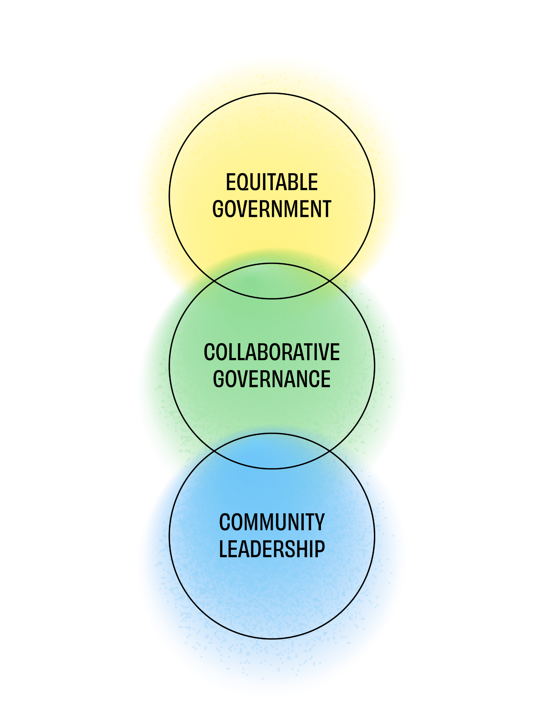
What makes the draft CJP different?
Creates a vision for climate justice that is reflected in universal goals.
Provides a framework for aligning efforts toward climate justice over time.
Co-created toolkit with both community and government priorities.
Strategies prioritize the needs of most impacted communities.

Slide 7
Multnomah County’s existing work on this goal
EJ Resolution: Commitment to Centering Impacted Communities
Multnomah County Administers Elections
Advisory Committees and Board (Over 59)
  Advisory Committee for Sustainability and Innovation
  Multnomah County Youth Commission
  Multnomah County Public Health Advisory Board
Community Partnerships
  Racial and Ethnic Approaches to Community Health (REACH)
  Future Generations Collaborative
  Community Partnership and Capacity Building
  Traditional/Community health worker climate education

Slide 8
What we have heard so far
General feedback:
Comments stressed the importance of broad and continued community engagement during implementation
Comments supportive of strategies that increase transparency and accountability during implementation
Recommendations/Concerns:
Continue to prioritize engagement with frontline communities and recognize lived experience as technical expertise
Expand engagement and partnerships to be more inclusive of industries, trade unions, and other technical experts
Strengthen alignment with existing engagement efforts/pathways
Revise strategies to ensure they support community building and are feasible

Slide 9
Outcome Metrics
Purpose of the metrics (indicators)
Measure progress toward the goal
Basis for regular and recurring reporting
Understand disparate outcomes among demographic groups
Guiding questions
Do you have questions about these metrics?
Do these metrics look adequate in terms of measuring progress toward outcomes? Any adjustments you would offer?
What other metrics would you add? What is the source of data?

Slide 10
Strategies
Purpose of the strategies
Identify near term actions that the County can take
Identify community policy priorities
Guiding questions
Are there any strategies that you would modify?
Do the draft strategies align with county or community priorities as you see them?
Which strategy, from the ones that are listed, should be a priority for Multnomah County?
Are there any other strategies you would like to see in order to help achieve this goal?
Other considerations: cost, feasibility, and barriers

Slide 11
Submit Feedback & Next Steps
To ensure your feedback is considered for this goal, please provide your goal-specific comments within 14 days
Submit your goal specific comments via email to sustainability@multco.us
Invite staff to present or participate in a community discussion or workspace
Revised draft of the Climate Justice Plan in the early 2026
  The revised draft will be published online
  Staff will present the revised draft to the Board of County Commissioners in a work session
  Use feedback from the Board and CJP Steering Committee to finalize the draft
  Seek Board approval for the final plan

