Slide 1


Universal Goal: Green Infrastructure
Climate Justice Plan
Every community member is surrounded by and connected to nature, parks, and green infrastructure.
Community Forum #8
December 2, 2025

Slide 2
Purpose of Today's Meeting
Review Metrics: Ensure the metrics measure progress toward the goal and that one or metrics can be disaggregated to measure for disparate impacts.
Review Strategies: Ensure strategies are S.M.A.R.T (Specific, Measurable, Attainable, Relevant, Timely) and effectively balance recommendations.
Deepen Collaboration: Ensure the process of the Climate Justice Plan is inclusive of diverse perspectives
Gather Technical Input: Gather specific and technical feedback on proposed metrics and strategies.

Slide 3
Core Values
Climate change is real and driven by fossil fuel combustion.
Climate change impacts public health and well-being.
Climate justice links the climate crisis to social, racial, and environmental equity.
We must center frontline communities—those most impacted—to drive efficient and equitable solutions.

Slide 4
Shared Agreements
Tell us your name and affiliation (if any) when talking
Respect each other
Listen to understand, not to respond. Don’t interrupt.
Make space, take space/share airtime. Balance participation in the room.
Expect and accept discomfort (and joy!)
Practice community and self-care
“Bike rack” to capture off topic or detailed questions or ideas that arise
Never a failure, always a lesson
Others?

Slide 5
Where this came from where we are going
Laying the Foundation - Vision & Values (2020 - 2023)
  Climate Justice Earth Day Convening
  Environmental Justice (EJ) Indicators Storytelling Zine
  Vision & Values Framework: Climate Justice Framework
Phase 1 - Frontline Community Engagement (2023 - 2025)
  Launched Steering Committee
  Prioritized non-transactional conversations with communities typically excluded from government planning
Phase 2 - Public Comment Period (2025)
  Significant Feedback Gathered (webinars, survey responses, written comment)
Phase 3 - Refinement & Finalization (2025-2026)
  Community Forums on each Universal Goal
  Collaboration to finalize a plan that is both technically effective and equitably centered, serving as a comprehensive government action plan and community toolkit.

Slide 6
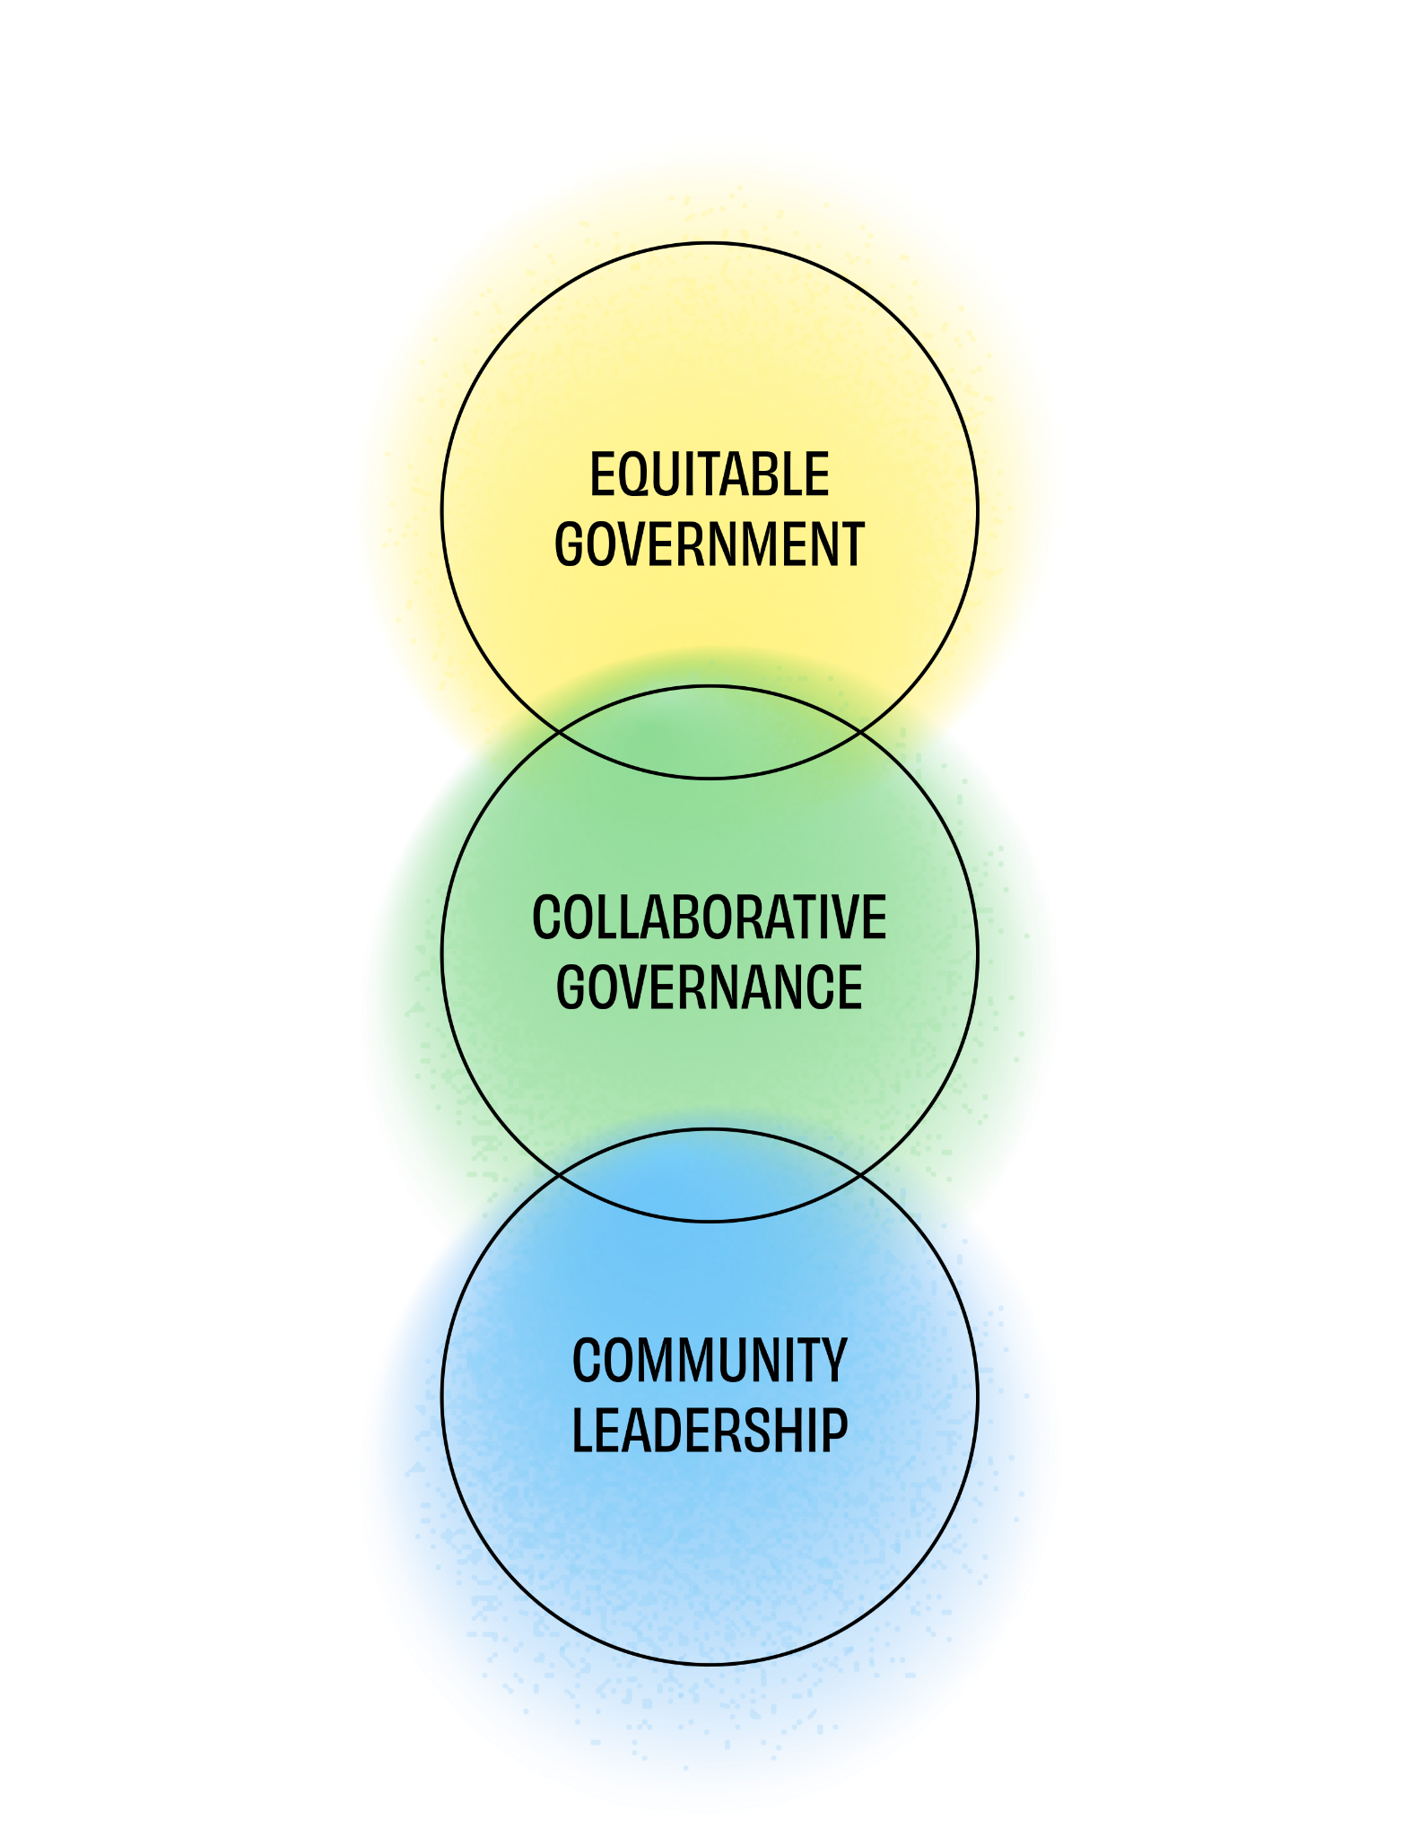
What makes the draft CJP different?
Creates a vision for climate justice that is reflected in universal goals.
Provides a framework for aligning efforts toward climate justice over time.
Co-created toolkit with both community and government priorities.
Strategies prioritize the needs of most impacted communities.

Slide 7
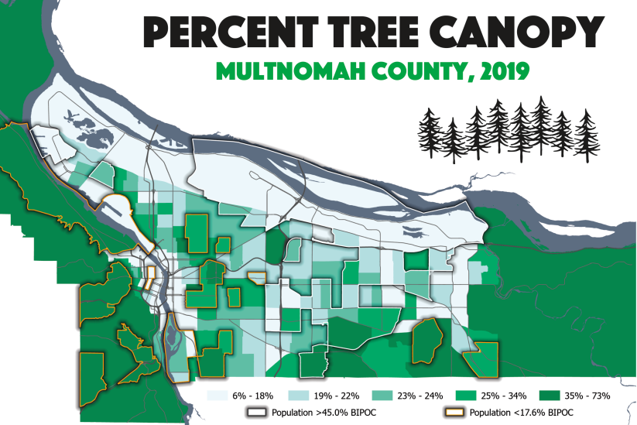
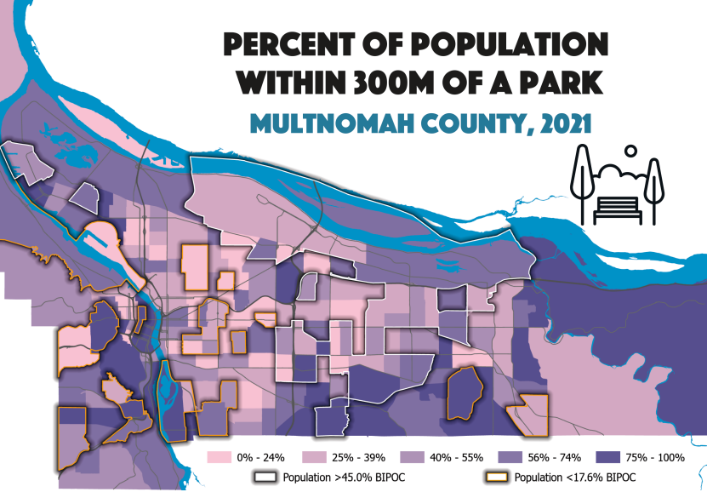
Multnomah County’s existing work on this goal
Environmental Justice Indicators Report
Green Gresham / Healthy Gresham
Vance Vision Project
East County Urban Public Right of Way

Slide 8
What we have heard so far
General feedback:
Comments were strongly supportive of the parks and nature goal
Comments were broadly supportive of the strategies, particularly the emphasis on addressing disparities in access to trees and nature
Many comments saw nature and greenspaces as giving a deep and personal connection to this region
Recommendations/Concerns:
Many comments emphasized that green spaces need to address multiple priorities at once, such as habitat, shade/cooling, food access and play.
Some comments noted the tension between housing and other developments and protecting nature/tree canopy.
Some comments noted the importance of transportation in addressing safe access to parks and urban heat island disparities

Slide 9
Outcome Metrics
Purpose of the metrics (indicators)
Measure progress toward the goal
Basis for regular and recurring reporting
Understand disparate outcomes among demographic groups
Guiding questions
Do you have questions about these metrics?
Do these metrics look adequate in terms of measuring progress toward outcomes? Any adjustments you would offer?
What other metrics would you add? What is the source of data?

Slide 10
Strategies
Purpose of the strategies
Identify near term actions that the County can take
Identify community policy priorities
Guiding questions
Are there any strategies that you would modify?
Do the draft strategies align with county or community priorities as you see them?
Which strategy, from the ones that are listed, should be a priority for Multnomah County?
Are there any other strategies you would like to see in order to help achieve this goal?
Other considerations: cost, feasibility, and barriers

Slide 11
Submit Feedback & Next Steps
To ensure your feedback is considered for this goal, please provide your goal-specific comments within 14 days
Submit your goal specific comments via email to sustainability@multco.us
Invite staff to present or participate in a community discussion or workspace
Revised draft of the Climate Justice Plan in the early 2026
  The revised draft will be published online
  Staff will present the revised draft to the Board of County Commissioners in a work session
  Use feedback from the Board and CJP Steering Committee to finalize the draft
  Seek Board approval for the final plan

