Slide 1

Universal Goal: Green Jobs
Climate Justice Plan
Every community member has access to wealth-building opportunities and green jobs.
Community Forum #6
November 18, 2025

Slide 2
Purpose of Today's Meeting
Review Strategies: Ensure strategies are S.M.A.R.T (Specific, Measurable, Attainable, Relevant, Timely) and effectively balance recommendations.
Review Metrics: Ensure the metrics are effective, measurable, and clearly aligned with key environmental justice indicators.
Deepen Collaboration: Ensure the process of the Climate Justice Plan is inclusive of diverse perspectives
Gather Technical Input: Gather specific and technical feedback on proposed metrics and strategies.

Slide 3
Core Values
Climate change is real and driven by fossil fuel combustion.
Climate change impacts public health and well-being.
Climate justice links the climate crisis to social, racial, and environmental equity.
We must center frontline communities—those most impacted—to drive efficient and equitable solutions.

Slide 4
Shared Agreements
Tell us your name and affiliation (if any) when talking
Respect each other
Listen to understand, not to respond. Don’t interrupt.
Make space, take space/share airtime. Balance participation in the room.
Expect and accept discomfort (and joy!)
Practice community and self-care
“Bike rack” to capture off topic or detailed questions or ideas that arise
Never a failure, always a lesson
Others?
Notes:
-Respect each other. Practice deep listening and continuous learning.
-Listen to understand, not to respond. Don’t interrupt while someone is talking, let them finish speaking their sentences and sharing their thoughts.
-Make space, take space. Balance participation in the room. In dialogue it can be easy for those participants who feel most comfortable speaking up in large groups to dominate the conversation and for those who are more introverted to stay quiet. However, in order for everyone to grow and learn, it is important to balance who is sharing.
-Confidentiality. Take the lessons, leave the details. We expect everyone to respect privacy and confidentiality. Please do not share personal stories, private and confidential information, and other information you hear/experience/witness that folks did not consent to share outside of this space. You may not share this information.
-Expect and accept discomfort. View discomfort as an indicator that learning is happening and recognize that new learning can also lead to feelings of pride, understanding, growth, and joy.
-It’s okay to fun!
-Practice community and self-care.

Slide 5
Where this came from where we are going
Laying the Foundation - Vision & Values (2020 - 2023)
  Climate Justice Earth Day Convening
  Environmental Justice (EJ) Indicators Storytelling Zine
  Vision & Values Framework: Climate Justice Framework
Phase 1 - Frontline Community Engagement (2023 - 2025)
  Launched Steering Committee
  Prioritized non-transactional conversations with communities typically excluded from government planning
Phase 2 - Public Comment Period (2025)
  Significant Feedback Gathered (webinars, survey responses, written comment)
Phase 3 - Refinement & Finalization (2025-2026)
  Community Forums on each Universal Goal
  Collaboration to finalize a plan that is both technically effective and equitably centered, serving as a comprehensive government action plan and community toolkit.

Slide 6
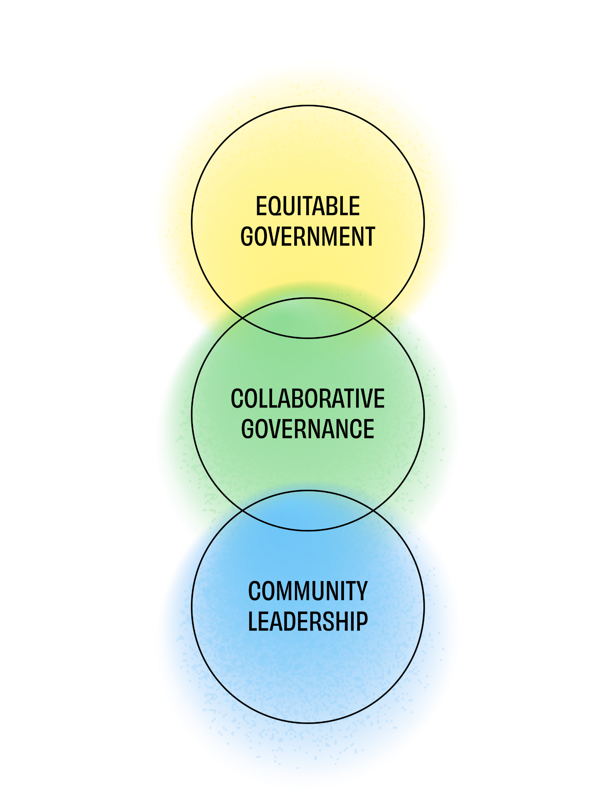
What makes the draft CJP different?
Creates a vision for climate justice that is reflected in universal goals.
Provides a framework for aligning efforts toward climate justice over time.
Co-created toolkit with both community and government priorities.
Strategies prioritize the needs of most impacted communities.

Slide 7
Multnomah County’s existing work on this goal
Former Multnomah IDEA Lab economic research
  Economic Justice Report
  Multnomah Mothers’ Trust
  Self sufficiency research
Multnomah County Commission for Economic Dignity
College to County, other internships
Walnut Park Redevelopment Project and Vance Vision
Construction project workforce goals - Regional Workforce Equity Agreement (e.g. Library Capital Projects)
Preschool for All and other social service pathways
Notes:
The Multnomah Idea Lab (MIL) was formed by the Multnomah County Board of Commissioners in 2015 in response to this vision, and was located within Multnomah County’s Department of County Human Services until the program ended in June 2024.
The MIL was charged with seeking approaches at the intersection of poverty and racism.
This Discussion Guide was developed by the Economic Justice Project (EJP) to kick-start a process to build a shared vision for incorporating a commitment to economic justice into the County’s programs, policies, and practices. It is designed to provide the basis for a collaborative community design process to develop a blueprint for economic justice in Multnomah County.
Multnomah Mother’s Trust (2021 to June 2024)
The Multnomah Mothers’ Trust describes recipients of the Department of County Human Services’ Unconditional Cash Transfer (UCT) program. The MIL partnered with two community-based organizations: Black Parent Initiative and WomenFirst Transition and Referral. These two agencies provided us with 100 participants who were Black mothers in need. The total cohort represents a population highly impacted by the COVID-19 pandemic and who might not otherwise have access to resources. Implementation and disbursement of funds ($500 per month for each household) began in May 2022.
In November 2022, the former Multnomah Idea Lab initiated a human-centered design process to create a system to help African American women become homeowners. The result was a concept called Finna Act Black (FAB), a suite of services: peer support, one-on-one counseling, down payment assistance, and debt relief, provided by Black women for the benefit of Black women.
Self sufficiency research - this work takes into account how much a family is spending on necessities like housing, health care, food, child care and transportation in determining whether a family is experiencing poverty.

Slide 8
What we have heard so far
General feedback:
Comments broadly supportive of the wealth/green jobs goal, and recognized it as an important aspect of climate justice
Many comments called for an expansive view of green jobs, including work that supports overall community vitality
Recommendations/Concerns:
Several comments called for a profound shift to a “well-being economy”
Several comments raised concerns about unintended negative job and economic impacts from the CJP goals and how it is implementation
Other comments highlighted the significant job creation and wealth building opportunities from the CJP, particularly from some strategies in the plan

Slide 9
Outcome Metrics
Purpose of the metrics (indicators)
Measure progress toward the goal
Basis for regular and recurring reporting
Understand disparate outcomes among demographic groups
Guiding questions
Do you have questions about these metrics?
Do these metrics look adequate in terms of measuring progress toward outcomes? Any adjustments you would offer?
What other metrics would you add? What is the source of data?

Slide 10
Strategies
Purpose of the strategies
Identify near term actions that the County can take
Identify community policy priorities
Guiding questions
Are there any strategies that you would modify?
Do the draft strategies align with county or community priorities as you see them?
Which strategy, from the ones listed, should be a priority for Multnomah County?
Are there any other strategies you would like to see to help achieve this goal?
Other considerations: cost, feasibility, and barriers

Slide 11
Submit Feedback & Next Steps
To ensure your feedback is considered for this goal, please provide your goal-specific comments within 14 days
Submit your goal specific comments via email to sustainability@multco.us
Invite staff to present or participate in a community discussion or workspace
Revised draft of the Climate Justice Plan in the early 2026
  The revised draft will be published online
  Staff will present the revised draft to the Board of County Commissioners in a work session
  Use feedback from the Board and CJP Steering Committee to finalize the draft
  Seek Board approval for the final plan

