Slide 1
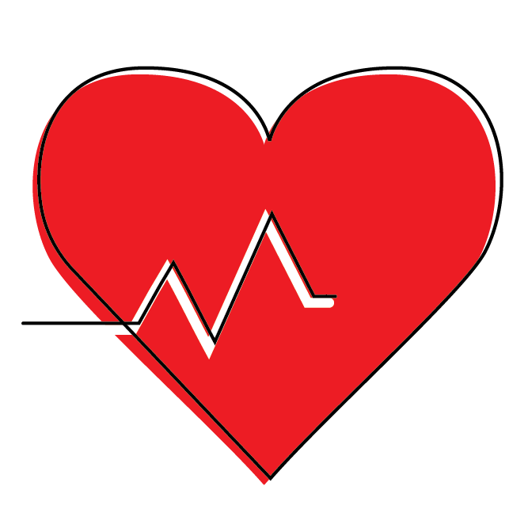
Universal Goal: Health
Climate Justice Plan - DRAFT
Every community member has access to the resources and underlying conditions that promote health and well being.
Community Forum #3
November 4, 2025

Slide 2
Purpose of Today's Meeting
Review Strategies: Ensure strategies are S.M.A.R.T (Specific, Measurable, Attainable, Relevant, Timely) and effectively balance recommendations.
Review Metrics: Ensure the metrics are effective, measurable, and clearly aligned with key environmental justice indicators.
Deepen Collaboration: Ensure the process of the Climate Justice Plan is inclusive of diverse perspectives
Gather Technical Input: Gather specific and technical feedback on proposed metrics and strategies.

Slide 3
Core Values
Climate change is real and driven by fossil fuel combustion.
Climate change impacts public health and well-being.
Climate justice links the climate crisis to social, racial, and environmental equity.
We must center frontline communities—those most impacted—to drive efficient and equitable solutions.

Slide 4
Shared Agreements
Tell us your name and affiliation (if any) when talking
Respect each other
Listen to understand, not to respond. Don’t interrupt.
Make space, take space/share airtime. Balance participation in the room.
Expect and accept discomfort (and joy!)
Practice community and self-care
“Bike rack” to capture off topic or detailed questions or ideas that arise
Never a failure, always a lesson
Others?

Slide 5
Where this came from where we are going
Laying the Foundation - Vision & Values (2020 - 2023)
  Climate Justice Earth Day Convening
  Environmental Justice (EJ) Indicators Storytelling Zine
  Vision & Values Framework: Climate Justice Framework
Phase 1 - Frontline Community Engagement (2023 - 2025)
  Launched Steering Committee
  Prioritized non-transactional conversations with communities typically excluded from government planning
Phase 2 - Public Comment Period (2025)
  Significant Feedback Gathered (webinars, survey responses, written comment)
Phase 3 - Refinement & Finalization (2025-2026)
  Community Forums on each Universal Goal
  Collaboration to finalize a plan that is both technically effective and equitably centered, serving as a comprehensive government action plan and community toolkit.

Slide 6
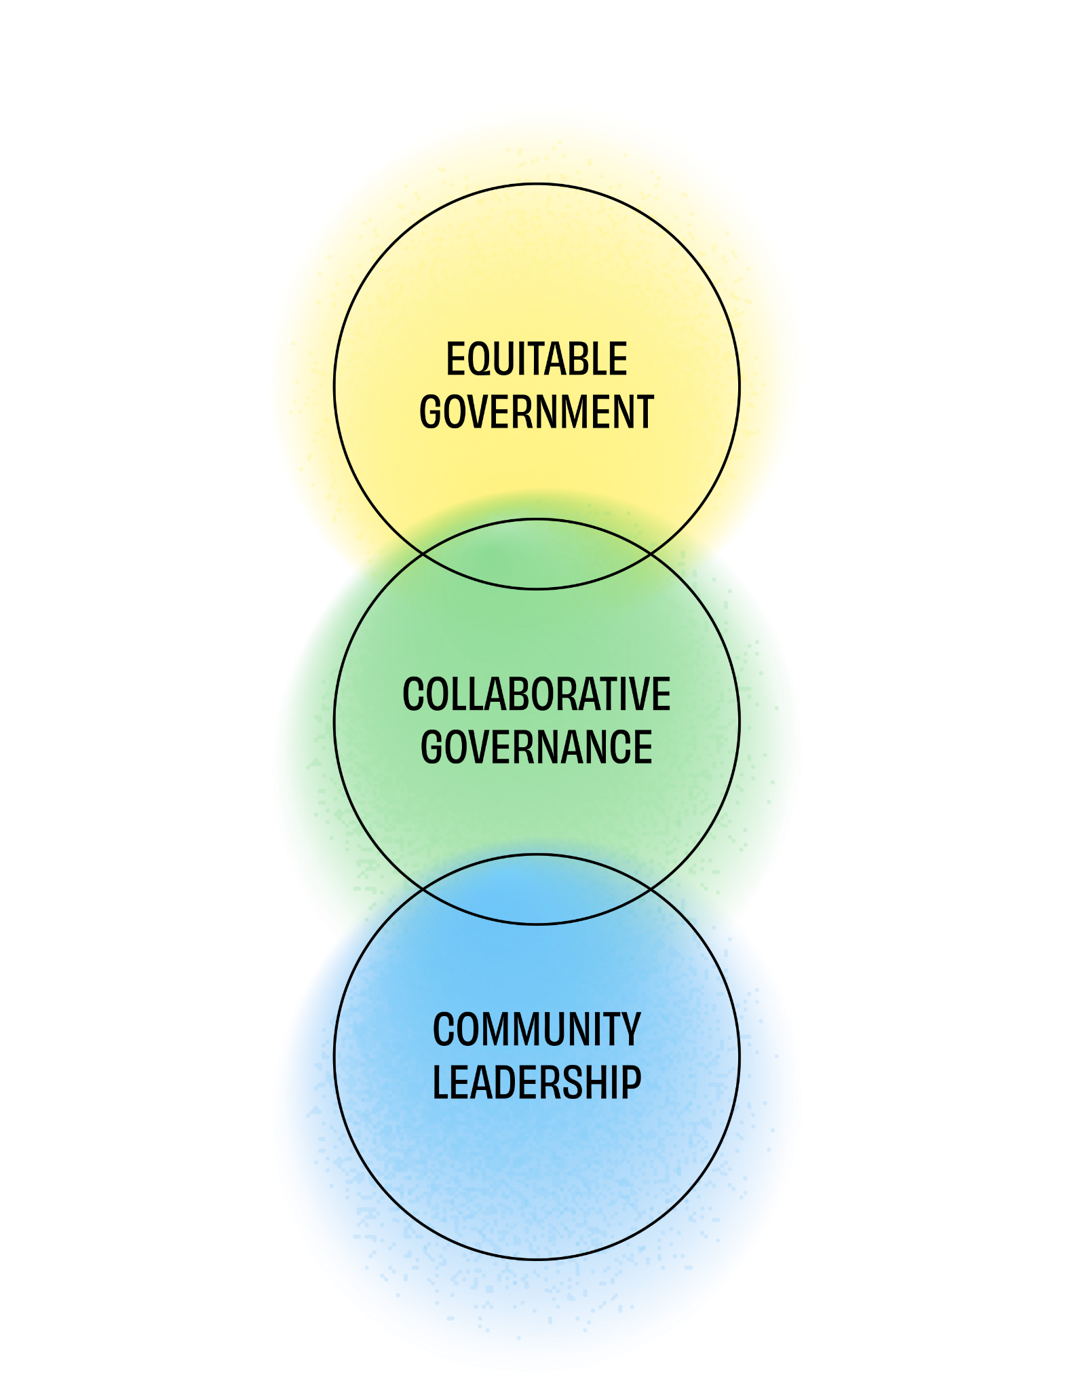
What makes the draft CJP different?
Creates a vision for climate justice that is reflected in universal goals.
Provides a framework for aligning efforts toward climate justice over time.
Co-created toolkit with both community and government priorities.
Strategies prioritize the needs of most impacted communities.

Slide 7
Multnomah County’s existing work on this goal
Multnomah County Health Department includes
  Clinical services
  Behavioral Health
  Public Health - Local Public Health Authority
Climate and health-specific work
  Hazard planning and response
  Policy development
  Heat mitigation
  Air quality
  Vector control
  Assessment and epidemiology
  Communications

Slide 8
What we have heard so far
General feedback:
Comments broadly supportive of the health goal and its strategies
Health seen as an important part of a compelling and holistic vision of climate justice
Many comments stressed the importance of linking health outcomes and the elimination of fossil fuel use
Recommendations/Concerns:
Greater emphasis and additional actions to support the link between climate impacts/stress and mental health
Additional consideration of unintended health impacts of some climate solutions
Additional analysis about the linkages between climate change, climate action and health and well-being

Slide 9
Outcome Metrics
Purpose of the metrics (indicators)
Measure progress toward the goal
Basis for regular and recurring reporting
Guiding questions
Do you have questions about these metrics?
Do these metrics look adequate in terms of measuring progress toward outcomes? Any adjustments you would offer?
What other metrics would you add? What is the source of data?

Slide 10
Strategies
Which strategies would you like to discuss today? Are there any strategies that you would modify?
Do the draft strategies align with county or community priorities as you see them?
Which strategy, from the ones that are listed, should be a priority for Multnomah County?
Are there any other strategies you would like to see in order to help achieve this goal?
Other considerations: cost, feasibility, and barriers

Slide 11
Submit Feedback & Next Steps
To ensure your feedback is considered for this goal, please provide your goal-specific comments within 7 days
Submit your goal specific comments via email to sustainability@multco.us
Invite staff to present or participate in a community discussion or workspace
Revised draft of the Climate Justice Plan in early 2026
  The revised draft will be published online
  Staff will present the revised draft to the Board of County Commissioners in a work session
  Use feedback from the Board and CJP Steering Committee to finalize the draft
  Seek Board approval for the final plan

