Slide 1
Evidence-Based Public Policy in the Criminal Justice System ⎯ Washington State’s (Evolving) Approach⎯ What Works Conference, 2013 —Justice Reinvestment in Action— Portland, OR January 11, 2013
Elizabeth K. Drake
Senior Research Associate
Washington State Institute for Public Policy
(360) 586-2767
ekdrake@wsipp.wa.gov
www.wsipp.wa.gov

Slide 2
Washington State Institute for Public Policy
Recent Specific Directions to WSIPP from the WA Legislature
What works? What are the costs & benefits of policies to improve these outcomes?
Crime 1994, 1999, 2003, 2005, 2009, 2012
Education, Early Ed. 2003, 2006, 2009, 2012
Child Abuse & Neglect 2003, 2007, 2009, 2012
Substance Abuse 2003, 2005, 2009, 2012
Mental Health 2005, 2009, 2012
Developmental Disabilities 2008
Teen Births 1994, 2009
Employment 2009
Public Assistance 2009
Public Health 2009
Housing 2009
Created by Legislature (1983)
Mission: Non–partisan research on projects assigned by the Legislature or the Institute’s Board of Directors
2 of 15

Slide 3
Washington legislature has asked WSIPP this question:
Are There Evidence-Based Policy Options That Improve Public Outcomes, but at Less Cost?
WSIPP
“Consumer Reports” Lists:
What Works?
What Doesn’t?
What Can Give Washington
Taxpayers a Good Return
(Better Outcomes) for Their Money?
Given the Current Level of Credible Research, What Don’t We Know?
3 of 15

Slide 4
Adult Prison Incarceration Rates:
1930 to 2011
*Incarceration Rate
6
State GF Fiscal Impact
If Washington had the same incarceration rate as the average state, then DOC’s GF budget (including debt service) would be about $660 million more per biennium.
Crime Rates
(2011 compared to 1980)
US WA
- 45% - 46%
2005 Legislature directed WSIPP to identify evidence-based intervention and prevention programs that could:
Reduce the need for prison beds
Save taxpayers money
Contribute to lower crime rates
How can WA be smart on crime?
United States
5
4
3
Washington
2
CFC
Forecast
WA Jails
1
0
1930
1940
1950
1960
1970
1980
1990
2000
2010
2020
*The incarceration rate is defined as the number of inmates in state prisons per 1,000 resident population in Washington or the United States.
4 of 15

Slide 5
Evidence-Based Programs
WSIPP’s 3-Step Research Approach
What works (to improve outcomes)?
We identify programs that have already been rigorously tested (WA or elsewhere) to determine the program achieves expected outcomes.
What pays off for taxpayers?
We compute benefits, costs, and risk (return on investment) to the people of Washington for each policy option.
How can a “portfolio” of options affect statewide outcomes? How much risk of failure?
5 of 15

Slide 6
Benefit-Cost Analysis
Once we know what works, we determine how much it costs to buy that effect size, and what’s it worth to achieve it?
What works?
To reduce crime/ recidivism relative to a non-treated population
CJS response to crime
Resources used and victimizations incurred when crime happens
CJS resources not used and victimizations avoided
Estimate benefit-cost results from effective program
We monetize the benefits to taxpayers and crime victims of future crimes avoided and estimate the costs of a program versus the costs of not participating.
6 of 15

Slide 7
An example…
Functional Family Therapy for Juvenile Offenders
Reduces Recidivism Rates by 22 Percent
80%
Monetize the savings
70%
60%
Without FFT, an offender has a 72% chance of being reconvicted for a new felony or misdemeanor after 15 years;
50%
40%
Recidivism Rate
30%
With FFT, the odds drop to 59%.
20%
Without FFT
10%
With FFT
0%
1
2
3
4
5
6
7
8
9
10
11
12
13
14
15
Follow-up Years
7 of 15

Slide 8
Compute Benefit-Cost Statistics
What Works to Reduce Crime?
Change In
Crime
(# of EB Studies)
Benefits Minus Costs,
per-person, life cycle (probability you won’t lose $)
Adult Offenders
2012 Results
Corr. Education in Prison -16% (11) $20,298 (100%)
Cog-Behavioral Tx (mod-high risk) -7% (38) $9,283 (100%)
Drug Tx (outpatient, community) -5% (4) $5,154 (99%)
Drug Tx (inpatient, community) -2% (5) $2,489 (87%)
ISP: surveillance +0% (14) -$4,718 (11%)
ISP: treatment -14% (17) $7,295 (96%)
Juvenile Offenders
Functional Family Thpy (QA) -22% (8) $30,706 (100%)
Aggression Repl. Trng (QA) -20% (4) $29,740 (96%)
Prevention*
Pre-School* (low income) -21% (11) $14,934 (100%)
Nurse Family Partnership* -17% (2) $13,181 (80%)
8 of 15
* Programs have a number of other non-crime benefits; all benefits reported here.

Slide 9
Compute Benefit-Cost Statistics
Functional Family Therapy: Return on Investment (2010 Dollars)
Risk analysis of measured uncertainty:
99% of time, NPV is positive
Benefits Per Family (PV)
Main Source of Benefits
Reduced crime
$26,802
Lower CJ & victim costs
Increased high school grad
$6,782
Increased earnings
Reduced health care costs
$384
Lower public costs
Total Benefits Per Family
$33,976
Cost Per Family (PV)
$3,270
$0
$4
$8
$12
$16
$20
$24
$27
$31
$35
$39
Net Present Value (000)
Net Present Value
$30,706
Benefits Per Dollar of Cost
$10.42
(= 91% ROI)
9 of 15

Slide 10
Follow- Up With an Outcome Evaluation:
Results from Washington’s Functional Family Therapy
35%
Quality assurance matters!
Use program fidelity and adherence standards.
30%
32%
25%
27%
20%
Recidivism Rate
15%
17%
Comparison youth
10%
FFT youth
(Competent therapists)
5%
FFT youth
(Not competent therapists)
0%
10 of 15

Slide 11
Evidence-Based Community Supervision (adults): WSIPP Findings of Three Supervision Tactics
More Crime
Intensive Supervision: Surveillance-Oriented (14)*
Intensive Supervision: Treatment-Oriented (17)*
Supervision: Focused on Risk, Need, & Responsivity (6)*
Change in Recidivism
+1%
-10%
Less Crime
-16%
*The number of high-quality research studies on which this finding is based.
11 of 15

Slide 12
Some Major Washington Legislative Actions
1999-01: Funded evidence-based juvenile justice programs in late 90’s. Less crime, save $.
2002: Cut prison sentences for drug offenders and diverted some fiscal savings to drug courts and treatment. Less crime, save $.
2007: Funded a portfolio of evidence-based programs in adult and juvenile corrections, and prevention. 2000 bed, $250 Million, prison avoided.
Washington now explicitly ties the evidence-based program
portfolio to the official state prison forecast.
2012: Evidence-based, research-based, and promising juvenile justice, child welfare, and children’s mental health.
Adult Criminal Justice
Cognitive behavioral therapy
Correctional education/vocation
Drug treatment community/prison
Work release
Juvenile Justice
Aggression Replacement Training
Functional Family Therapy
Multisystemic Therapy
Victim offender mediation
Prevention
Early childhood education assistance program (low income 3 & 4-year olds)
12 of 15
Notes:
Washington now explicitly ties the official state prison forecast to the evidence-based program portfolio

Slide 13
Keeping Track of Results: Prison Beds Avoided
Cumulative Effect of Washington’s History of Evidence-based Programming
24,000
As of 2011, there are 1,100 fewer people in prison as a result of Washington’s evidence-based adult, juvenile, & prevention programs. These effects are in the CFC prison forecast.
22,000
20,000
18,000
16,000
14,000
Average Daily Prison Population
12,000
10,000
8,000
6,000
4,000
Blue Area = Actual Prison Population
Years beyond 2011 are current CFC forecast.
2,000
Orange Area = What Prison ADP would have been without the programs.
0
1980
1985
1990
1995
2000
2005
2010
2015
2020
2025
Year
13 of 15

Slide 14
A Cheat Sheet on Six Evidence-Based Principles:
Evidence
Focus on research-proven prevention and intervention.
Economics
Compute benefits and costs: not all options have sound economics.
Quality assurance
Re-visit the EBP path periodically to ensure expected results.
Risk (for re-offense)
Follow the risk principle and align offenders with the right EBPs.
Funding
Encourage interest in EBPs and monitor the results. WA now ties the official state prison forecast to the expected effects of the funded portfolio.
Punishment
Focus on swiftness and certainty of punishment (strong deterrence evidence for certainty, but not for severity of punishment).
14 of 15

Slide 15
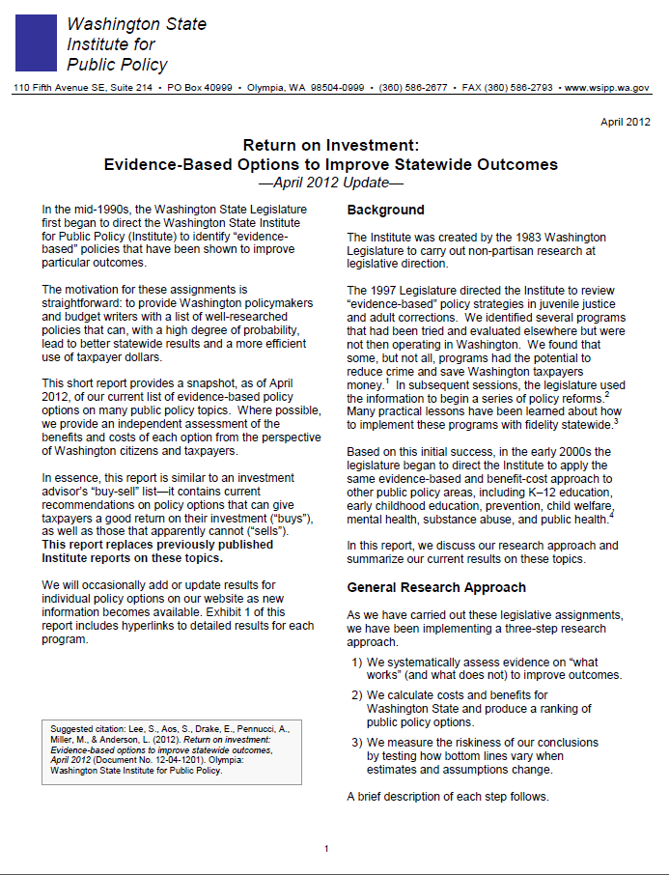
Questions?
“Return on Investment: Evidence-Based Options to Improve Statewide Outcomes ”
www.wsipp.wa.gov
Thank you!
15 of 15

