Slide 1
Multnomah County
Employee Resource Group for Immigrants and
Refugees
July 23, 2014
By Victoria Cross

Slide 2
Welcome
добро пожаловать
bem-vindo
欢迎
Bienvenido
歡迎
chào đón

Slide 3
Everything Works Better When
Everyone Works Together

Slide 4
Reflection on
WHO WE ARE and
WHAT WE DO

Slide 5
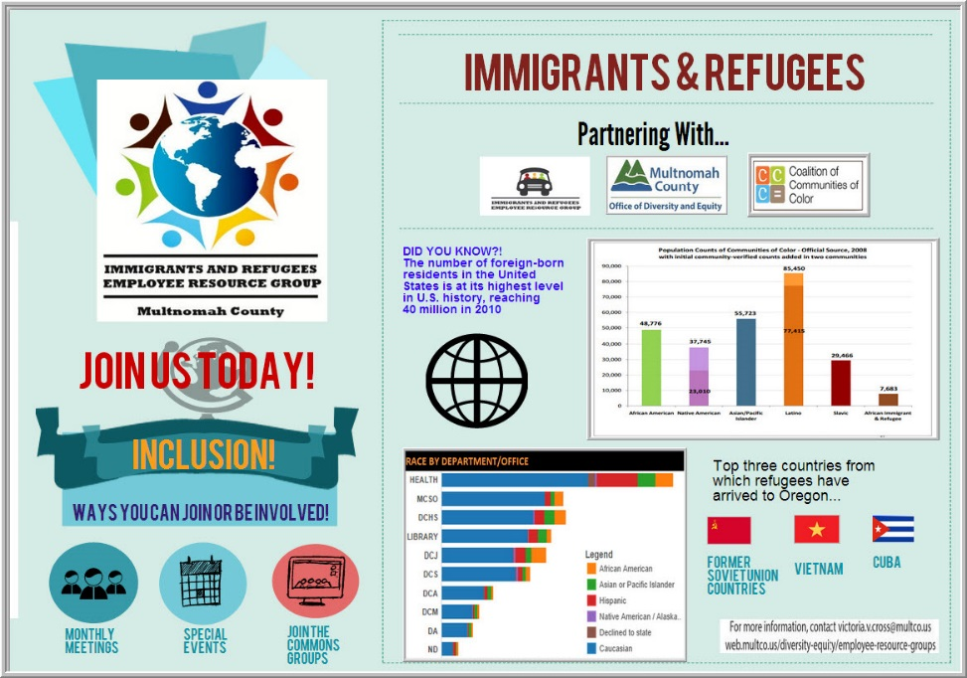

Slide 6
Charter requirements
Mission Statement
Purpose
Benefit to the County
Governance
Accountability

Slide 7
Mission Statement
Welcoming all immigrant, refugee and interested employees to connect, share, and educate each other and the greater County community on the skills, expertise and cultural value of a diverse workforce. Expanding the opportunities for our employee group to grow their careers and enhance the County through this important staffing pipeline.
Notes:
This is a first draft that will be edited and crafted by all members in our work session later this a.m.

Slide 8
Purpose
To identify challenges and opportunities faced by this employee group;
To generate organizational awareness on issues faced by this group;
To advance this group’s knowledge about the American workforce;

Slide 9
Purpose
To enhance and utilize these employees’ skills; assist employees in achieving their full potential;
To help employees in their career progression;
To prepare Multnomah County workforce to meet future needs of this diverse workforce.

Slide 10
Benefits to
Multnomah County
Builds EMPLOYEE support network and skill utilization
Enhances ORGANIZATIONAL effectiveness
  Strengthens COMMUNITY connection to the organization

Slide 11

Governance
We come together in the form of:
CHAMPIONS across the organization
Passionate ACTION-TAKERS
INCLUSION vs. exclusion
Notes:
Inclusion means that we welcome and develop allies, immigrants, mentors, supporters together

Slide 12
ERG Accountability
Establish metrics and goals.
Submit an annual report containing:
  a summary of last year’s accomplishments toward the work and plan,
  identified business value added by the group, and
  a work plan for the coming year.

Slide 13

We are ALL Leaders
Notes:
We provide opportunities for emerging leaders to network and stretch yourselves!
We are a safe place for people to have the kind of trial and error that is fundamental to human learning!

Slide 14
Honoring and acknowledging our commitment and struggles:
ERG members face a tough challenge in juggling their job duties and the responsibilities of leading and organizing the volunteer groups.

Slide 15
Our ACCOMPLISHMENTS
Our CONNECTIONS
Our GROWTH

Slide 16
BIG
ACCOMPLISHMENTS

Slide 17

June 2014

Slide 18
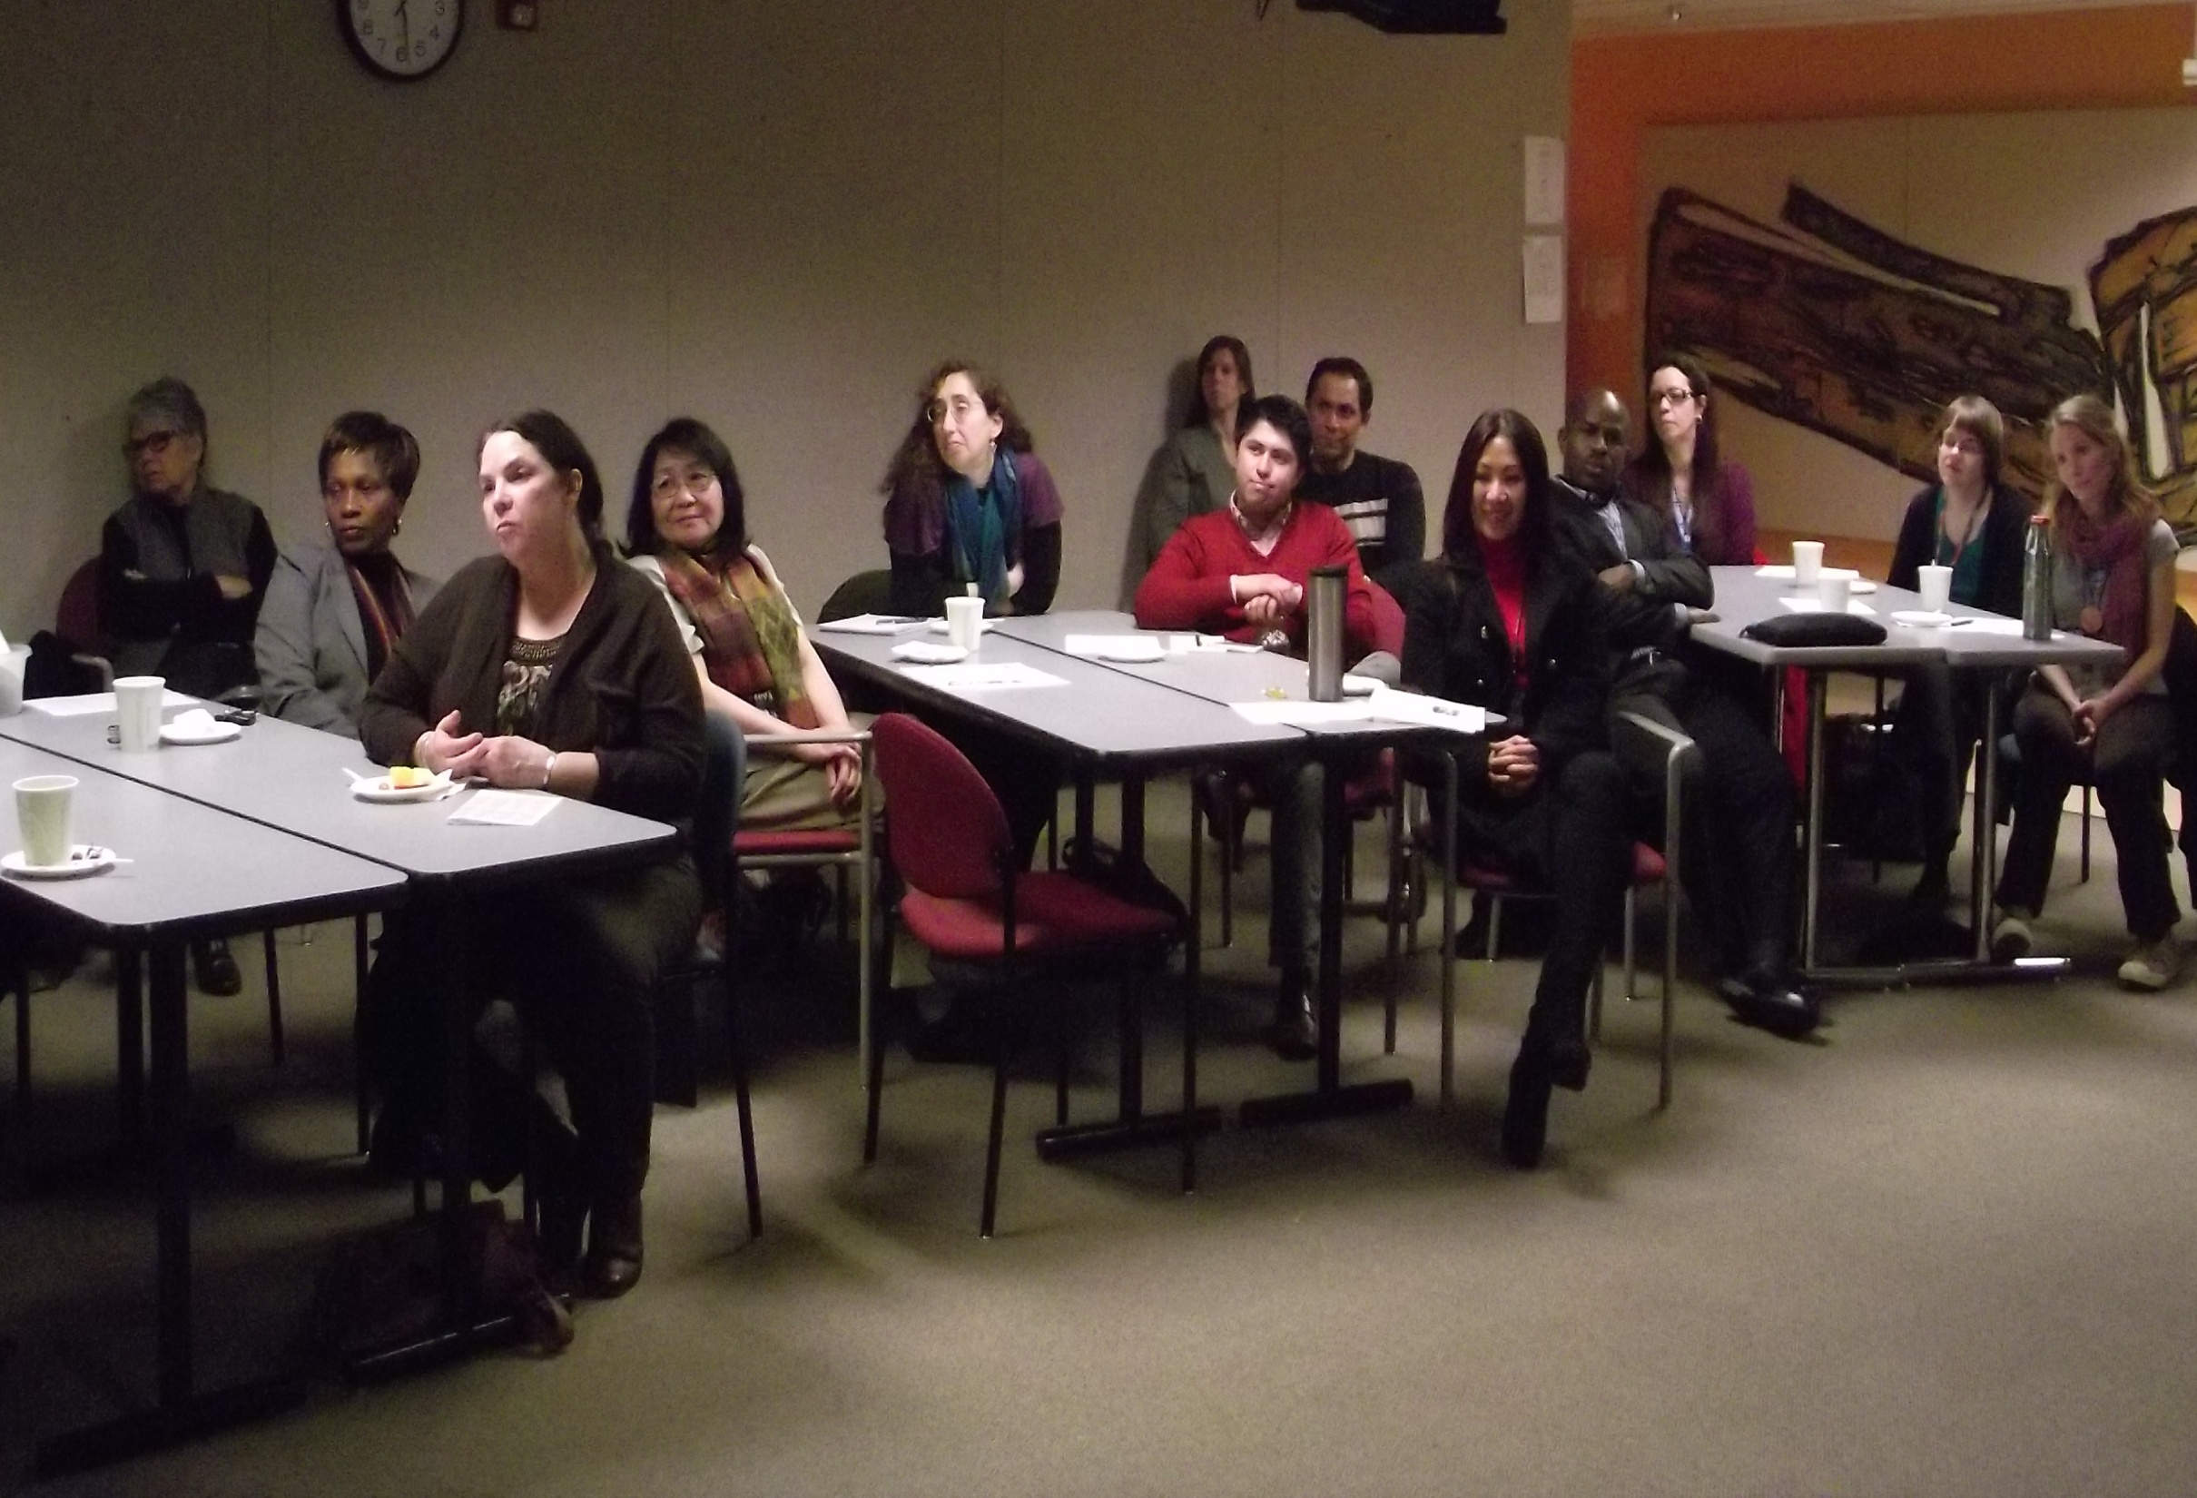

Slide 19
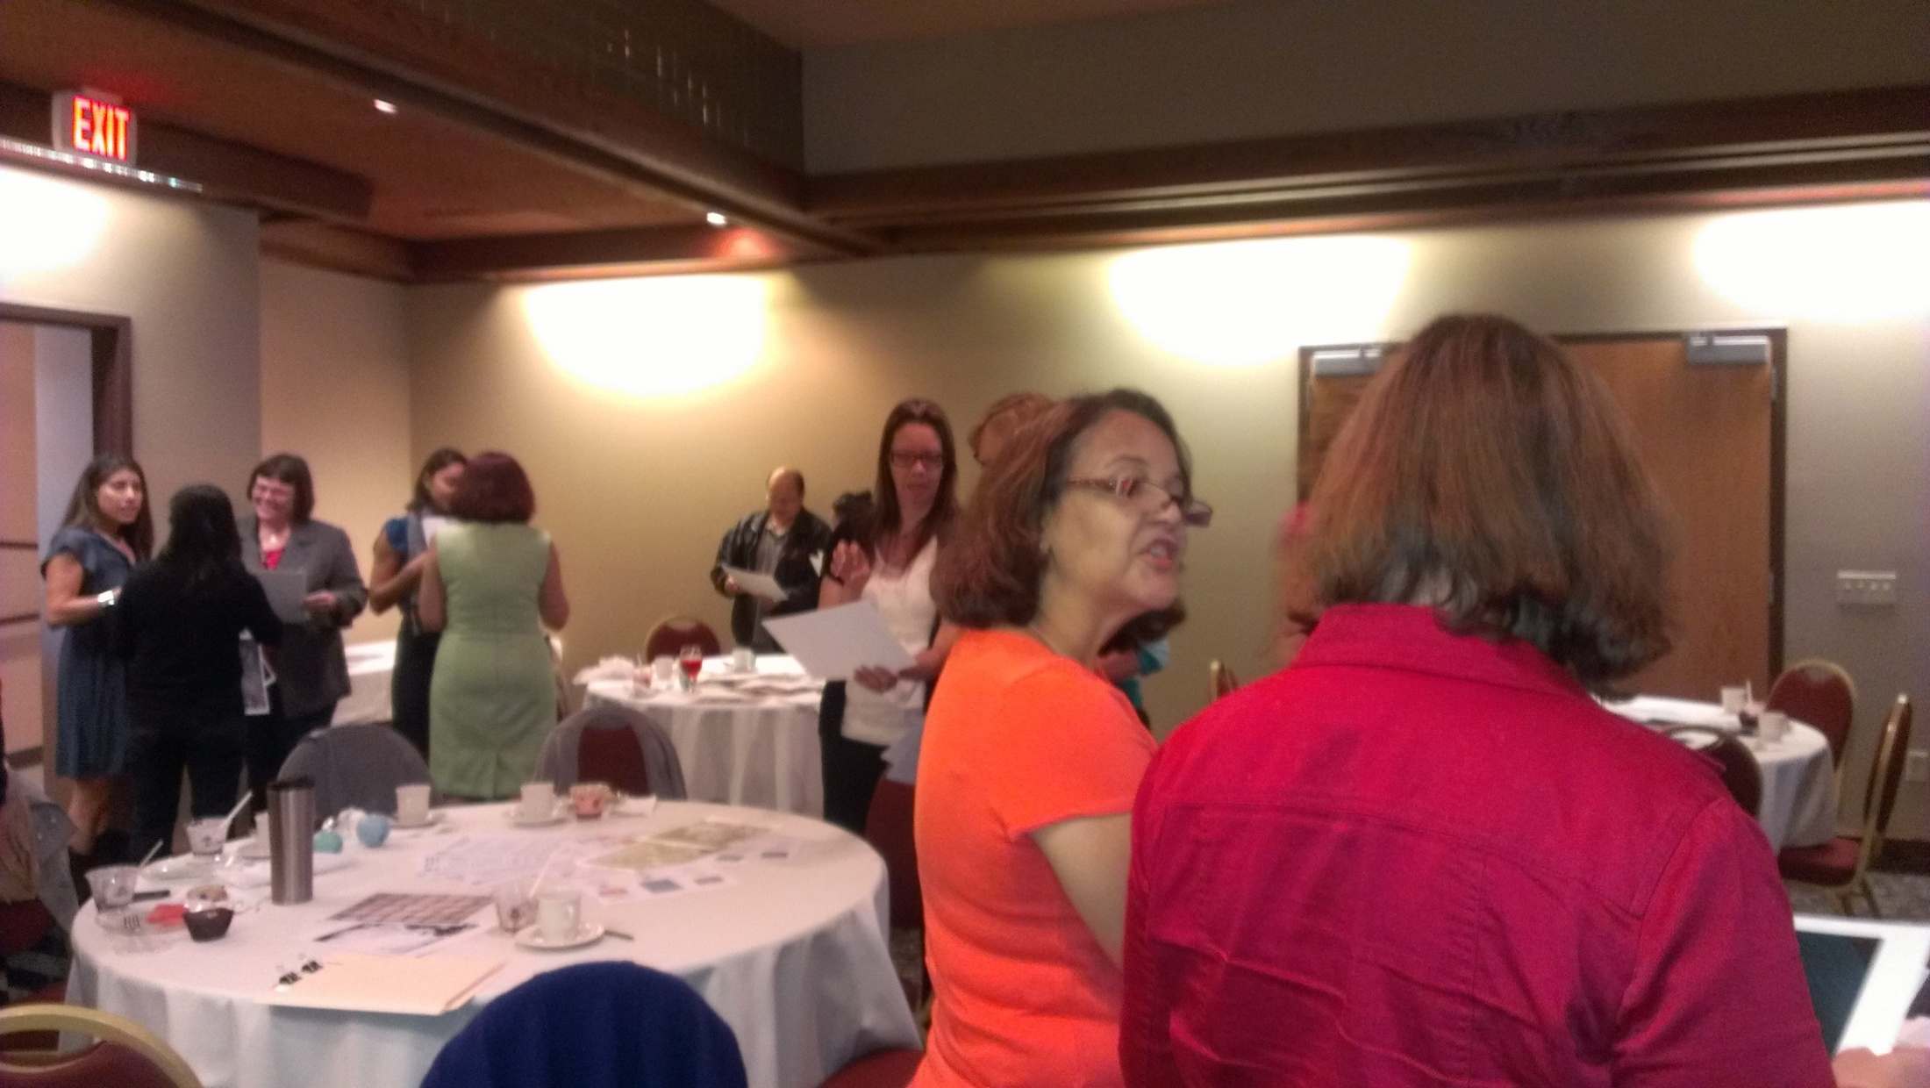

Slide 20


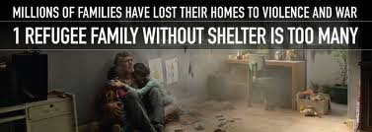
June 20, 2013
World Refugee Day
Proclamation by the Board of County Commissioners

Slide 21
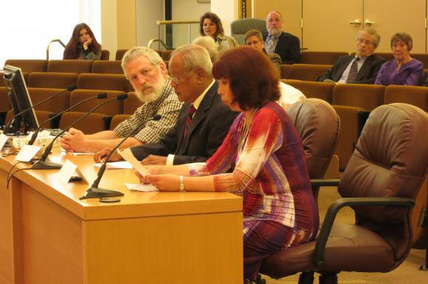
The Proclamation

Slide 22


Slide 23
Our CONNECTIONS and
Our GROWTH
Notes:
Let’s look at how our monthly meetings and organizational collaborations build connections and growth for our members and staff

Slide 24
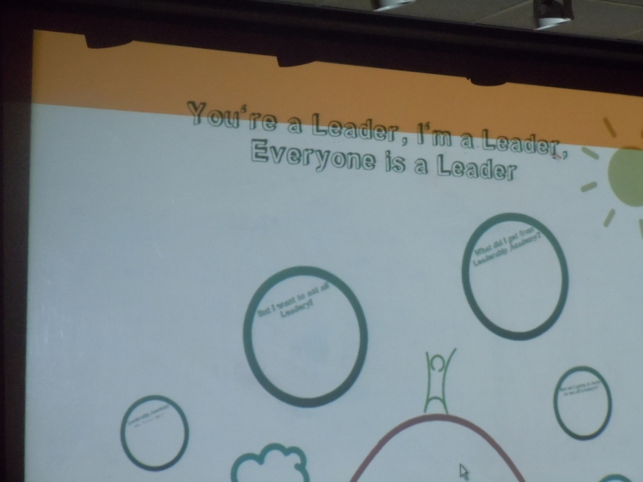
September 2013
Annual Retreat:
We are Leaders

Slide 25
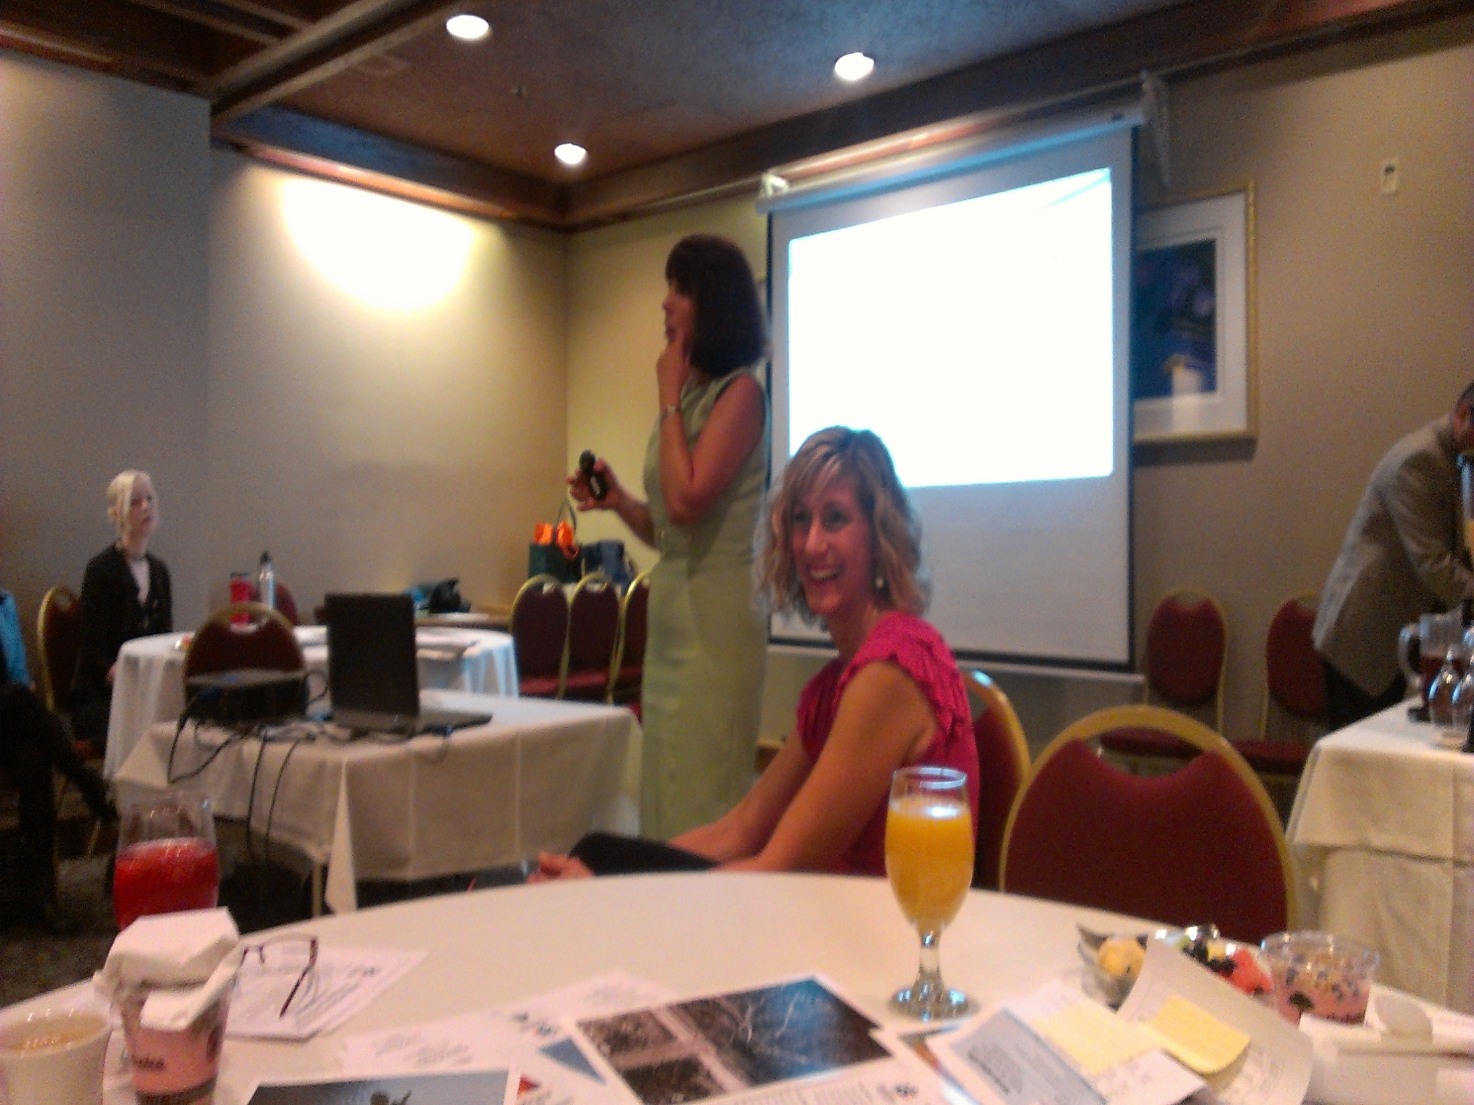

Slide 26
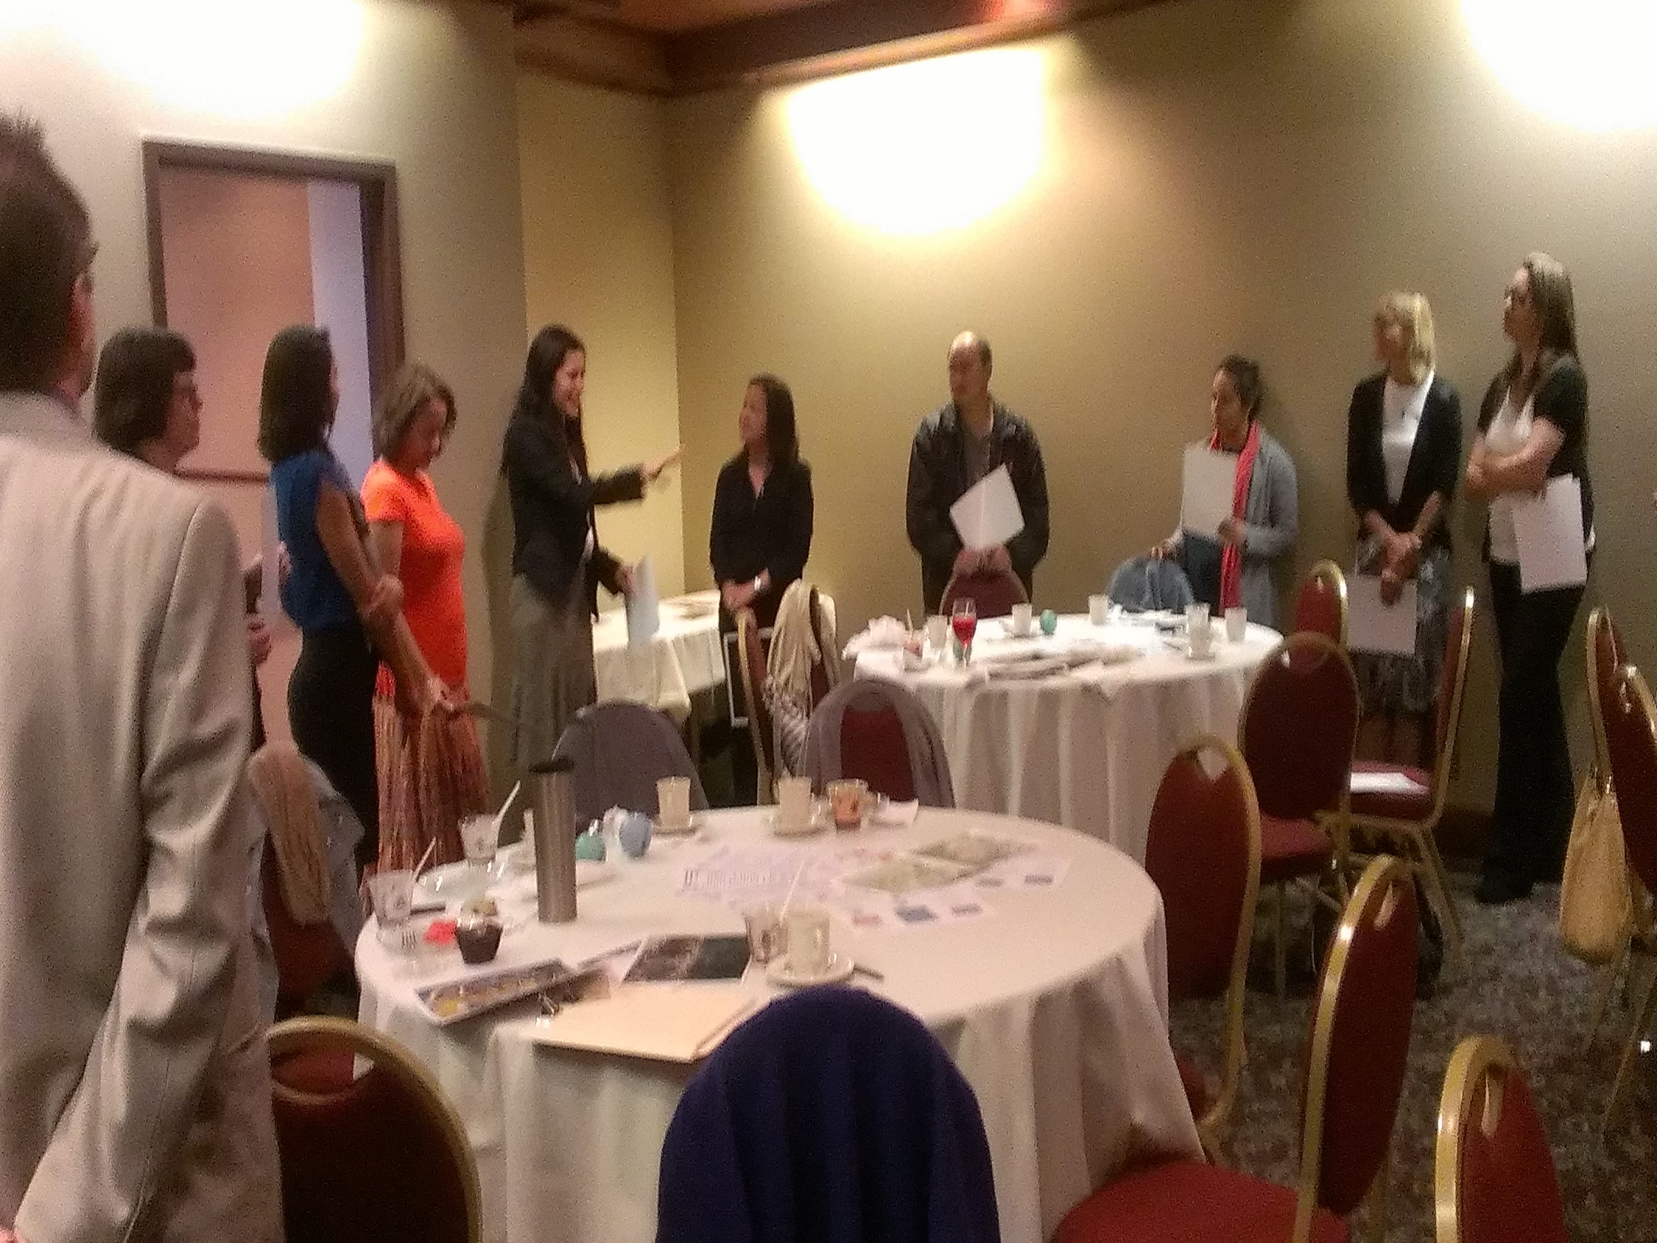

Slide 27
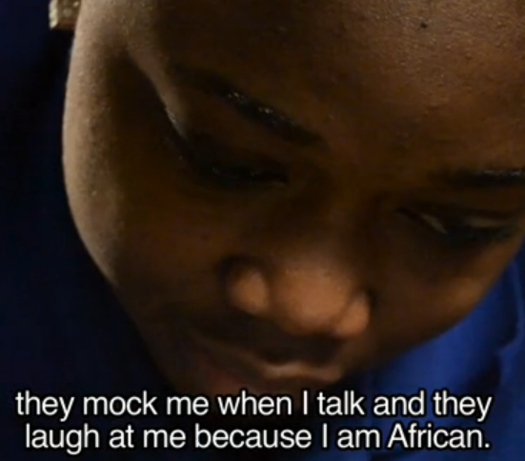
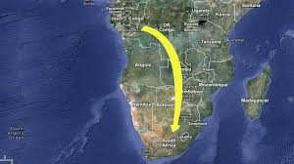

November 2013
Monthly Meeting:
“Our differences define us”
video viewing & discussion
Notes:
http://www.youtube.com/watch?v=odRtnfNz9Fw
http://vimeo.com/49455416

Slide 28
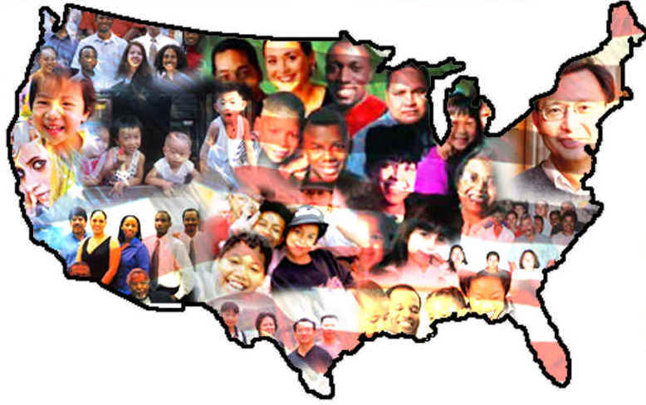
November 2013
Language Access Project
With County Chair’s Office
Notes:
ODE, Community Wellness and Prevention Program, Coalition for a Livable Future Race and Ethnicity Data Collection

Slide 29
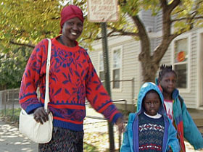
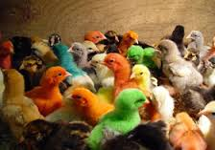
December 2013
Library: We speak your language

Slide 30
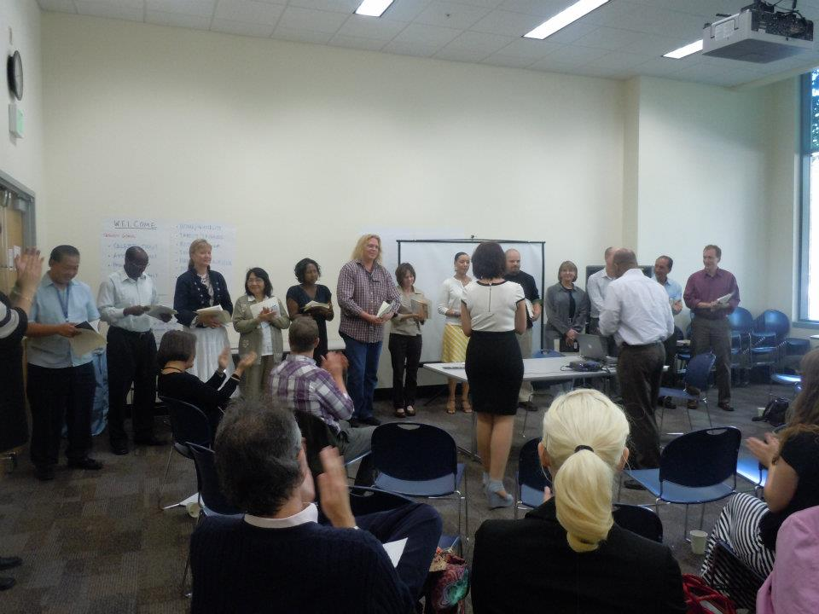
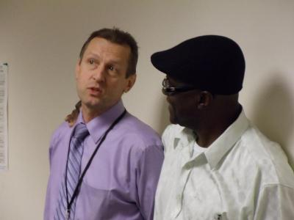
December 2013
Celebration and Holiday Potluck!

Slide 31
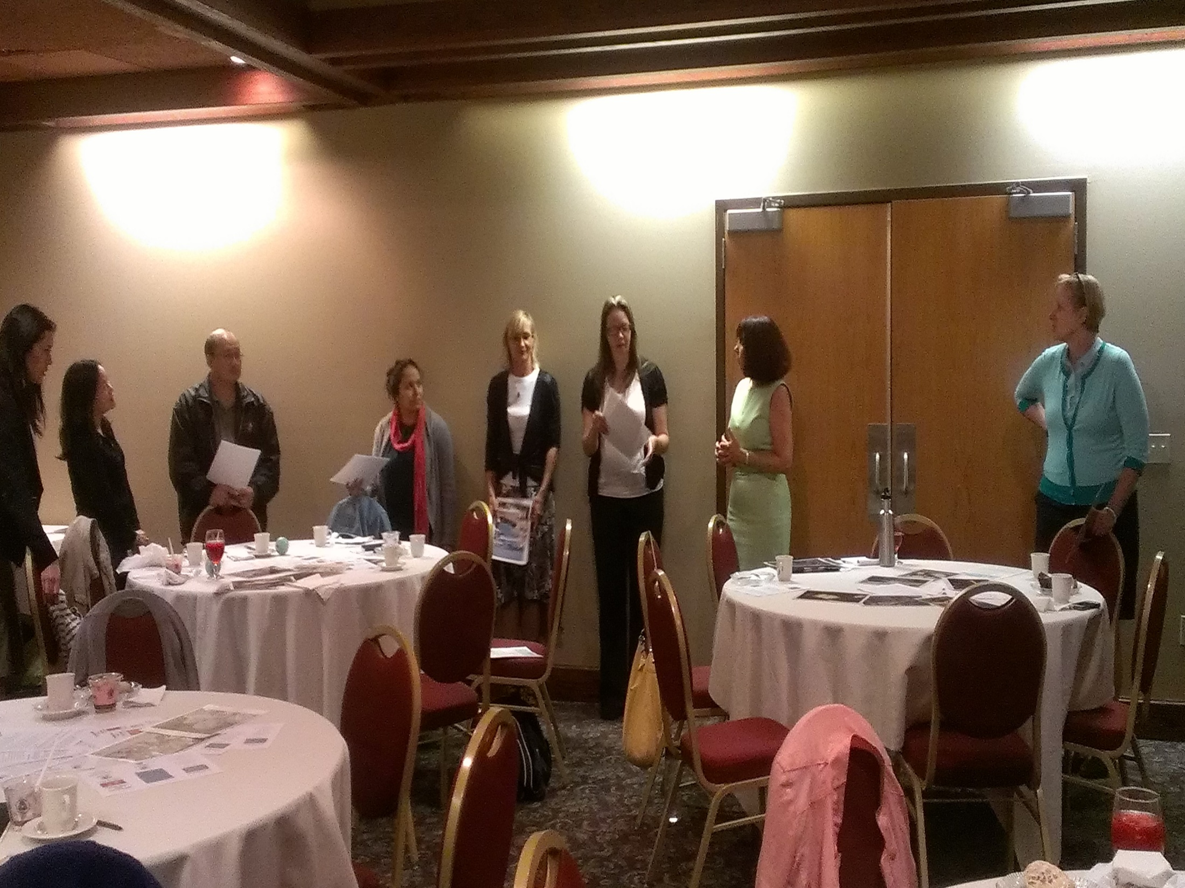

Slide 32
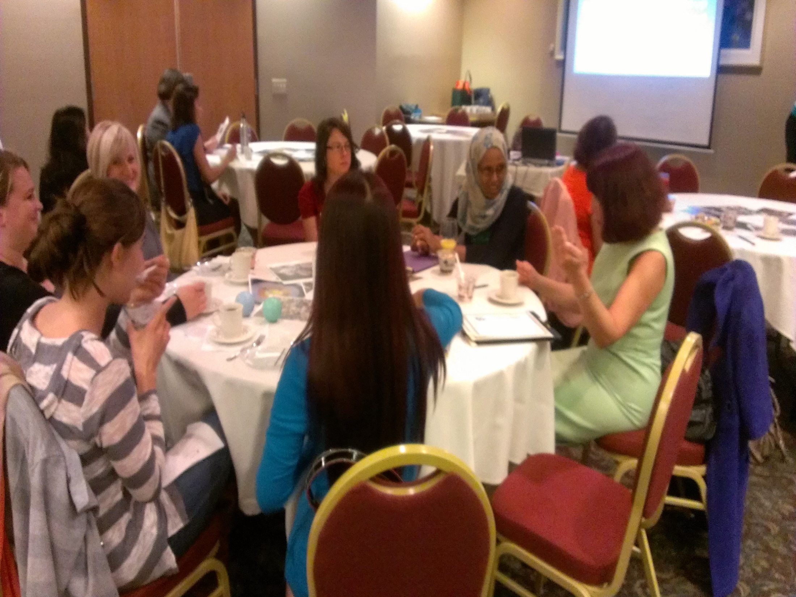

Slide 33

October 2014
Central HR Strategic Plan
Travis Graves, HR Director

Slide 34
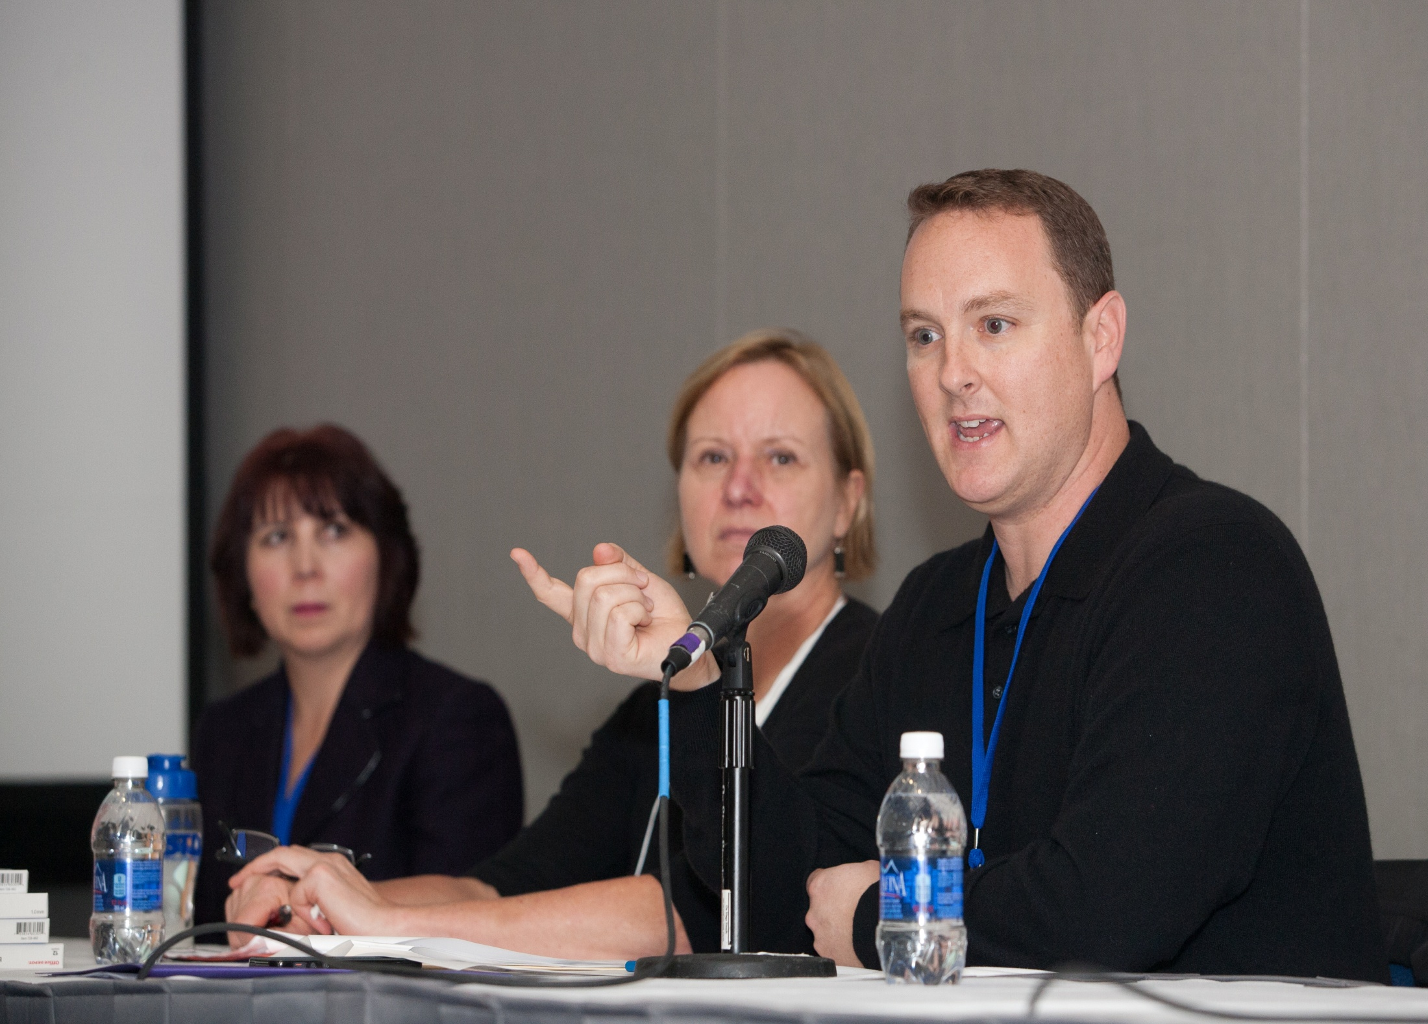

Slide 35

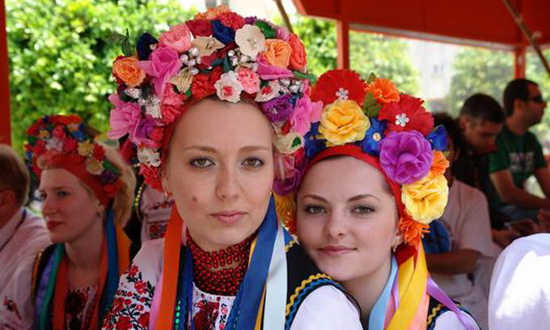
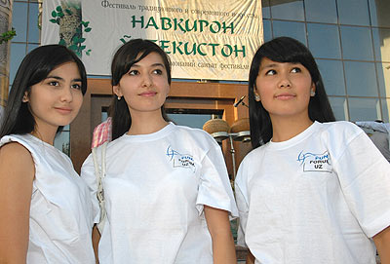
January 2014
Monthly Meeting:
Many Faces of Russian-speaking community
collaborative discussion

Slide 36

February 2014
Monthly Meeting
Chinese New Year Celebration

Slide 37


Slide 38
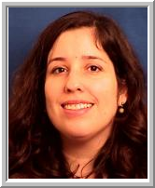
February 2014
Monthly Meeting
Meet with Multnomah County Chair
Marissa Madrigal

Slide 39

March 2014
Monthly Meeting
Partner with Health Equity Initiative
“Becoming American”

Slide 40
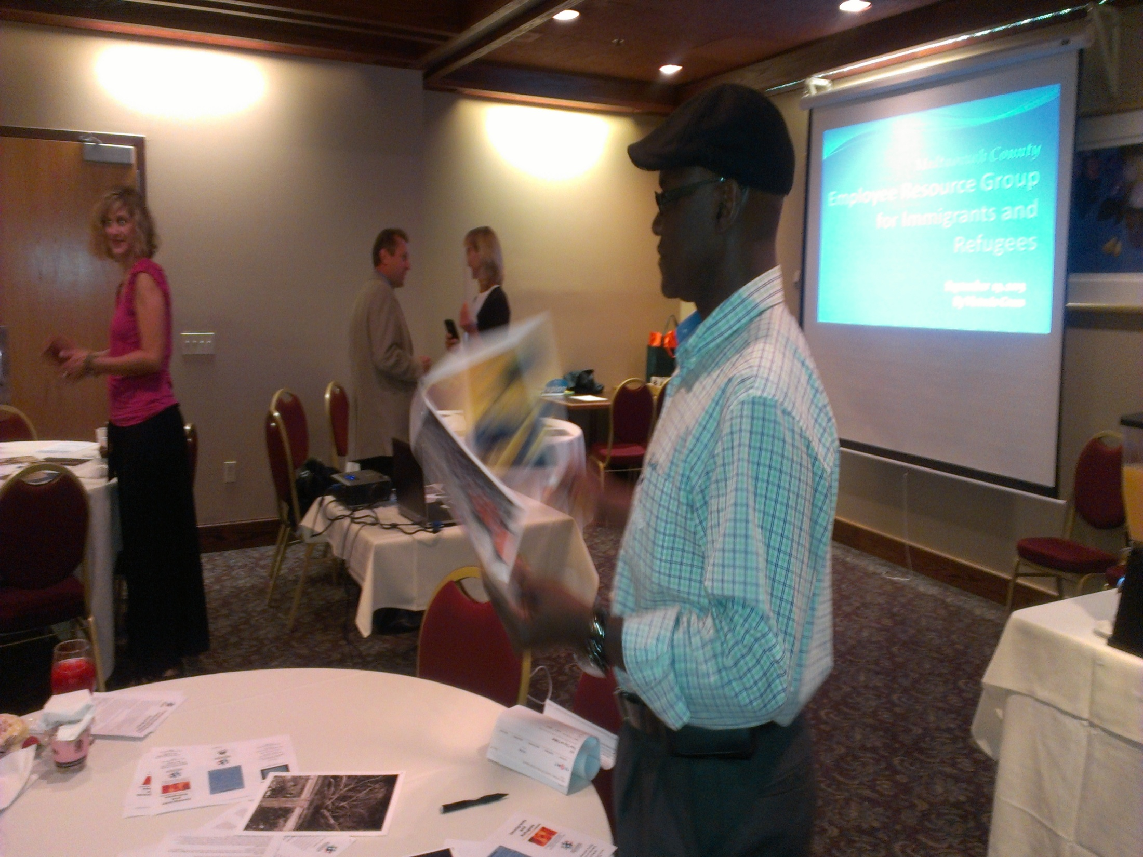

Slide 41
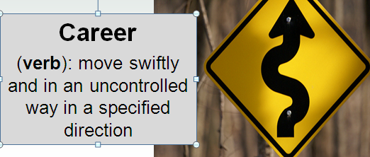

April 2014
Monthly Meeting
Career Management Training
with Steve Joiner of Talent Development

Slide 42

May 2014
The Equity and
Empowerment
Lens Logic
Model
Notes:
ODE, Community Wellness and Prevention Program, Coalition for a Livable Future Race and Ethnicity Data Collection

Slide 43
Honoring and acknowledging our connection to other ERGS:
Collaboration is key!

Slide 44
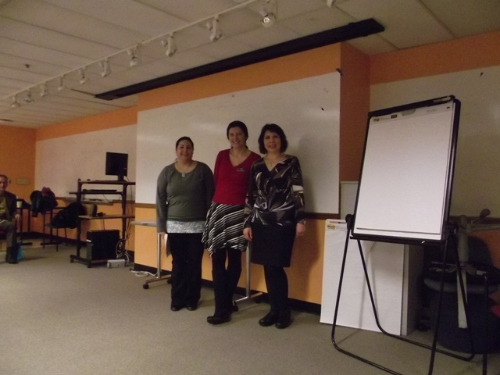

Slide 45


Slide 46
Workgroups
Generate the Goals for our Strategic Plan
Notes:
3 Tables
20 Minutes Per Table
Add your ideas in your team color, Discuss

Slide 47
Workgroups
Table One: Mission Statement: Craft It
Table Two: Adaptive Ways to Bring Us Together with Management
Table Three: Technical Ways to Bring Us Together with Management
Notes:
3 Tables
20 Minutes Per Table
Add your ideas in your team color, Discuss

Slide 48
Dance Lesson
Alan Gabriel

Slide 49
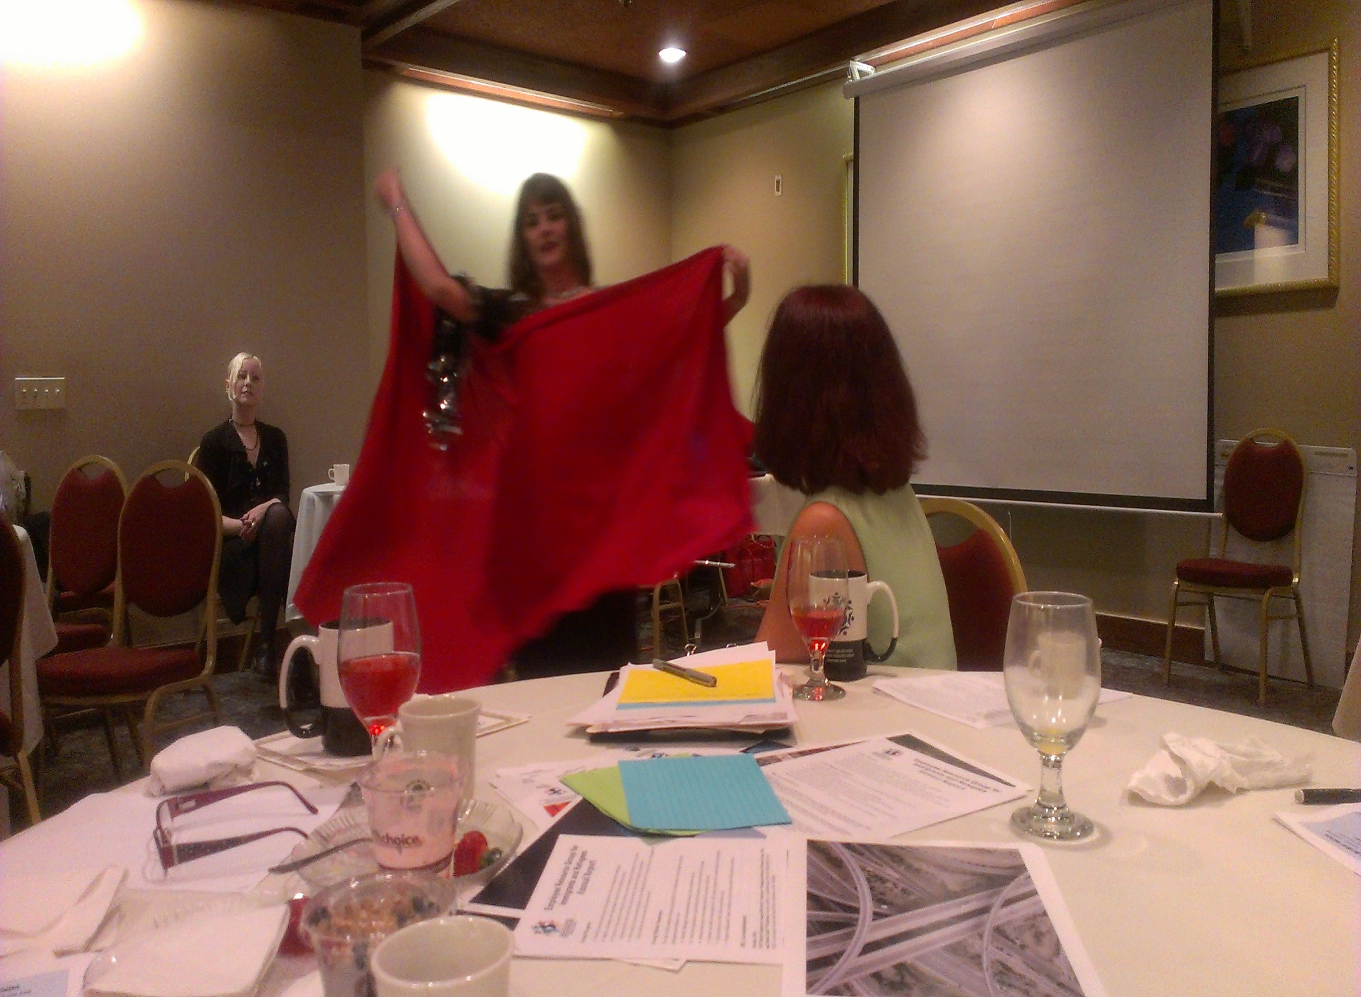

Slide 50
THANK YOU

