Slide 1



City of Portland & Multnomah County
2025 State Legislative Session Recap
LPSCC
July 28, 2025
Notes:
Stacy - intro and session overview/landscape

Slide 2
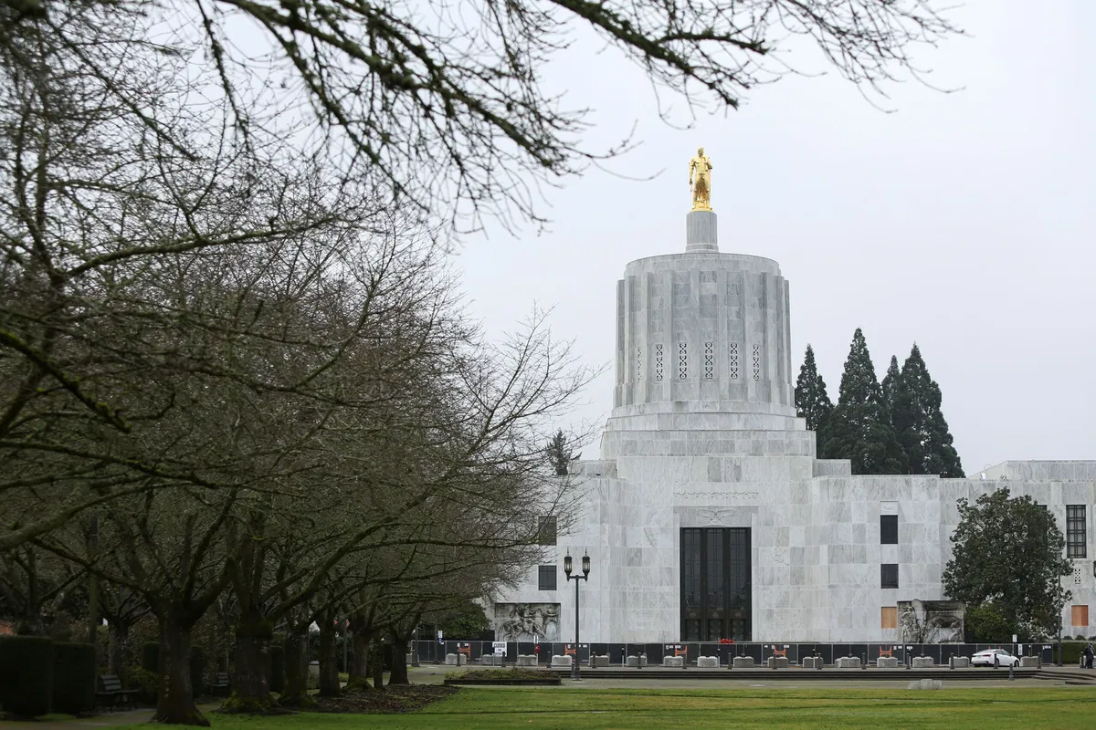
Top Legislative Priorities
City:
Shelter & Housing
Transportation
Bull Run Water Filtration
County:
Shelter Funding & Homelessness Service
Behavioral Health Treatment
Community Corrections Funding
Notes:
Evyn and Stacy

Slide 3
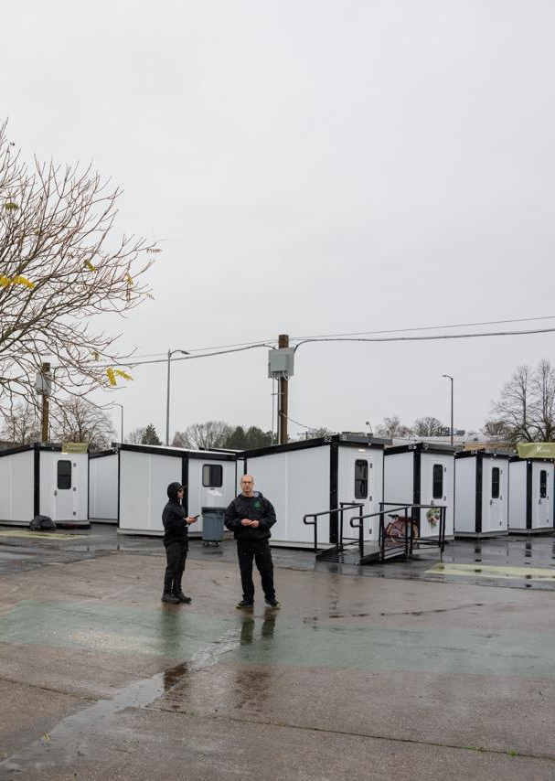
Shelter & Housing
Shelter & Rent Assistance
  Statewide shelter funding framework w/ $204 M allocated statewide.
  Reduced short- and long-term rent assistance funding. $135 M total statewide.
Housing
  Housing infrastructure fund with $10 M
  $50 M affordable housing preservation
  $568 M LIFT Affordable Rental Housing & Homeownership Programs statewide
  Condo Defect Liability Reform
  Local Investments in OMSI, AVT
Notes:
Evyn

Slide 4
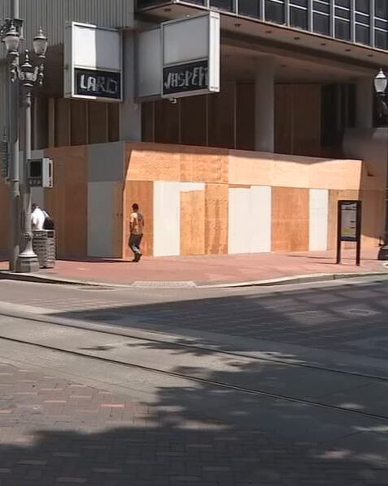
HB 4002 (2024) Implementation
HB 5005: Criminal Justice Commission Budget
  $40M for Deflection Grant Program
  $10M for Behavioral Health IMPACTS Grants
  $4M Restorative Justice Program
  $6M Jail-Based Medication for Opioid Use Disorder Grant Program
SB 236: statutory clarifications to HB 4002 (2024)
  Separates possession, delivery and manufacture of fentanyl into separate statutes.
HB 3069: Reorganizes and consolidates CJC grants under two programs:
  Oregon Public Safety Grant Program
  Law Enforcement Focused Grant Program
Notes:
Evyn

Slide 5
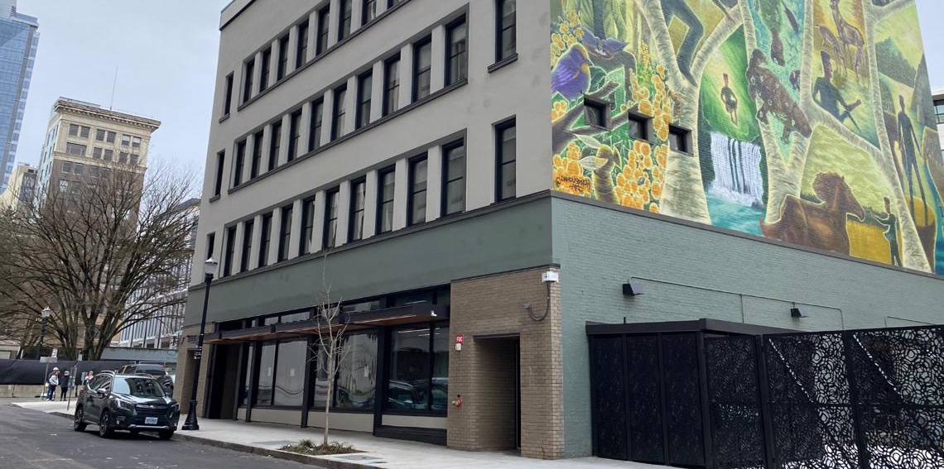
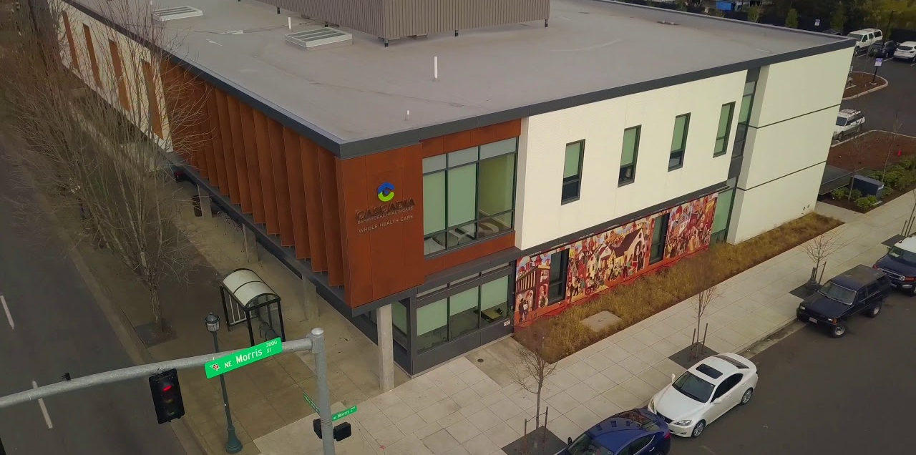
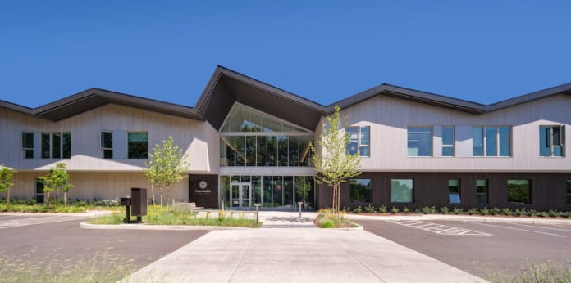
Expand Access to Behavioral Health
HB 2005: Omnibus Behavioral Health Bill
  Civil commitment reforms
    Removes “imminent danger” standard
  Procedural Changes
    Voluntary pre-hearing treatment diversion
    Super-siting of residential facilities
  Aid and Assist
    Length of stay of defendants
Expanding Capacity
  ~$81.8 M new funding including:
    $65M for new residential treatment facilities
    $5M for recruitment and retention
Notes:
Stacy

Slide 6
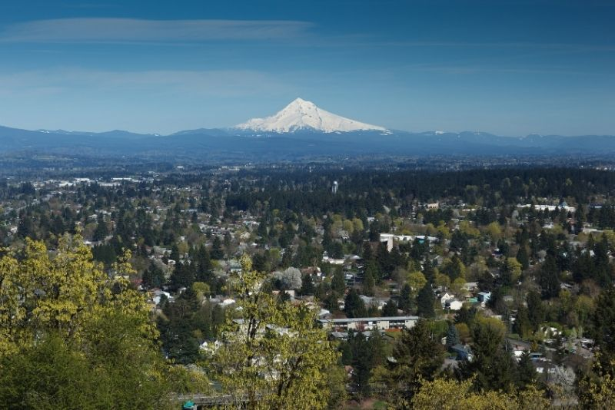
Law Enforcement Training & Tools
HB 5032: DPSST Budget Bill (Passed)
  Total Approved for 2025-2027: $98.9 M
    2023-2025 Service Level: $97.3 M
    Maintains additional $13M secured in 2023 that eliminated police training academy backlog.
HB 2183: Recognition of Previous Experience (Passed)
  DPSST must adopt rules for prior law enforcement experience and training to be recognized in meeting some training requirements.
SB 238: Use of Drones by Law Enforcement (Failed)
  Would have allowed drone use/acquisition of some info in connection with calls for service, emergencies (like fires), search & rescue, executing a warrant, and obtaining info about a property (with property owner’s consent).
  Maintained ORS 181A.250 prohibitions
Notes:
Evyn
$45M Criminal Justice Standards and Training Program: police, 9-1-1 telecommunicators, emergency medical dispatchers, corrections, parole/probation, OLCC enforcement
$6M Fire Standards and Training
$5M Private Security and Investigators
Public Safety Academy Basic Police Training Capacity – continuation of 23-25 reforms
Would have allowed law enforcement agency or officer to acquire and disclose information acquired through the operation of a drone in connection with:
calls for service
emergencies that could result in injury to people or property like fires
search and rescue
executing a warrant
obtaining information about a property with property owner’s consent
Repealed portions of laws requiring:
Written authorization from consenting property owner
Issuance of a warrant in all be exigent circumstances with probable cause or for search and rescue or training
Sworn statement within 48 hours in search and rescue activities
Explicitly prohibited:
Surveillance of commercial and private properties without property owner consent.
Use in traffic related enforcement
Collecting information in a manner prohibited under ORS 181A.250
Prohibits collection of information about a person’s political, religious or social activities unless directly related to a criminal investigation.
No videotaping (or livestreaming) of people without probable cause. No transmitting or storing of video
(no filming or collecting info about anyone without probable cause of a crime)

Slide 7
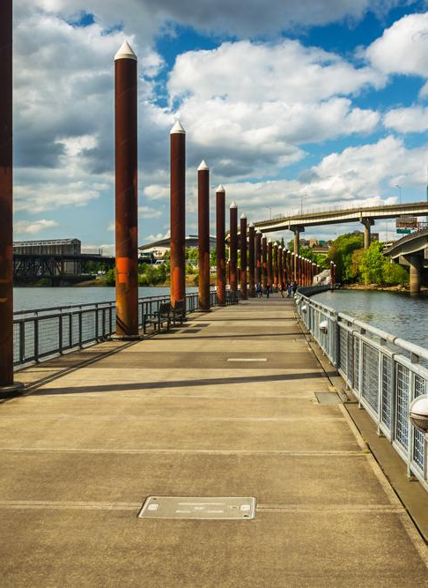
Gun Violence Prevention
HB 243: Omnibus
  Local governments can regulate firearms in buildings where official meetings take place
    Can apply to Concealed Handgun License holders now
  Bans “bump stocks”
HB 3076: Gun Dealer Licensing
  Did not emerge from Ways and Means
Notes:
Stacy

Slide 8
Community Corrections & Public Defense Commission
HB 5004 - Dept. of Corrections
$315.9M for Community Corrections, includes $3.3 M for SB 395 DUII incarceration
HB 5031 - Public Defense Commission
$681M - Establish and maintain Oregon’s public defense system.
  Funding is provided to reflect the April 2025 caseload forecast and to continue to address the unrepresented defendant crisis.
  Includes the establishment of an Enhanced Provider Capacity Pilot Program in the six crisis counties, continuation of funding for law schools, a dedicated position for Expedited Resolution Case Docketing, and Case Assignment Coordinators.
Notes:
Stacy

Slide 9
Other Legislation
SJM 2: Urging Federal Action to Address Crime Victims Fund Crisis
HB 2555: Making the Family Sentencing Alternative Program Permanent
SB 816: Updates to Juvenile Diversion and Crime Prevention Plans
HB 3929: Peer Support Confidentiality for Public Safety Workers
SB 97: Family Law Services Funding Changes
Notes:
Stacy

Slide 10
Questions & Discussion

