Slide 1


Multnomah County
Code Update Project
Planning Commission Meeting
June 1, 2026

Slide 2
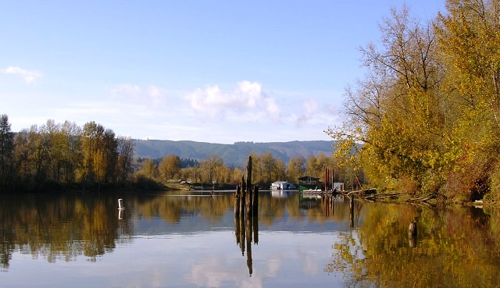
Presentation
Agenda
Project Update
Module 3 Code Amendment Presentation & Discussion
Next Steps
Questions & Discussion
1

Slide 3
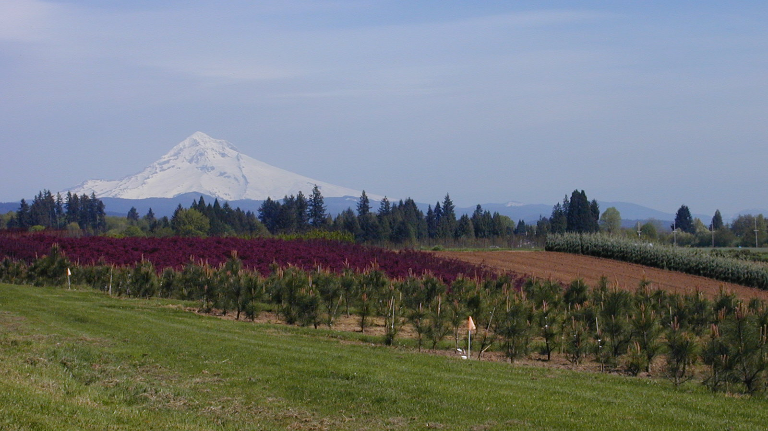
Project Team
County Staff Team
Megan Gibb, Land Use Planning Director
Kevin Cook, Principal Planner
Alexandra Howard, Land Use Deputy Director
Consulting Team (MIG)
Matt Hastie
Carrie Brennecke
Cathy Corliss

Slide 4
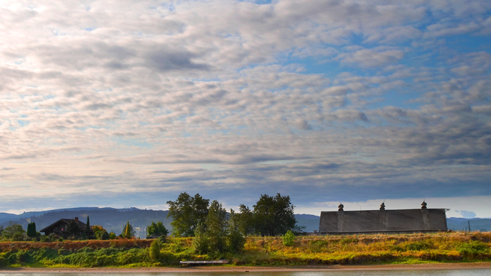
Project Background
Project Goals
Update and modernize the Zoning Code
Make the code consistent with County policy priorities
  Promote affordable housing, social equity, climate resiliency, and customer service
Ensure housing related provisions are Clear & Objective (C&O) and comply with State legal requirements
Funded with County and State Grant Funding

Slide 5
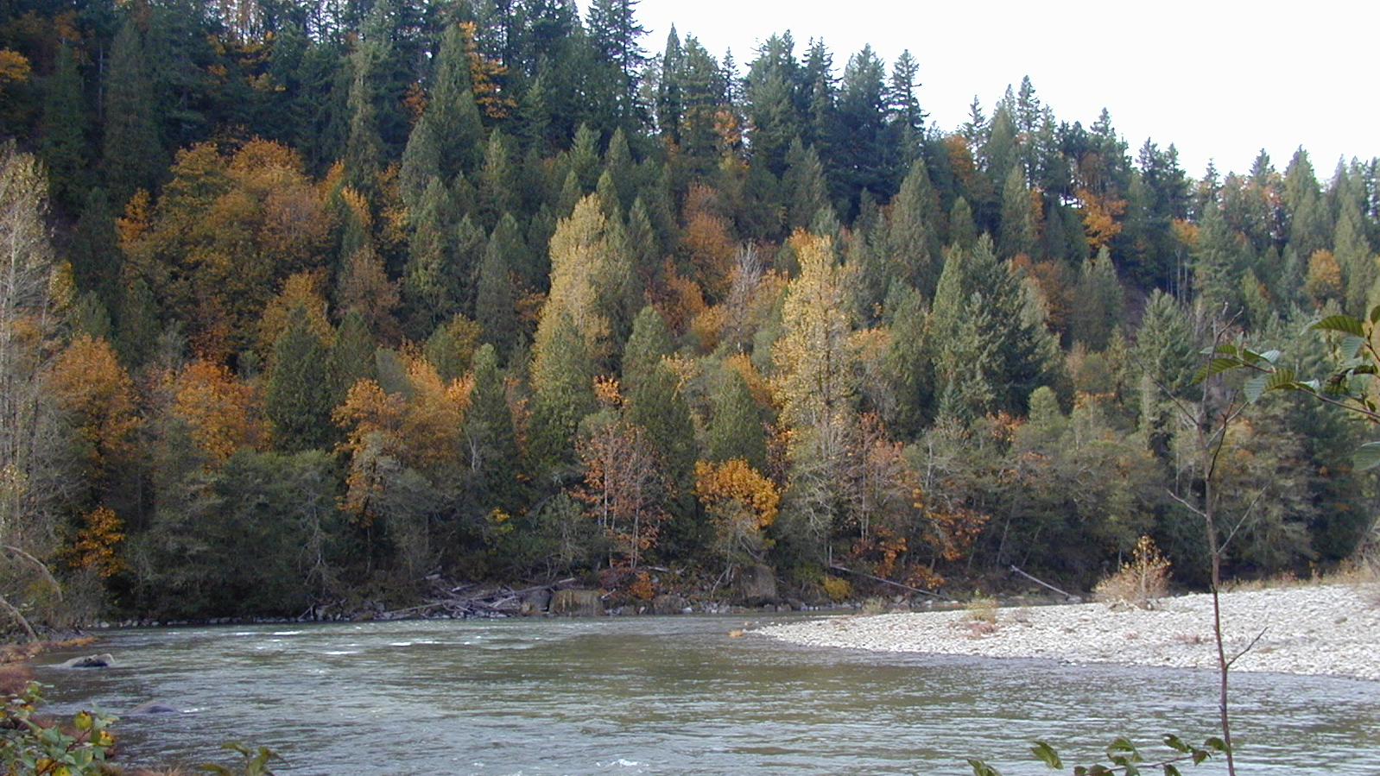
Overall Process
Code Audit
Policy Options & Direction
Adoption
Code Rewrite

Slide 6

Current Project Schedule – Phases 3-4
 | 2026 |  |  |  |  |  |  |  |  |  |  |  | 2027
 | JAN. | FEB. | MAR. | APR. | MAY | JUNE | JULY | AUG. | SEPT. | OCT. | NOV. | DEC. | JAN. | FEB. | MAR. | APR. | MAY
DRAFT CODE AMENDMENTS
REVISED CODE AMENDMENTS
MODULE 1
MODULE 1
CONFORMING AMENDMENTS
REVISED & FINAL CODE AMENDMENTS
ADOPTION READY
CODE AMENDMENTS
MODULE 2
MODULE 2
MODULE 3
MODULE 3
MODULE 4
MODULE 4
STAKEHOLDER MEETINGS
COMMUNITY MEETINGS
ADOPTION PROCEEDINGS
PC MEETING
BOCC MEETING
Note: Updates to the Zoning Code are being prepared in four different parts, or “Modules.” The first three modules will address specific topics or chapters in the Code. The fourth module will include additional needed changes to ensure consistency and clarity throughout the Code.
2

Slide 7
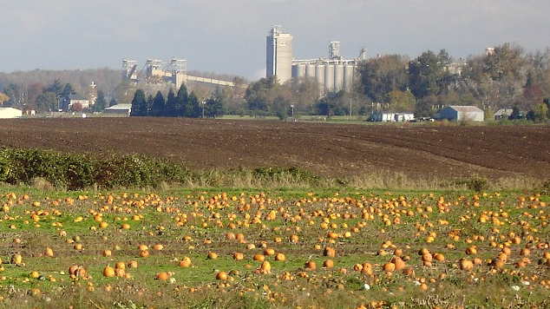
Tasks Completed to Date
All Phase 1 and 2 Activities
Phase 3 Scoping & Initiation
Project Webpage Updates
Module 1 Code Concepts
Module 2 Code Concepts
Module 3 Code Concepts
Module 4 Code Amendments
Notes:
Initial review, recommended edits and discussion with the PC has been done for Module 1 and 2.
Initial review and comments has occurred for Module 3 with PC discussion tonight so initial work is still in progress.
Work on Module 4 is underway by the Consultant team now.

Slide 8
Code Update Organization
Module 1 | Module 2 | Module 3 | Module 4
Part 1 – Administration, Procedures, Enforcement, Permits and Fees Part 3 – General Provisions (Lot of Record) Part 7 – Conditional Uses and Community Service Uses | Part 4 – Base Zones Part 5 – Overlays Part 6 – Common Development Standards | Part 2 – Definitions Part 8 – Specific Use Standards Part 9 – Parcels, Lots, Property Lines and Land Divisions | Conforming amendments Code sections identified for further refinement Additional graphics and formatting
3

Slide 9
Tonight’s Focus: Module 3 Key Issues
Part 8: Specific Use Standards
Improvements to the Site Design Review process and approval criteria
Relocation of specific use standards
Farm Store standards
Incorporation of Middle Housing standards
Part 9: Land Divisions
Revising categories of land divisions from four to two
Streamlining procedures & submittal requirements for tentative plans
Incorporation of Middle Housing land division procedures
4

Slide 10
Site Design Review
Issue: Site design review requirements are not clear and objective and are challenging for planning staff and decision-makers to address. (State Compliance Issue)
Recommendation:
  Remove the site design review requirement for all housing (except multi-unit dwellings), Type C home occupations, and conditional uses.
  Consider replacing the current site design review approval criteria with TGM model code site design review approval criteria.
(1) Relation of Design Review Plan Elements to Environment.
The elements of the design review plan shall relate harmoniously to the natural environment and existing buildings and structures having a visual relationship with the site.
(1) For non-residential uses, all adverse impacts to adjacent properties, such as light, glare, noise, odor, vibration, smoke, dust, or visual impact, are avoided; or where impacts cannot be avoided, they are minimized
5

Slide 11
Specific Use Standards
Issue: Relocate some specific use standards to more appropriate parts of the code (Organizational Issue)
Examples:
  Move the accessory structures standards located in each base zone to Part 8.
  Move the landscape requirements from the Site Design Review section to part 6 common development standards and update to be clear and objective.
  Benefit: Improves logic and navigability of the code
6

Slide 12


Farm Store Standards
Issue: Updating of rules for consistency with both current state rules, as well as current county policy direction (Policy Issue)
Recommendation:
  Continue to review HB 4153 and consult with DLCD regarding how best to implement the County’s Code, consistent with the legislation.
  Based on continue review, consultation with DLCD, and further community and decision-maker engagement, recommend changes to these code provisions at a later date
7

Slide 13
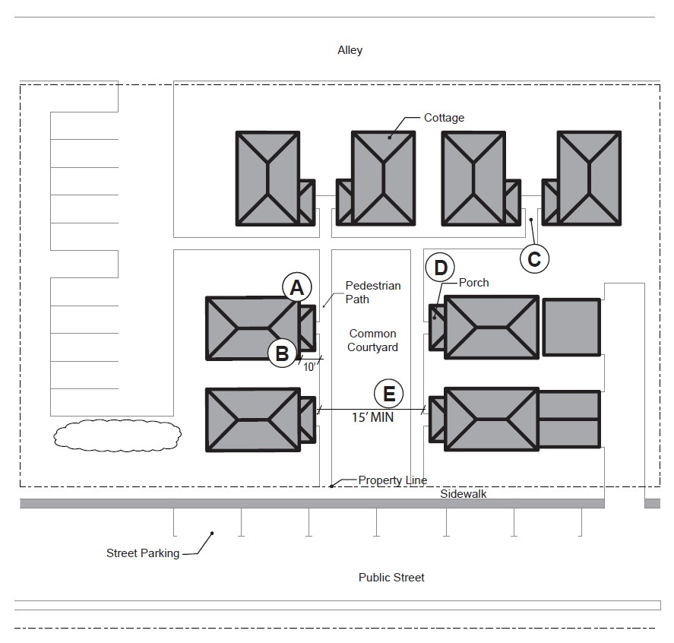
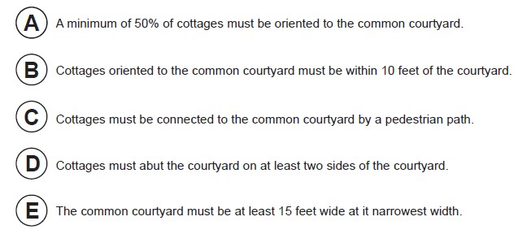

Middle Housing Standards
Issue: Standards for Middle Housing (State Compliance Issue)
Recommendation:
  Incorporate standards from the OHNA model code for large cities into a proposed new section in part 9 to provide C&O standards for middle housing development.
  Note: These standards will only apply in Interlachen and a few properties in urban pockets
8

Slide 14
Land Divisions
Issue: Updated the land division application and review processes to improve usability and clarity in the code and ensure compliance with recent state laws (Streamlining and State Compliance Issue)
Examples:
  Eliminate the four categories for Land Division applications and replace with two categories (Type II Land Divisions and Type III Land Divisions).
  Update the review procedures for Tentative Plans and Final Plats and the application submittal requirements. Use the TGM Model Code (2026) as a template, while customizing the updated standards for Multnomah County.
§ 39.9400 GENERAL REQUIREMENTS
A. Subdivision and Partition Approval Through Two-Step Process.
Applications for subdivision or partition approval shall be processed by means of a tentative plan evaluation and a final plat evaluation, according to the following two steps:
1. The tentative plan must be approved before the final plat can be submitted for approval consideration; and
2.The final plat must demonstrate compliance with all conditions of approval of the tentative plan.
9

Slide 15
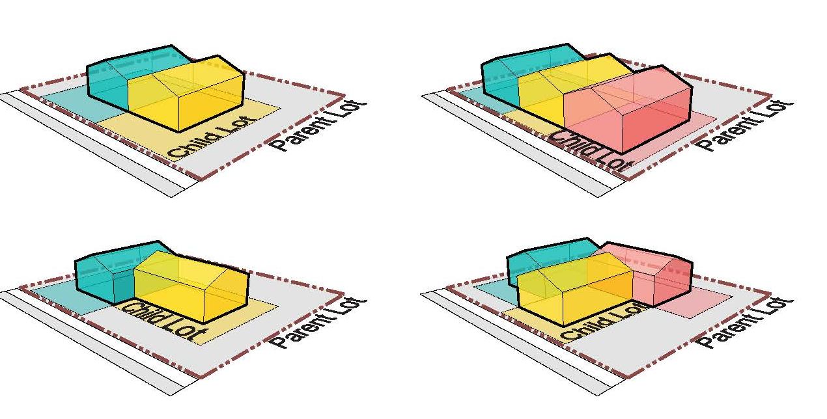
Middle Housing Land Divisions
Issue: Middle Housing Land Divisions (State Compliance and Policy Issue)
Options:
 | Inside UGB | Outside UGB
Allow Middle Housing Types | Required | Optional (considering duplexes)
Allow Middle Housing Land Divisions | Required | Optional for any Middle Housing Types Allowed
10
Notes:
State law requires the County to allow for Expedited Land Divisions and Middle Housing Land Divisions (MHLD). Incorporate new procedures and approval criteria into Part 9 as required.
As incorporated, the MHLD procedures are only applicable to lots entirely within the UGB. The County will need to determine whether MHLDs should be allowed within the RC zones if duplexes are allowed in those areas.
State requirements for MHLDs are very prescriptive and model code language from the state is recommended to be used.
Most counties and cities do not administer these provisions through their development code but address them through other non-land use application and review procedures.

Slide 16



Next Steps
PREPARE CODE UPDATE MODULE 4 REVIEW WITH STAFF
CONDUCT PC WORK SESSON FOR MODULE 4 AND BOCC PROJECT BRIEFING
PLAN FOR AND CONDUCT STAKEHOLDER MEETINGS
11

Slide 17
Next Steps – Stakeholder & Community Outreach
Stakeholder Meetings
Reconvene Phase 1+2 Stakeholders
Discuss Approach to Priority Recommendations
Use Results to Inform Community Meetings and Refine Code Amendments
Conduct and Summarize in late June
Community Engagement
Hold Community Meetings (similar to Phases 1+2)
Update People on Work to Date
Ask for Opinions Related to Priority Recommendations
Conduct and Summarize in early Fall
12

Slide 18
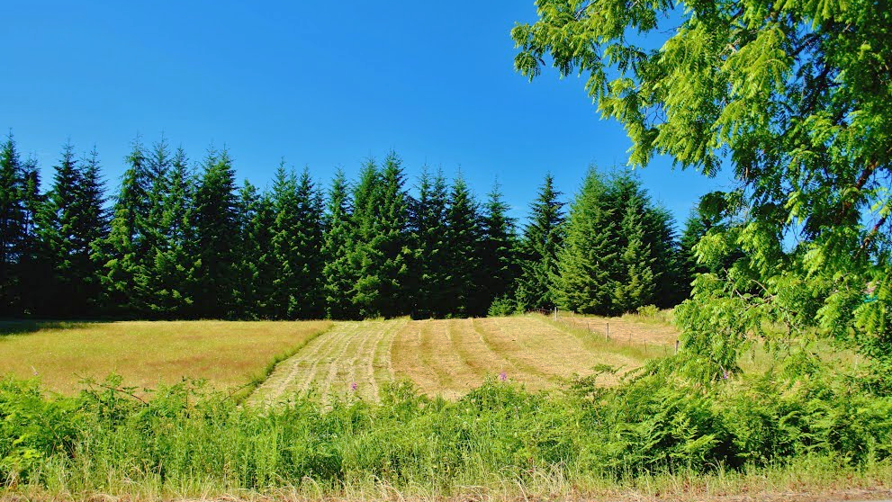
Additional Questions and Discussion
13

Slide 19
Project Contact Info
Kevin Cook, Principal Planner
kevin.c.cook@multco.us
971-421-3497
Department of Community Services
Land Use Planning
1600 SE 190th Ave
Portland OR 97233
14

