Slide 1


Multnomah County
Code Update Project
Planning Commission Meeting
September 15, 2025

Slide 2
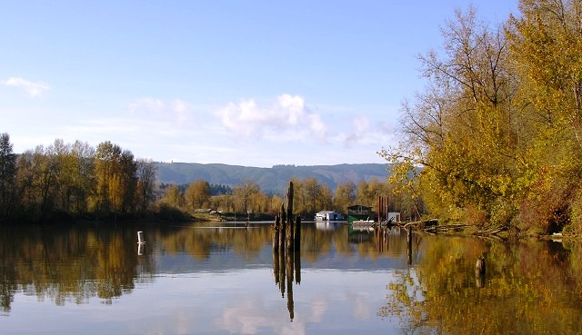
Presentation
Agenda
Introductions
Project Update
Community Engagement Findings
Code Amendments Approach
Next Steps
Questions & Discussion

Slide 3
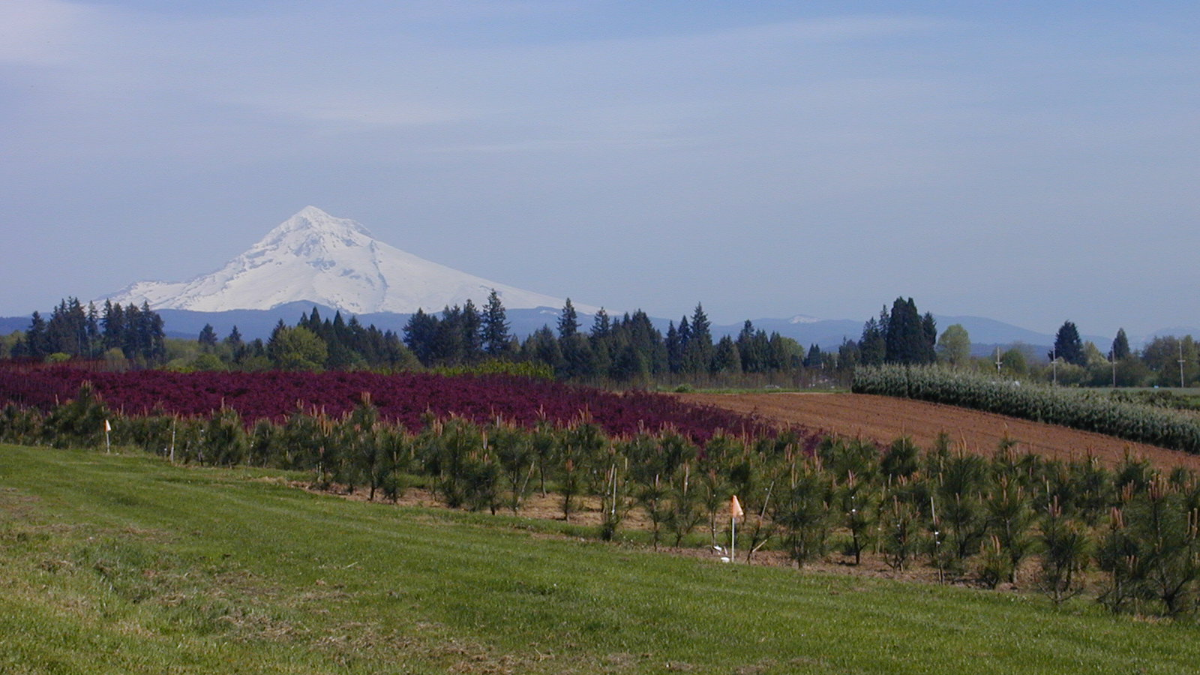
Introductions
County Staff Team
Megan Gibb, Land Use Planning Director
Kevin Cook, Principal Planner
Consulting Team (MIG)
Matt Hastie
Emma-Quin Smith
Carrie Brennecke
Cathy Corliss

Slide 4
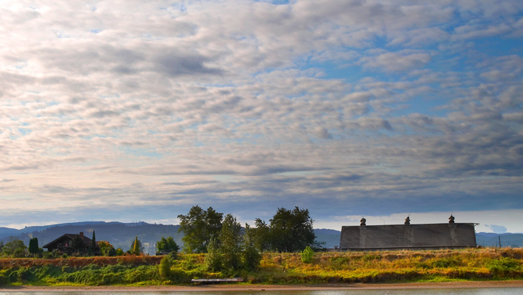
Project Background
Project Goals
Update and modernize the Zoning Code
Make the code consistent with County policy priorities
  Promote affordable housing, social equity, climate resiliency, and customer service
Ensure housing related provisions are Clear & Objective (C&O) and comply with State legal requirements
Funded with County and State Grant Funding

Slide 5
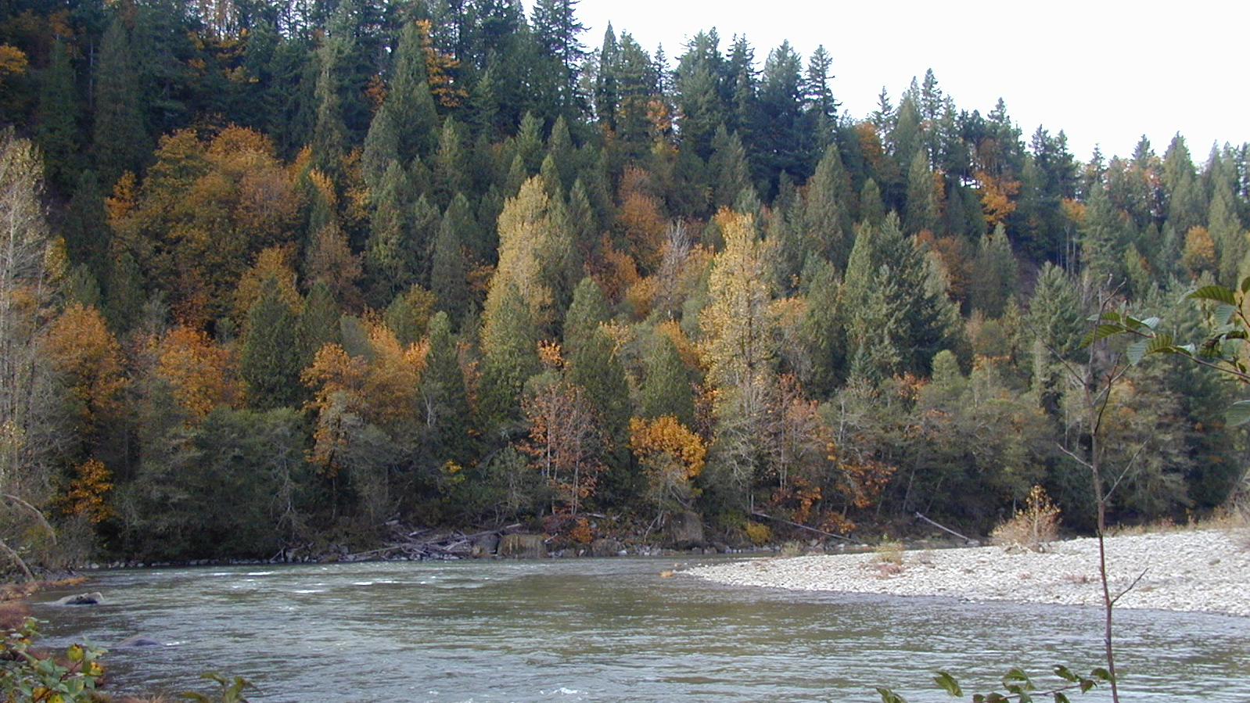
Overall Process
Code Audit
Policy Options & Direction
Adoption
Code Rewrite

Slide 6

Current Project Schedule – Phases 1-2
2025
JANUARY | FEBRUARY | MARCH | APRIL | MAY | JUNE | JULY | AUGUST | SEPTEMBER | OCTOBER
PROJECT KICK-OFF
BEST PRACTICES RESEARCH
FOCUS GROUP INTERVIEWS
COMMUNITY ENGAGEMENT
CODE AUDIT
KEY ISSUES REFINEMENT
PC MEETING
SEEKING POLICY DIRECTION
BOCC MEETING

Slide 7
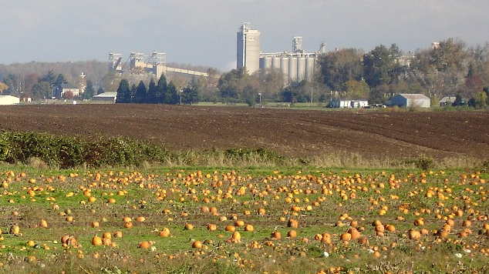
Tasks Completed to Date
Project Kickoff and Goal-Setting
Meeting with Current Planning Staff
Best Practices Research
Focus Group Meetings
Code Audit Report
Summary of Key Findings
Planning Commission Briefing
Community Meetings
Refined Recommendations

Slide 8
Code Issues
CODE ORGANIZATION
APPLICATION PROCEDURES
COMMON DEVELOPMENT STANDARDS
CONDITIONAL USES
SPECIFIC USE STANDARDS

Slide 9
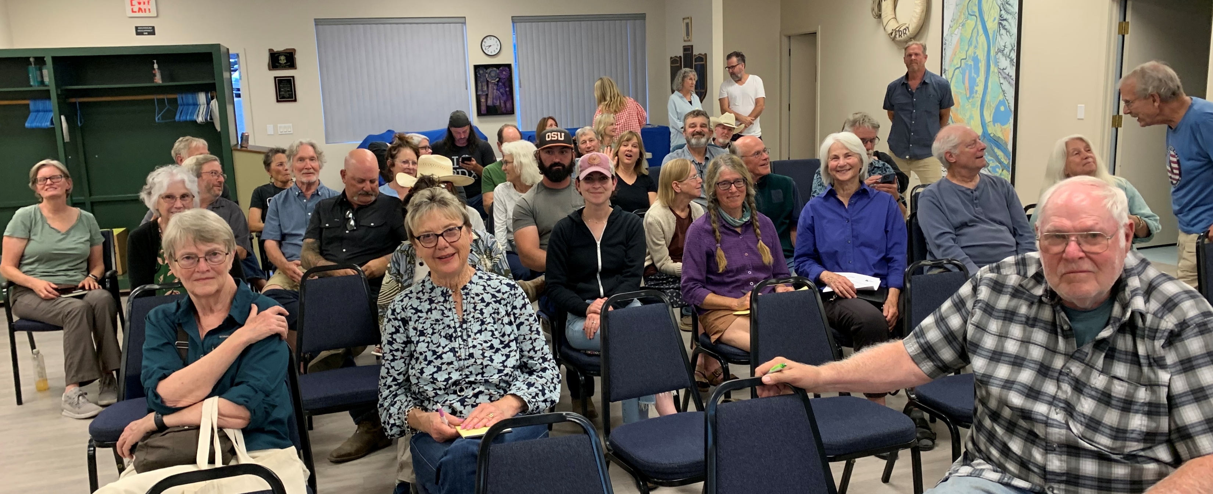
Community Engagement Process
Three in-person meetings co-hosted with neighborhood groups – Forest Park, Sauvie Island, Corbet (NEMCCA)
One hybrid meeting @ Multnomah Bldg –targeted to Ag community
Online presentations and survey – available for five weeks
Publicized via County website,
interested parties list, NH
associations, social media
About 120 participants in-
person and 55 online

Slide 10
Community Feedback
Code language is too complex, hard to understand and interpret
Lengthy and expensive permitting processes
Professional assistance needed for even minor applications
Lot of record and full compliance standards are significant issues
Clear & objective standards are needed; consistent interpretation lacking
Support agricultural community’s needs & opportunities
Need for customer service improvements
Improve coordination with City of Portland and NSA

Slide 11
Refined Recommendations
Transition to 1-column format
Simplify complex explanatory narrative
Use more tables & graphics to illustrate processes and standards
Consolidate location for Permitted Land Uses for all zones via use tables
Simplify application review process and update process graphics
Consider expedited review process for certain uses
Make discretionary language clear and objective (C&O), particularly for housing

Slide 12
Refined Recommendations
Clarify decision process for the development of housing
Consolidate definitions
Update conditional use purpose, criteria, and uses
Evaluate agri-tourism standards; coordinate with state process
Address high priority specific issues:
  Lot of record verification
  Full compliance and non-conforming situations
  Parking & other site development requirements
  Non-land use requirements (e.g., grading and erosion control)
  Accessory buildings
  Modification to approved plans
  Other short-term priority issues

Slide 13
Next Steps: Code Amendments
Near Term
Minor accessory structures
Process for minor modifications to approved plans
Process for Agricultural Fill Permit
Process for Marijuana Business Permit
Minor amendments to Administrative Procedures
Other minor housekeeping amendments
6 Months
Lot of record verification
Nonconforming situations (uses, lots, & development)
Full compliance requirements
Long Term
Simplify code language reformat document
Reformat text to one-column
Clarify application procedures
Insert use tables for base zones
Right-size development standards
Address state administrative rules and statutes
Expand the use of graphics
Ensure requirements related to development of housing are C&O

Slide 14



Next Steps
CONTINUE TO REFINE AMENDMENT OPTIONS BASED ON COMMISSION & COMMUNITY INPUT
BRIEF PC AND BOCC ON RESULTS
EMBARK ON PHASE 3 (CODE UPDATES) IN COORDINATION WITH STATE-FUNDED WORK

Slide 15
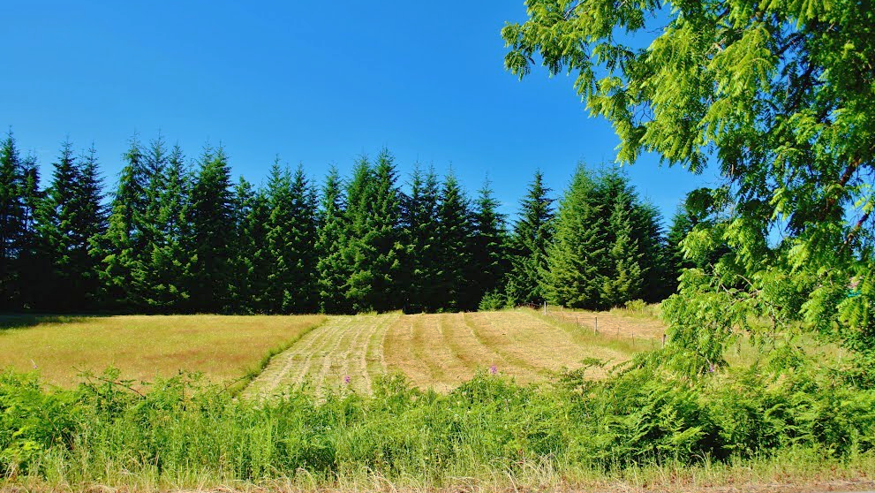
Questions and Discussion

Slide 16
Project Contact Info
Kevin Cook, Principal Planner
kevin.c.cook@multco.us
971-421-3497
Department of Community Services
Land Use Planning
1600 SE 190th Ave
Portland OR 97233

