Slide 1
Multnomah County
Land Use Planning Division
Briefing to the Planning Commission on unincorporated County Housing Options
June 1, 2026
Kevin Cook, Principal Planner

Slide 2
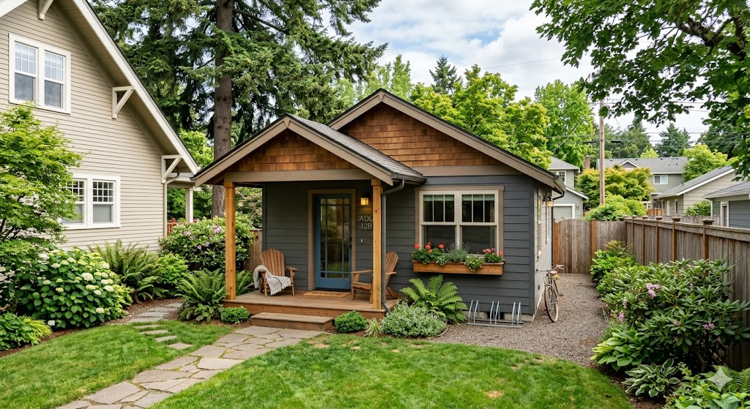
Background: Planning Context
Under Oregon’s statewide planning system, housing is primarily the responsibility of cities within the Urban Growth Boundary (UGB). Outside the UGB, focus is on protecting farm, forest, and natural resources.
Exception Zones
Key Regulations
Multnomah County exception zones retain rural residential designations:
Rural Residential (RR)
5 acre minimum lot size
Multiple Use Agriculture (MUA-20)
20 acre minimum lot size
•Properties typically range from 2 to 20 acres.
•Limited to one single dwelling unit per property.
•Accessory Dwelling Units (ADUs) are only allowed if located within the Urban Growth Boundary.

Slide 3
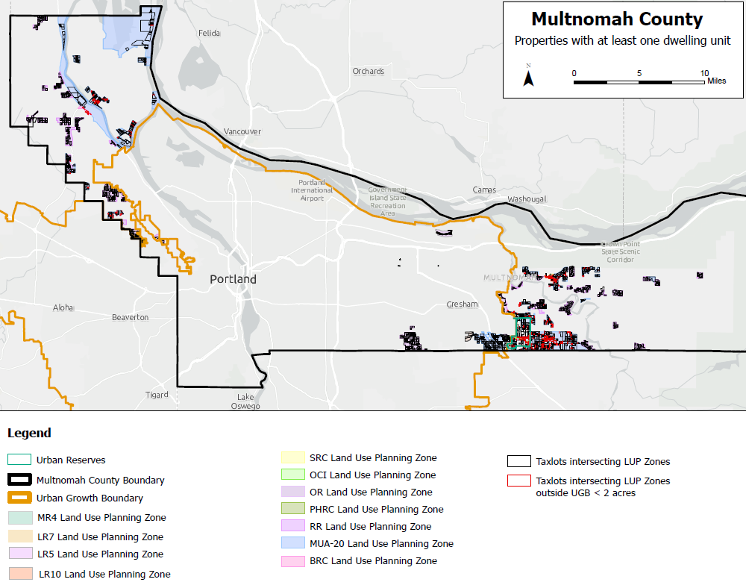

Slide 5
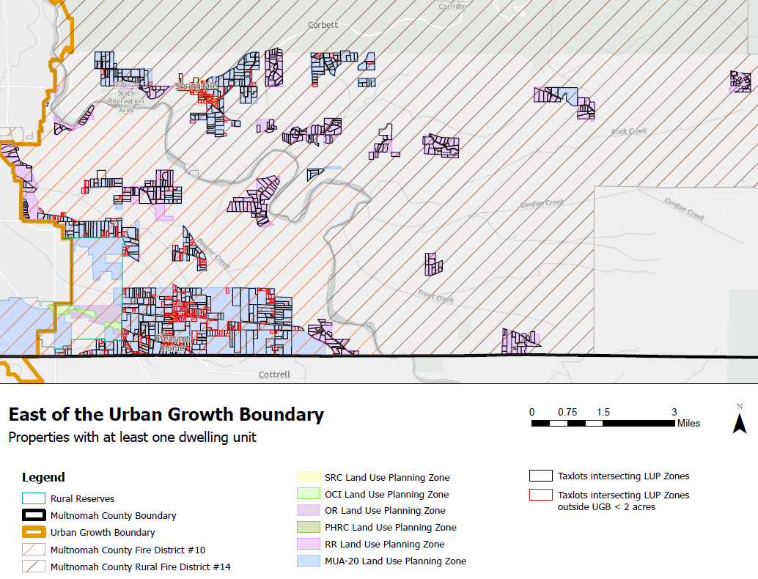

Slide 6
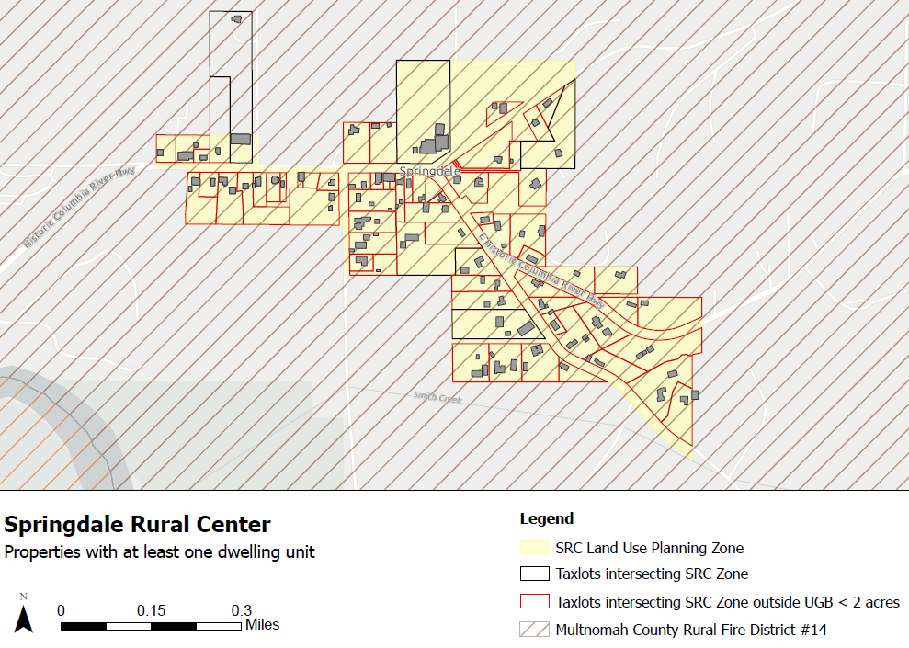

Slide 7
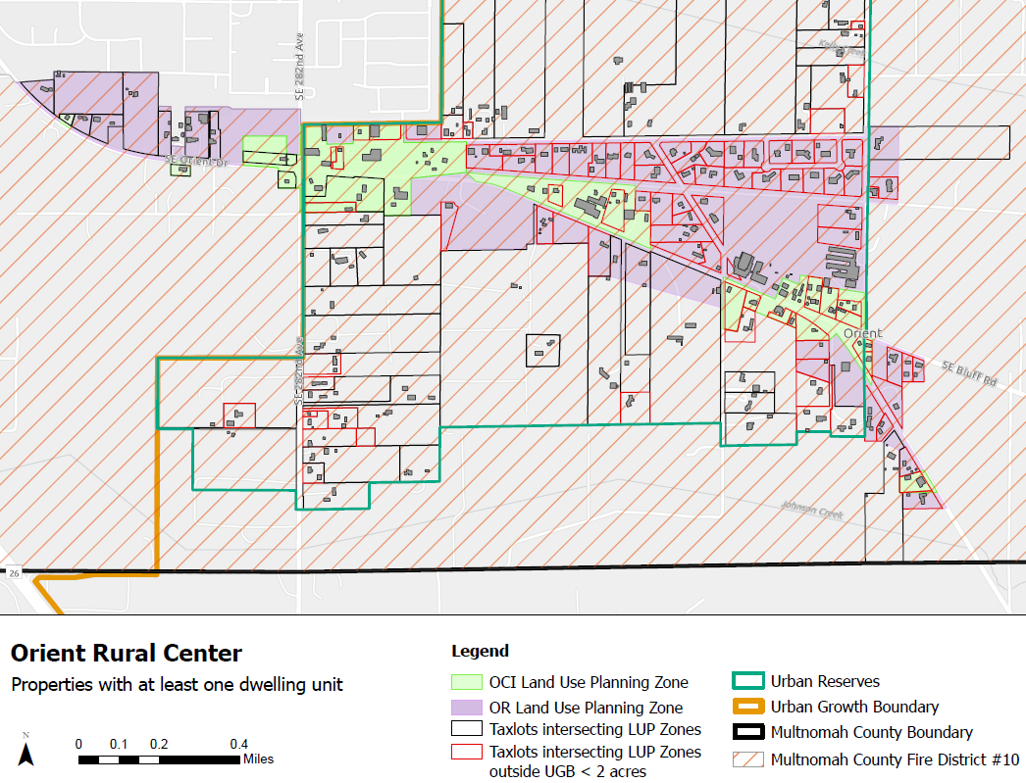

Slide 8
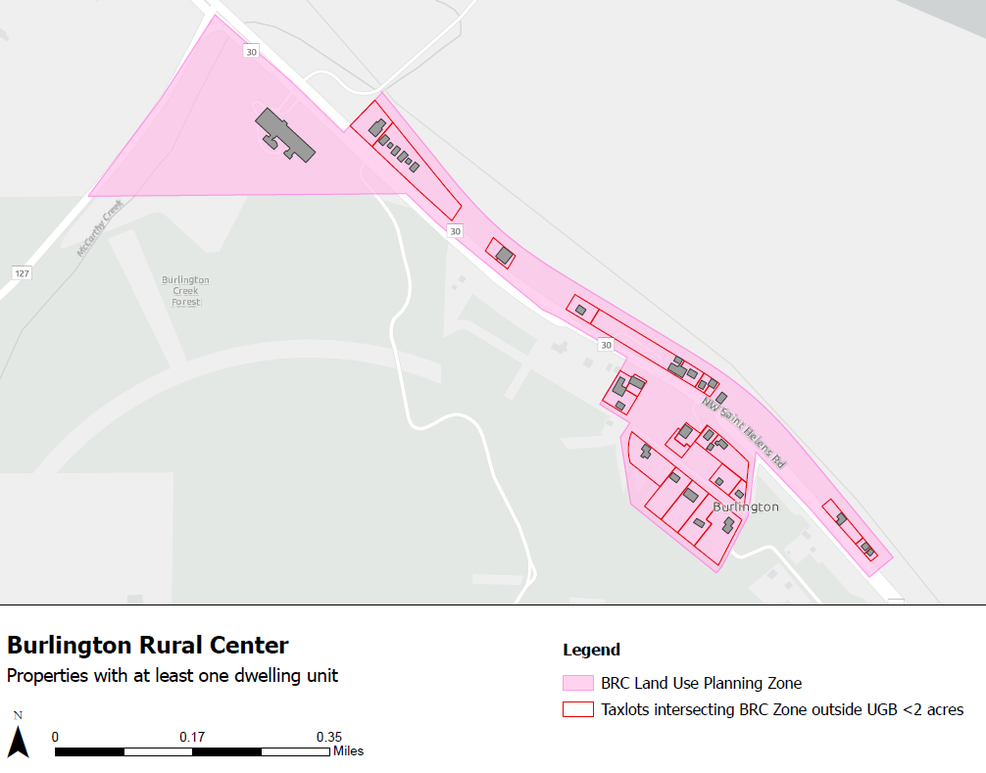

Slide 9
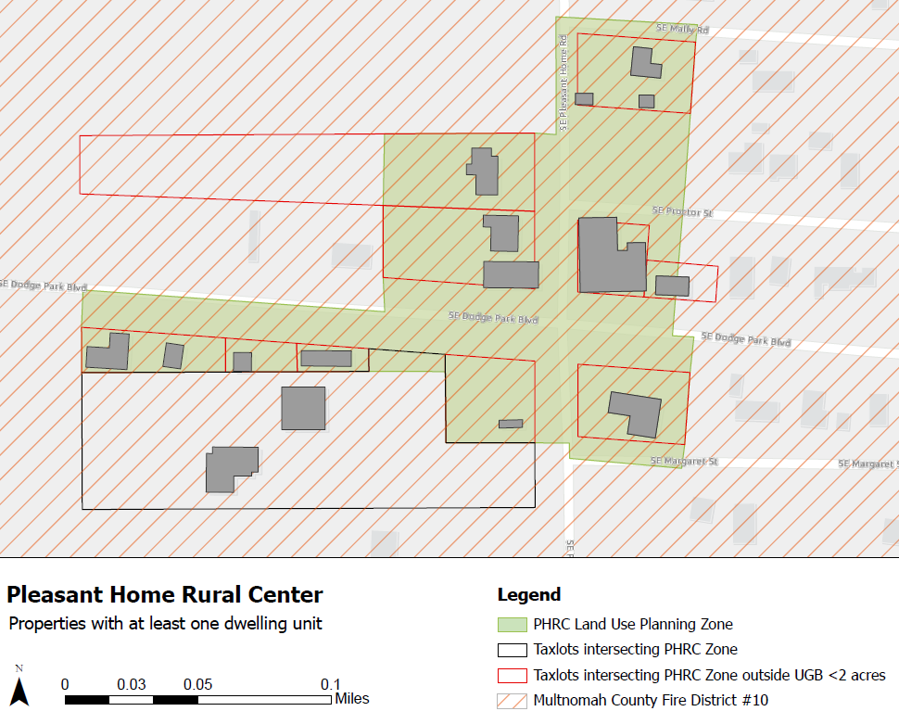

Slide 10
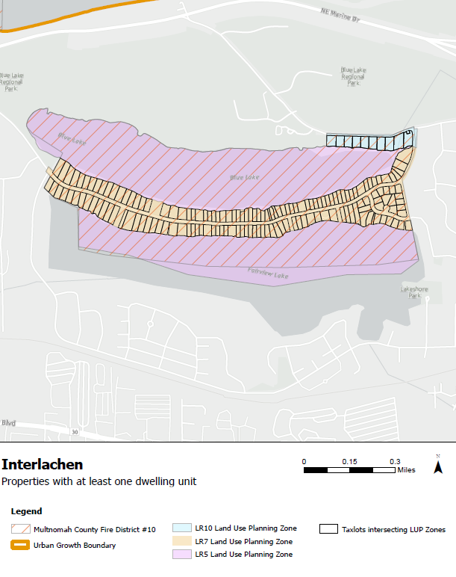

Slide 11
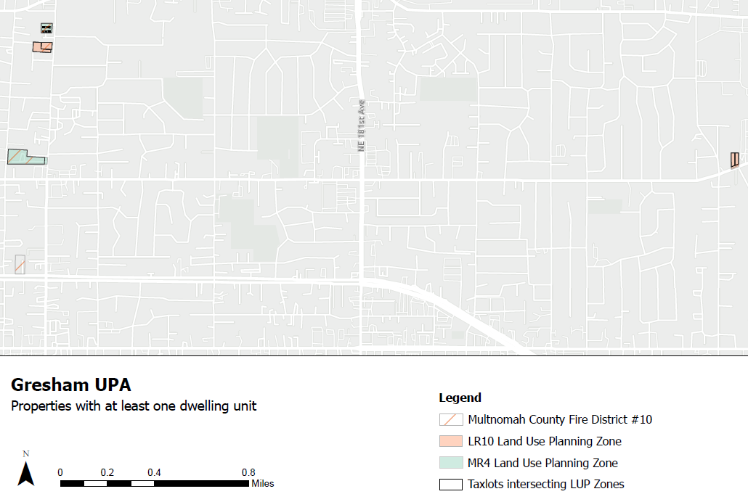

Slide 12

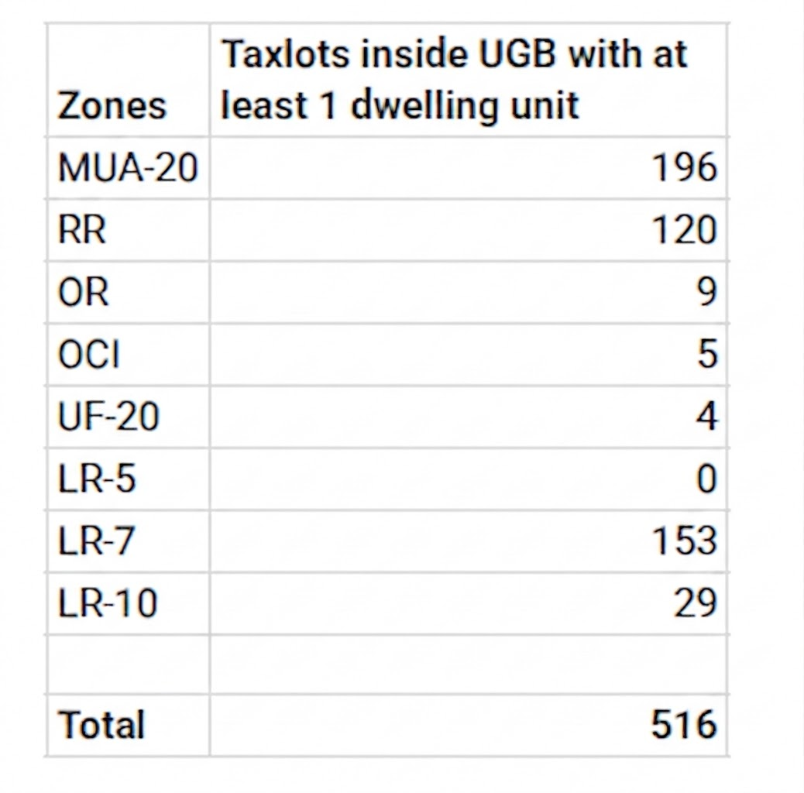
Current ADU Regulations
Regulatory Context
ADUs are currently only allowed within the Urban Growth Boundary (UGB).
State mandate requires ADU options for properties zoned for single-unit dwellings outright.
Per SB 1051 (2017) – ORS 197.312
Applicable Zones in the UGB
Taxlots inside UGB with at least 1 dwelling unit

Slide 13
Current ADU Regulations - Site Standards
Operational Context
County Regs in place since 2018.
ADUs must be attached or 7–20 ft from main dwelling.
Clustering preserves land for future urbanization.
Take-up Rate:
Only one property (RR zone, Pleasant Valley) has utilized this since 2018.
Design Standards
Max Size: 800 sq. ft.
Relative Size: Max 75% of primary dwelling area.
Code Reference: MCC 39.4360(L)
architecture

Slide 14
New Housing Options Outside the UGB
SB 391 (2021) - Rural ADU Framework
Establishes first-time ADU options outside the Urban Growth Boundary.
Zones: Exception zones (RR and MUA-20).
Lot Size: Must be 2+ acres and outside Urban Reserve.
Location: Max 100 ft. from existing dwelling.
Size: Up to 900 sq. ft. of usable floor area.
Eligibility: Must be served by fire district; no vacation rentals.
Properties with 2+ dwellings or floating homes are ineligible.
Subsequent Legislation (2023)
SB 644 - The "Fix" Bill
Bypassed state wildfire map delay to start rural ADU approvals.
SB 1013 - Rental RVs
Allows one permanent rental RV in RR/MUA-20 zones.
Properties 1+ acre.
Cannot have both ADU and RV.
gavel

Slide 15
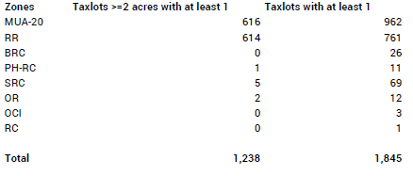
Table 2 - Tax Lots Outside UGB

Slide 16
Primary Policy Options
ZCIP Project:
Allow ADUs in RR and MUA-20 zones outside UGB and Urban Reserves?
Allow ADUs in Rural Center zones?
Allow RVs as dwelling units - all exception zones and rural centers?
Separate Planning Process:
Allow Duplexes in Rural Center zones?

