Slide 1
PCC CLEAR Clinic
Free Legal Services
Leni Tupper
alena.tupper15@pcc.edu

Slide 2
Legal Services
Criminal record expungements
Eviction expungements
Eviction legal defense
DACA renewals
Immigration screenings
Limited scope deportation defense
Legal name & gender-marker changes

Slide 3
The PCC CLEAR Clinic is here to help you reach your goals.
We believe that clearing up criminal records, eviction records, and immigration issues can help you succeed and can help us all build a stronger community.

Slide 4
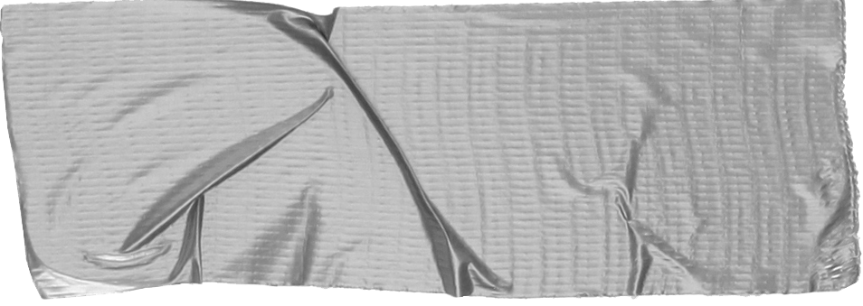
1. Criminal Record Expungements
If you have been arrested for or convicted of a crime, you may be eligible to have your criminal record “cleared” after a certain amount of time has passed
Immediately -7 years, depending on the crime
Clearing criminal records provides more opportunity for jobs, housing, education
Simple- fill out our intake form or come in person to Cascade on Fridays (TH 203)

Slide 5
2. Eviction Defense & Expungements
If you have an eviction on your record, you may be eligible to get it taken off!
Immediately-5 years, depending on the type of eviction
Clearing eviction records provides more opportunity for safe, secure, stable housing
Simple- fill out our intake form
We also offer eviction defense services, call 1-888-585-9638

Slide 6
3. DACA Renewals & Immigration Screenings
If you have had DACA in the past, you can still file to renew your application
The Government is not currently processing new DACA applications
File 150 days before expiration
If you do not have lawful immigration status and want to see options, we provide free immigration screenings!
Simple- fill out our intake form

Slide 7
4. Limited Scope Deportation Defense
If you are in deportation/removal proceedings (immigration court) we can help provide limited scope deportation legal defense through the Equity Corps of Oregon program
To get navigated into the FREE deportation defense program Equity Corps of Oregon, call 1-503-360-0324
Free! We can also refer you to other organizations for other immigration applications

Slide 8
5. Legal name & gender-marker changes
If you live in the state of Oregon and would like to change your legal name and/or gender-marker, we can help you with that!
Immediate availability
Remote or in person assistance
Simple- fill out our intake form

Slide 9
What people are saying
The CLEAR Clinic helped me with my name and gender- marker change over. It was super easy and approachable. No legalese, just legal ease!
Thanks to the CLEAR Clinic for helping me get my DACA renewed on time, what a sigh of relief!
The CLEAR Clinic helped me clear my record and obtain housing- I couldn’t be happier!

Slide 10
How to request our services?
Via our INTAKE FORM-
www.pcc.edu/clear-clinic/intake-form
We also have walk-in hours! PCC Cascade, Terrell Hall Room 203
Tuesdays, 12-4 pm (immigration)
Fridays, 12-4 pm (expungements)

