Slide 1
Urban Design and Aesthetics Working Group Mtg #3
Attendees join meeting via WebEx link in calendar invite
Department of Community Services Transportation Division
October 28, 2020

Slide 2
Bridge Concept Animations

Slide 3
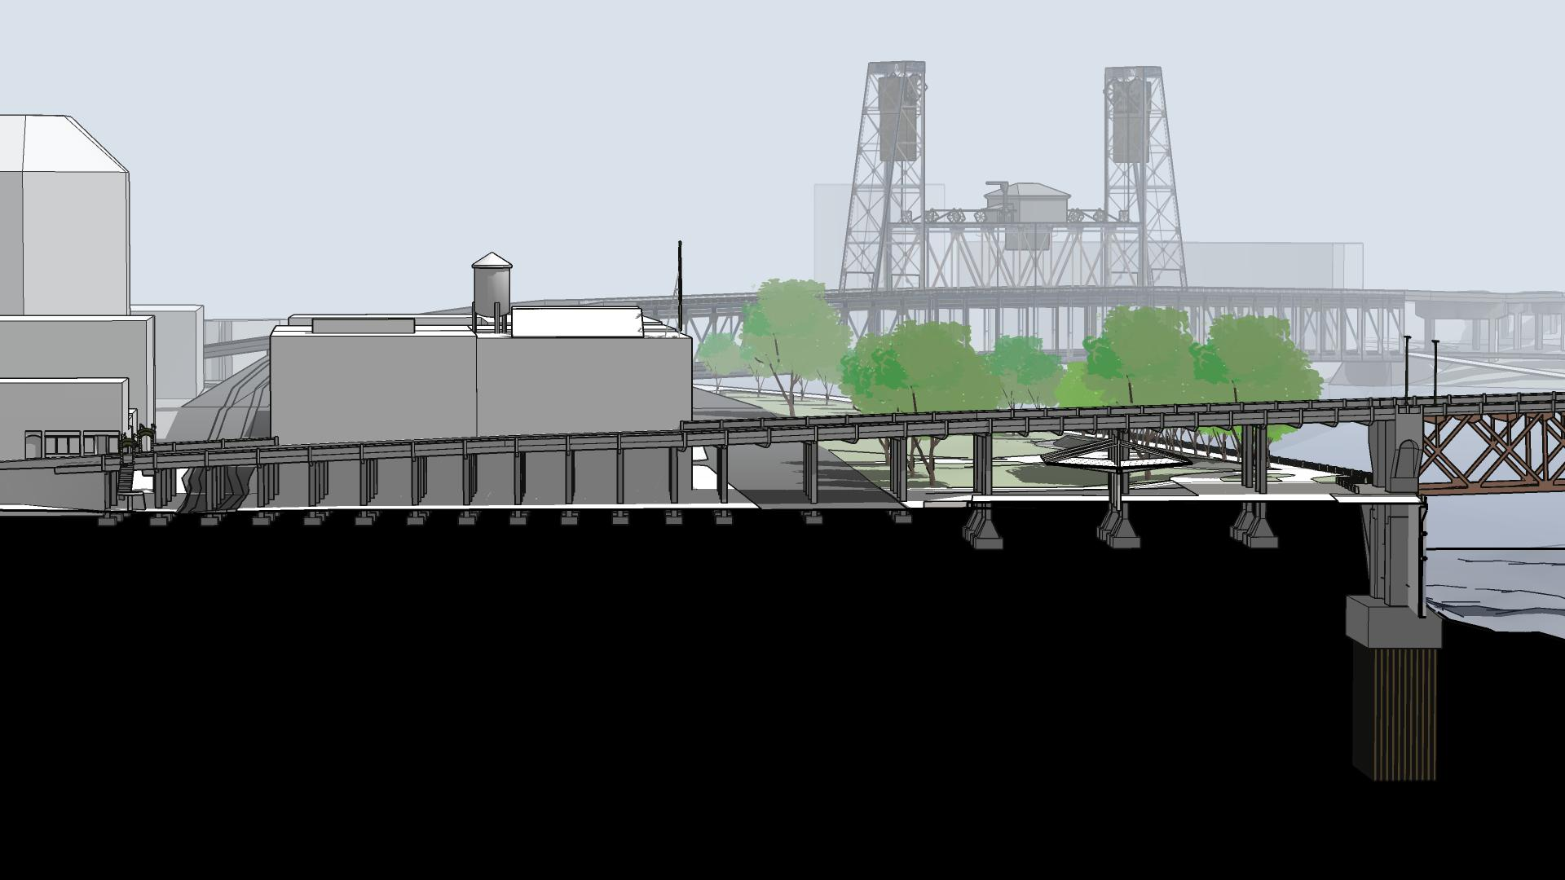
West Approach View: Existing Bridge
Made in Oregon Sign
on UO Bldg
Portland Rescue Mission
15.5’
TriMet Max
18’
Naito Parkway
Saturday
Market Pavilion
CSO Pipe
Geotechnical Hazard Zone

Slide 4
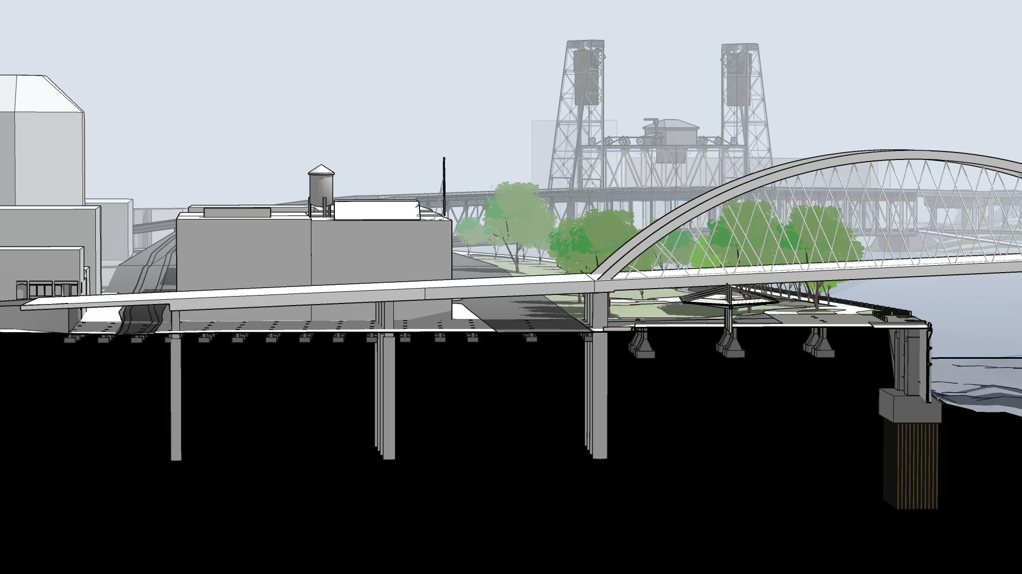
West Approach View: Tied Arch Concept
18’
Naito Parkway
23’
15.5’
TriMet Max

Slide 5
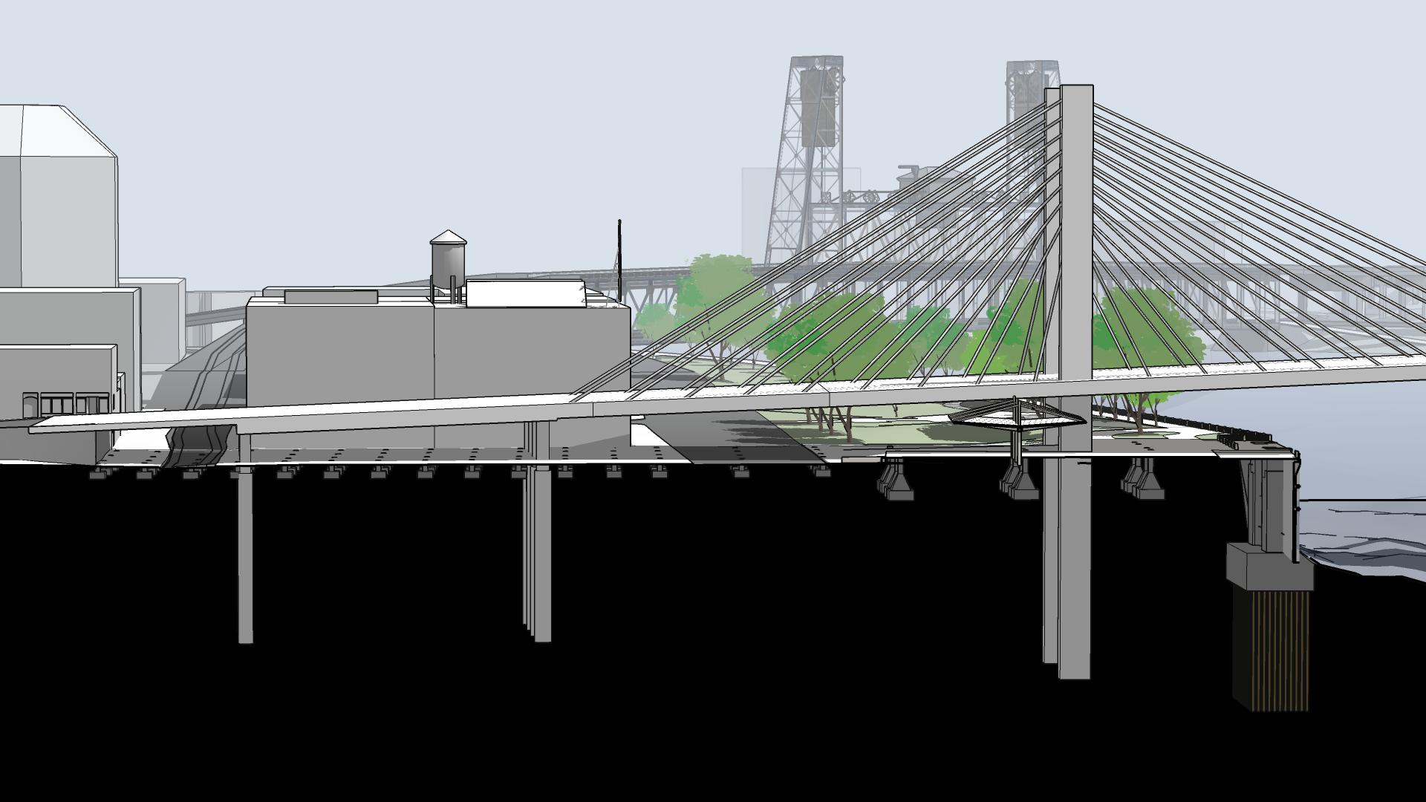
West Approach View: Cable Stayed Concept
18’
23’
15’-6”

Slide 6
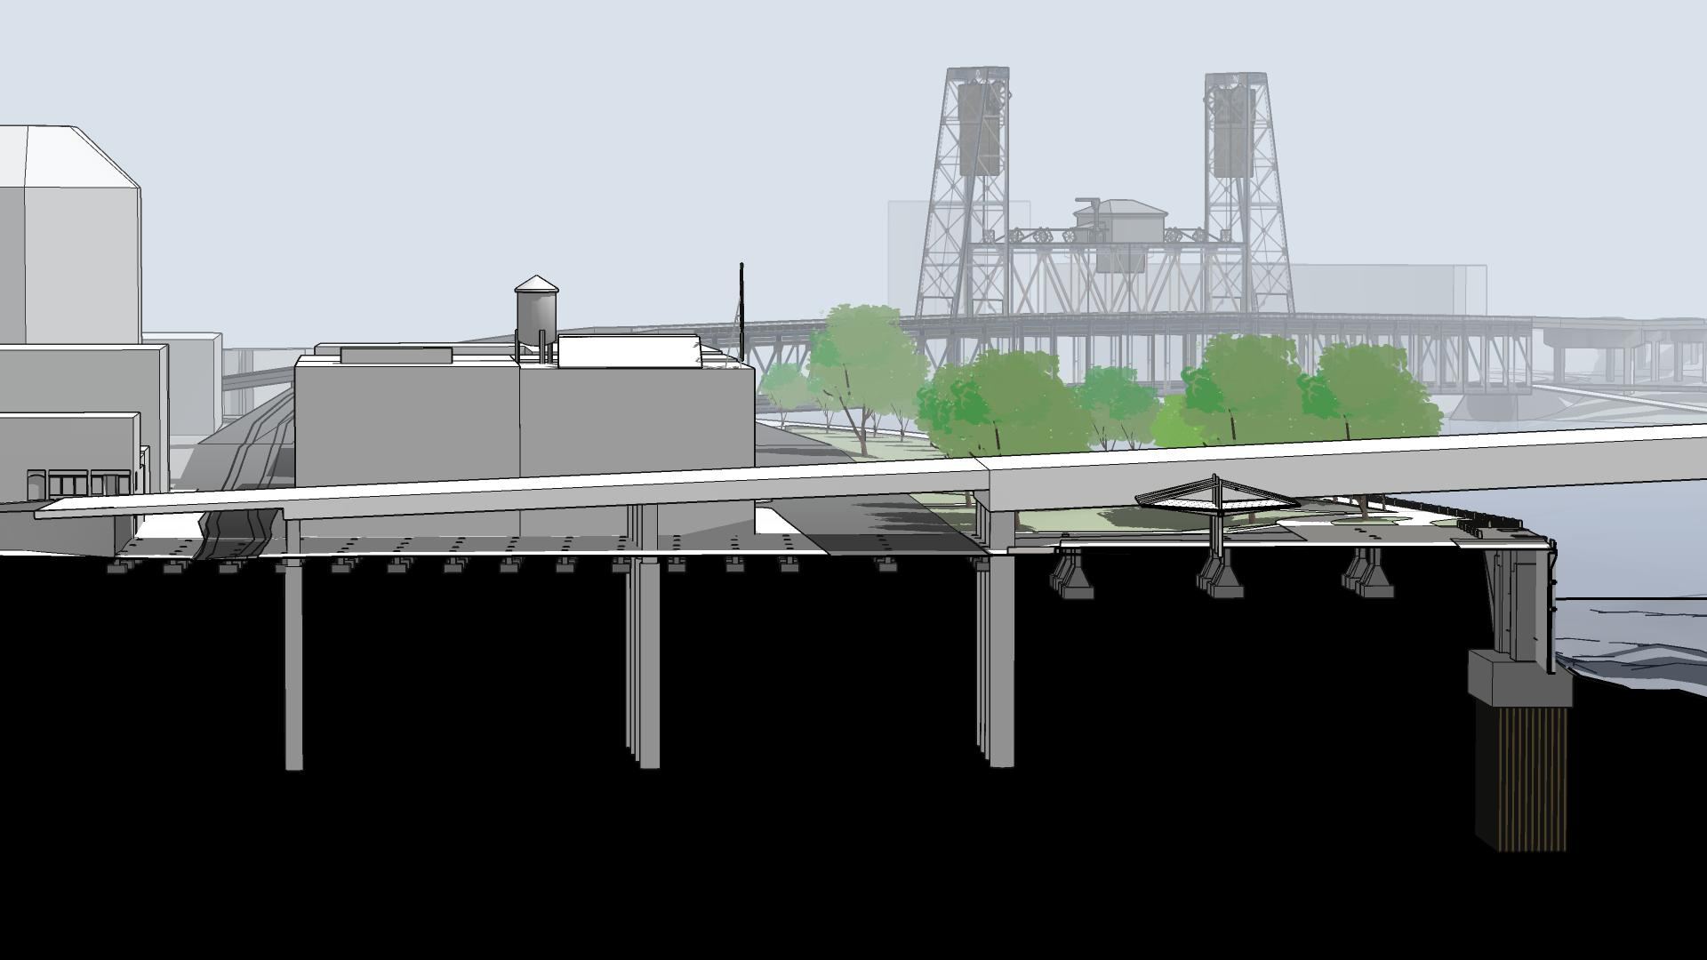
West Approach View: Steel Girder
18’
14’
15’-6”

Slide 7
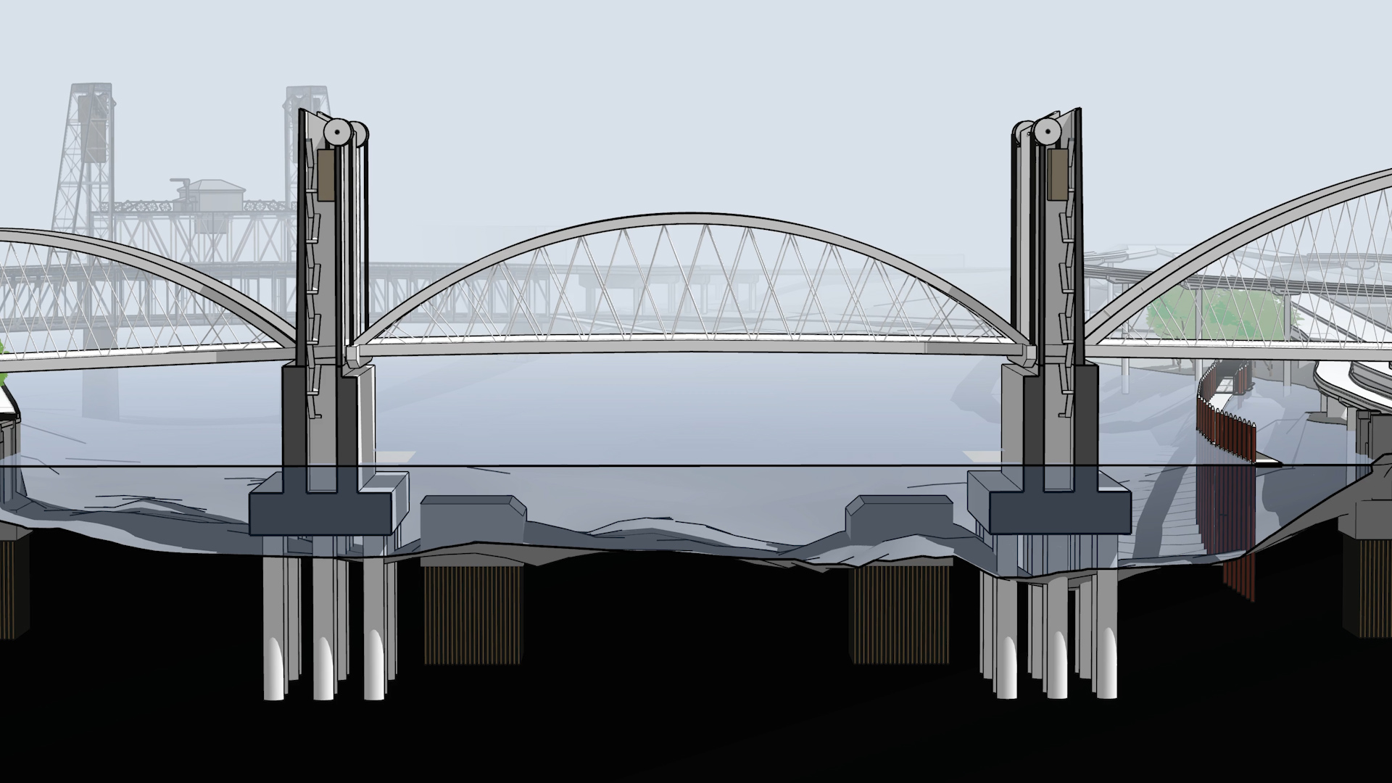
River View: Vertical Lift + Tied Arch Concept
Sheaves
Counterweights
Access Stairs
Machine room

Slide 8
River View: Vertical Lift + Tied Arch Concept
Navigation Clearance

Slide 9
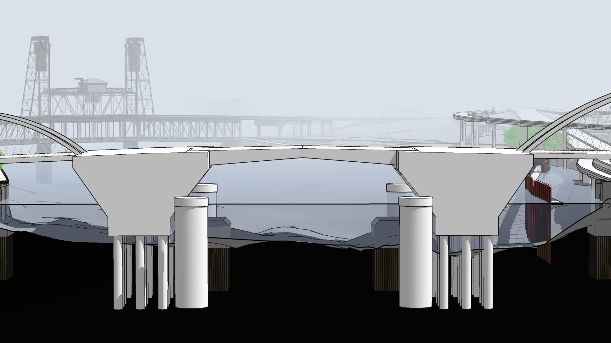
River View: Bascule + Tied Arch Concept
Trunnion
Counterweights
Machine
Room
Dolphins

Slide 10
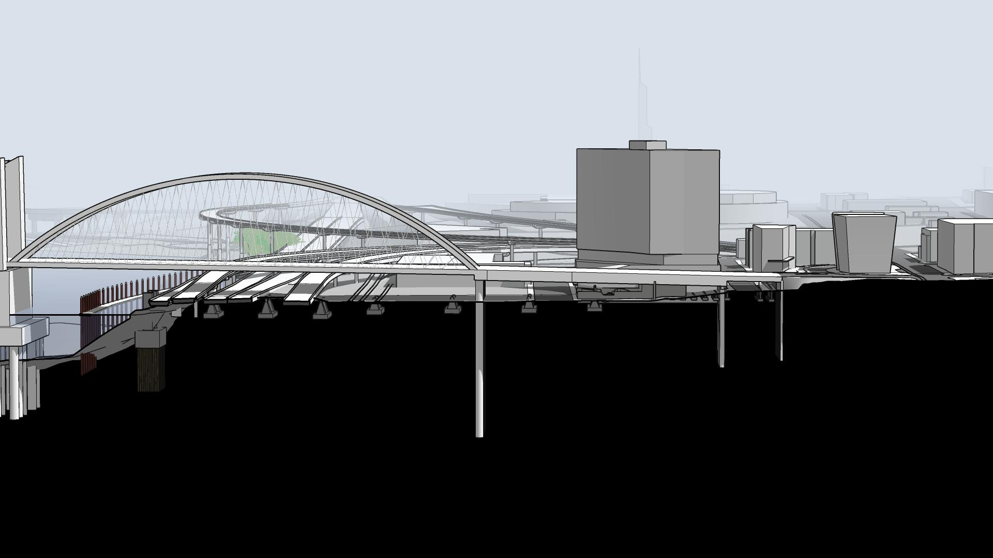
East Approach View: Tied Arch Concept
27’
13.7’
25’
17.3’
23.5’
18’
17.3’
24’
I-5 / I-84
Union Pacific Railroad
2nd Ave
3rd Ave
MLK
Burnside Skatepark
Geotechnical Hazard Zone
CSO Pipe

Slide 11
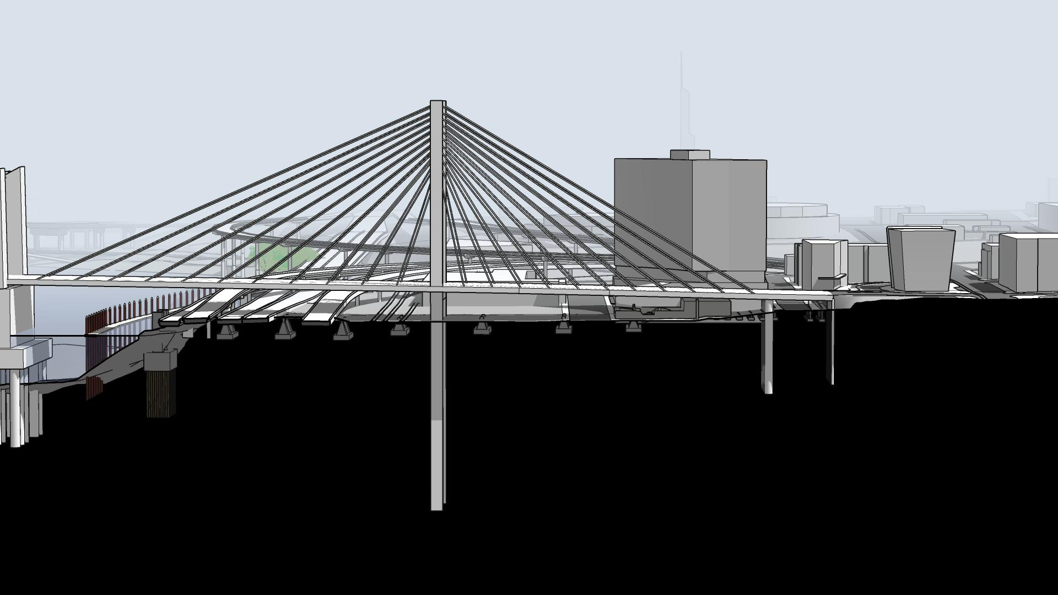
East Approach View: Cable Stayed Concept
27’
13.7’
25’
17.3’
23.5’
18’
17.3’
24’

Slide 12
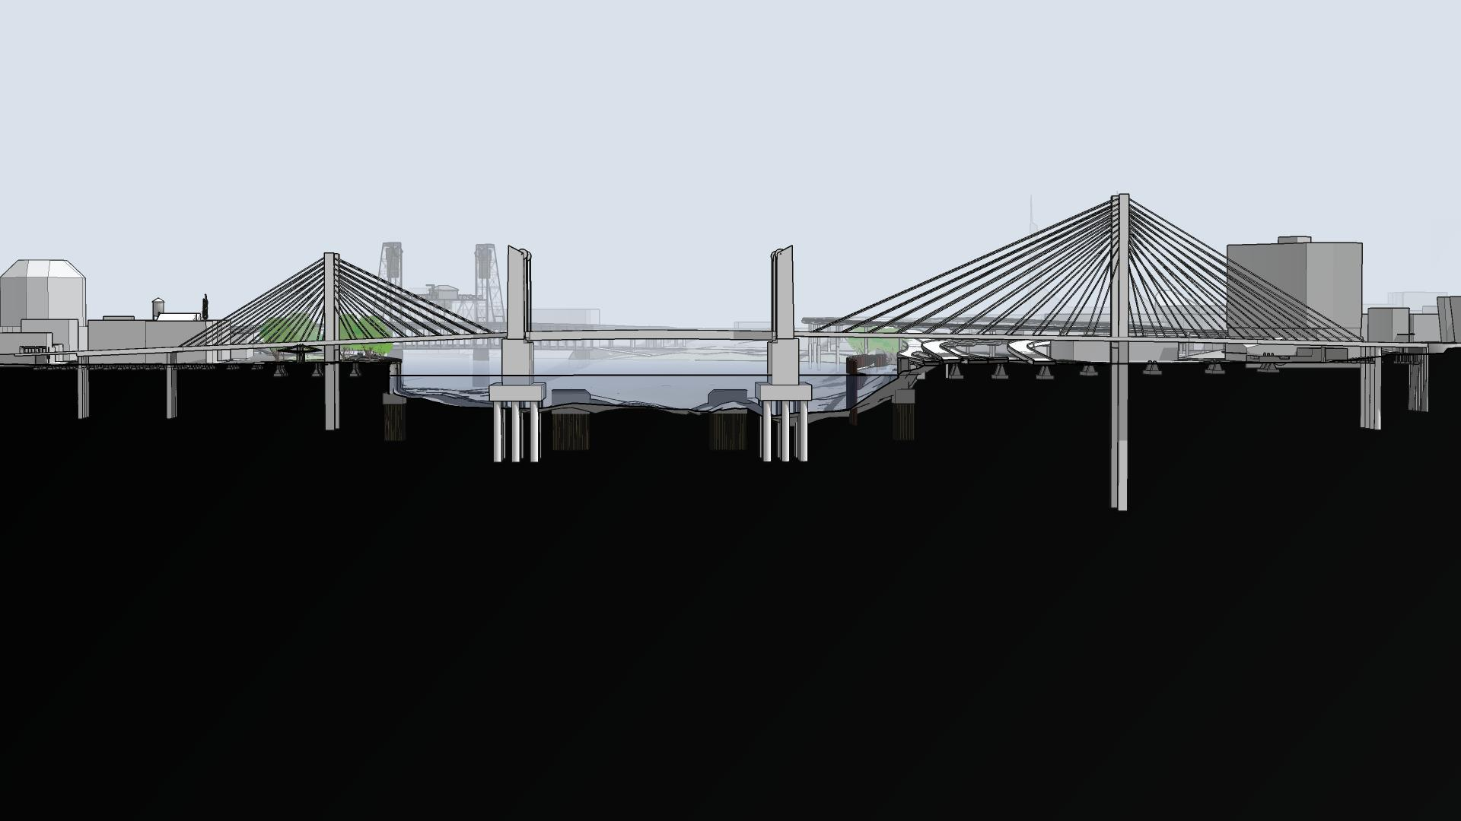
Vertical Lift + Cable Stayed Concept

Slide 13
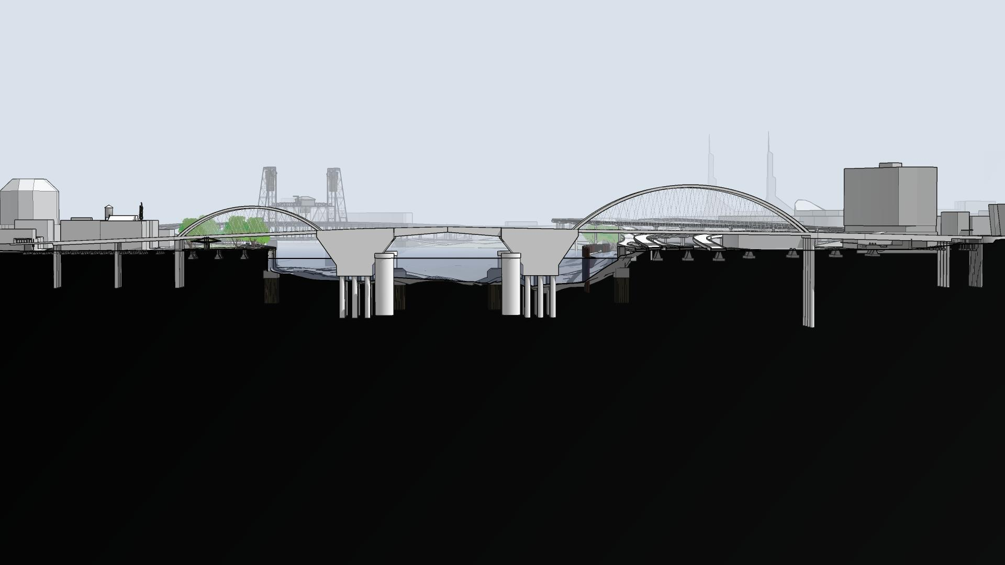
Bascule + Tied Arch Concept

Slide 14
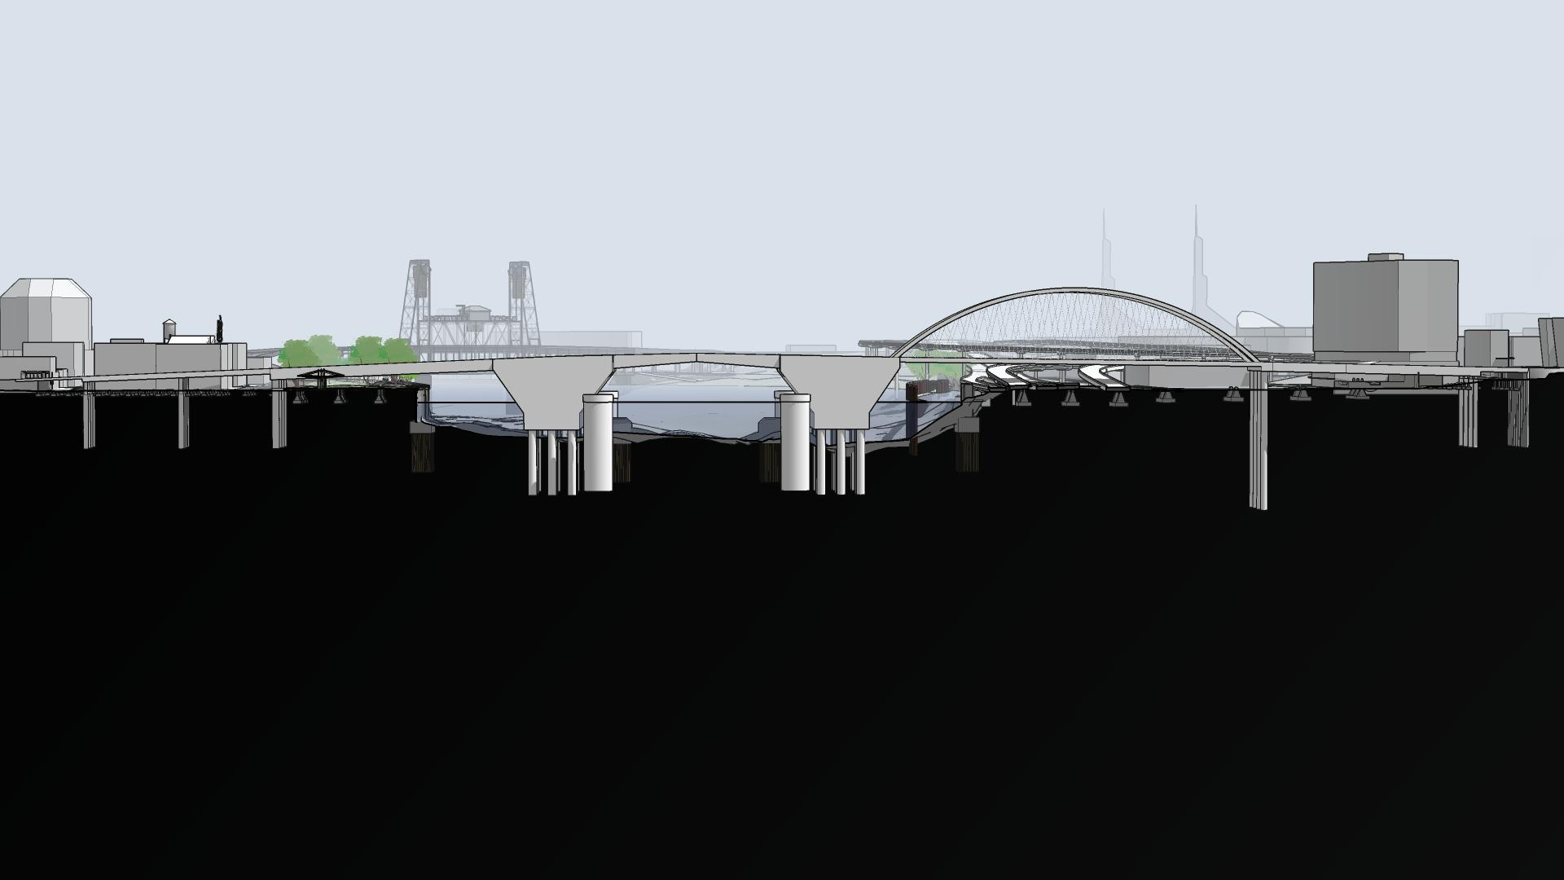
Bascule + Arch/Girder Asymmetrical Concept

